Slide 1
Nathaniel Ruleaux
The Art of Indigenous Resilience

Slide 2
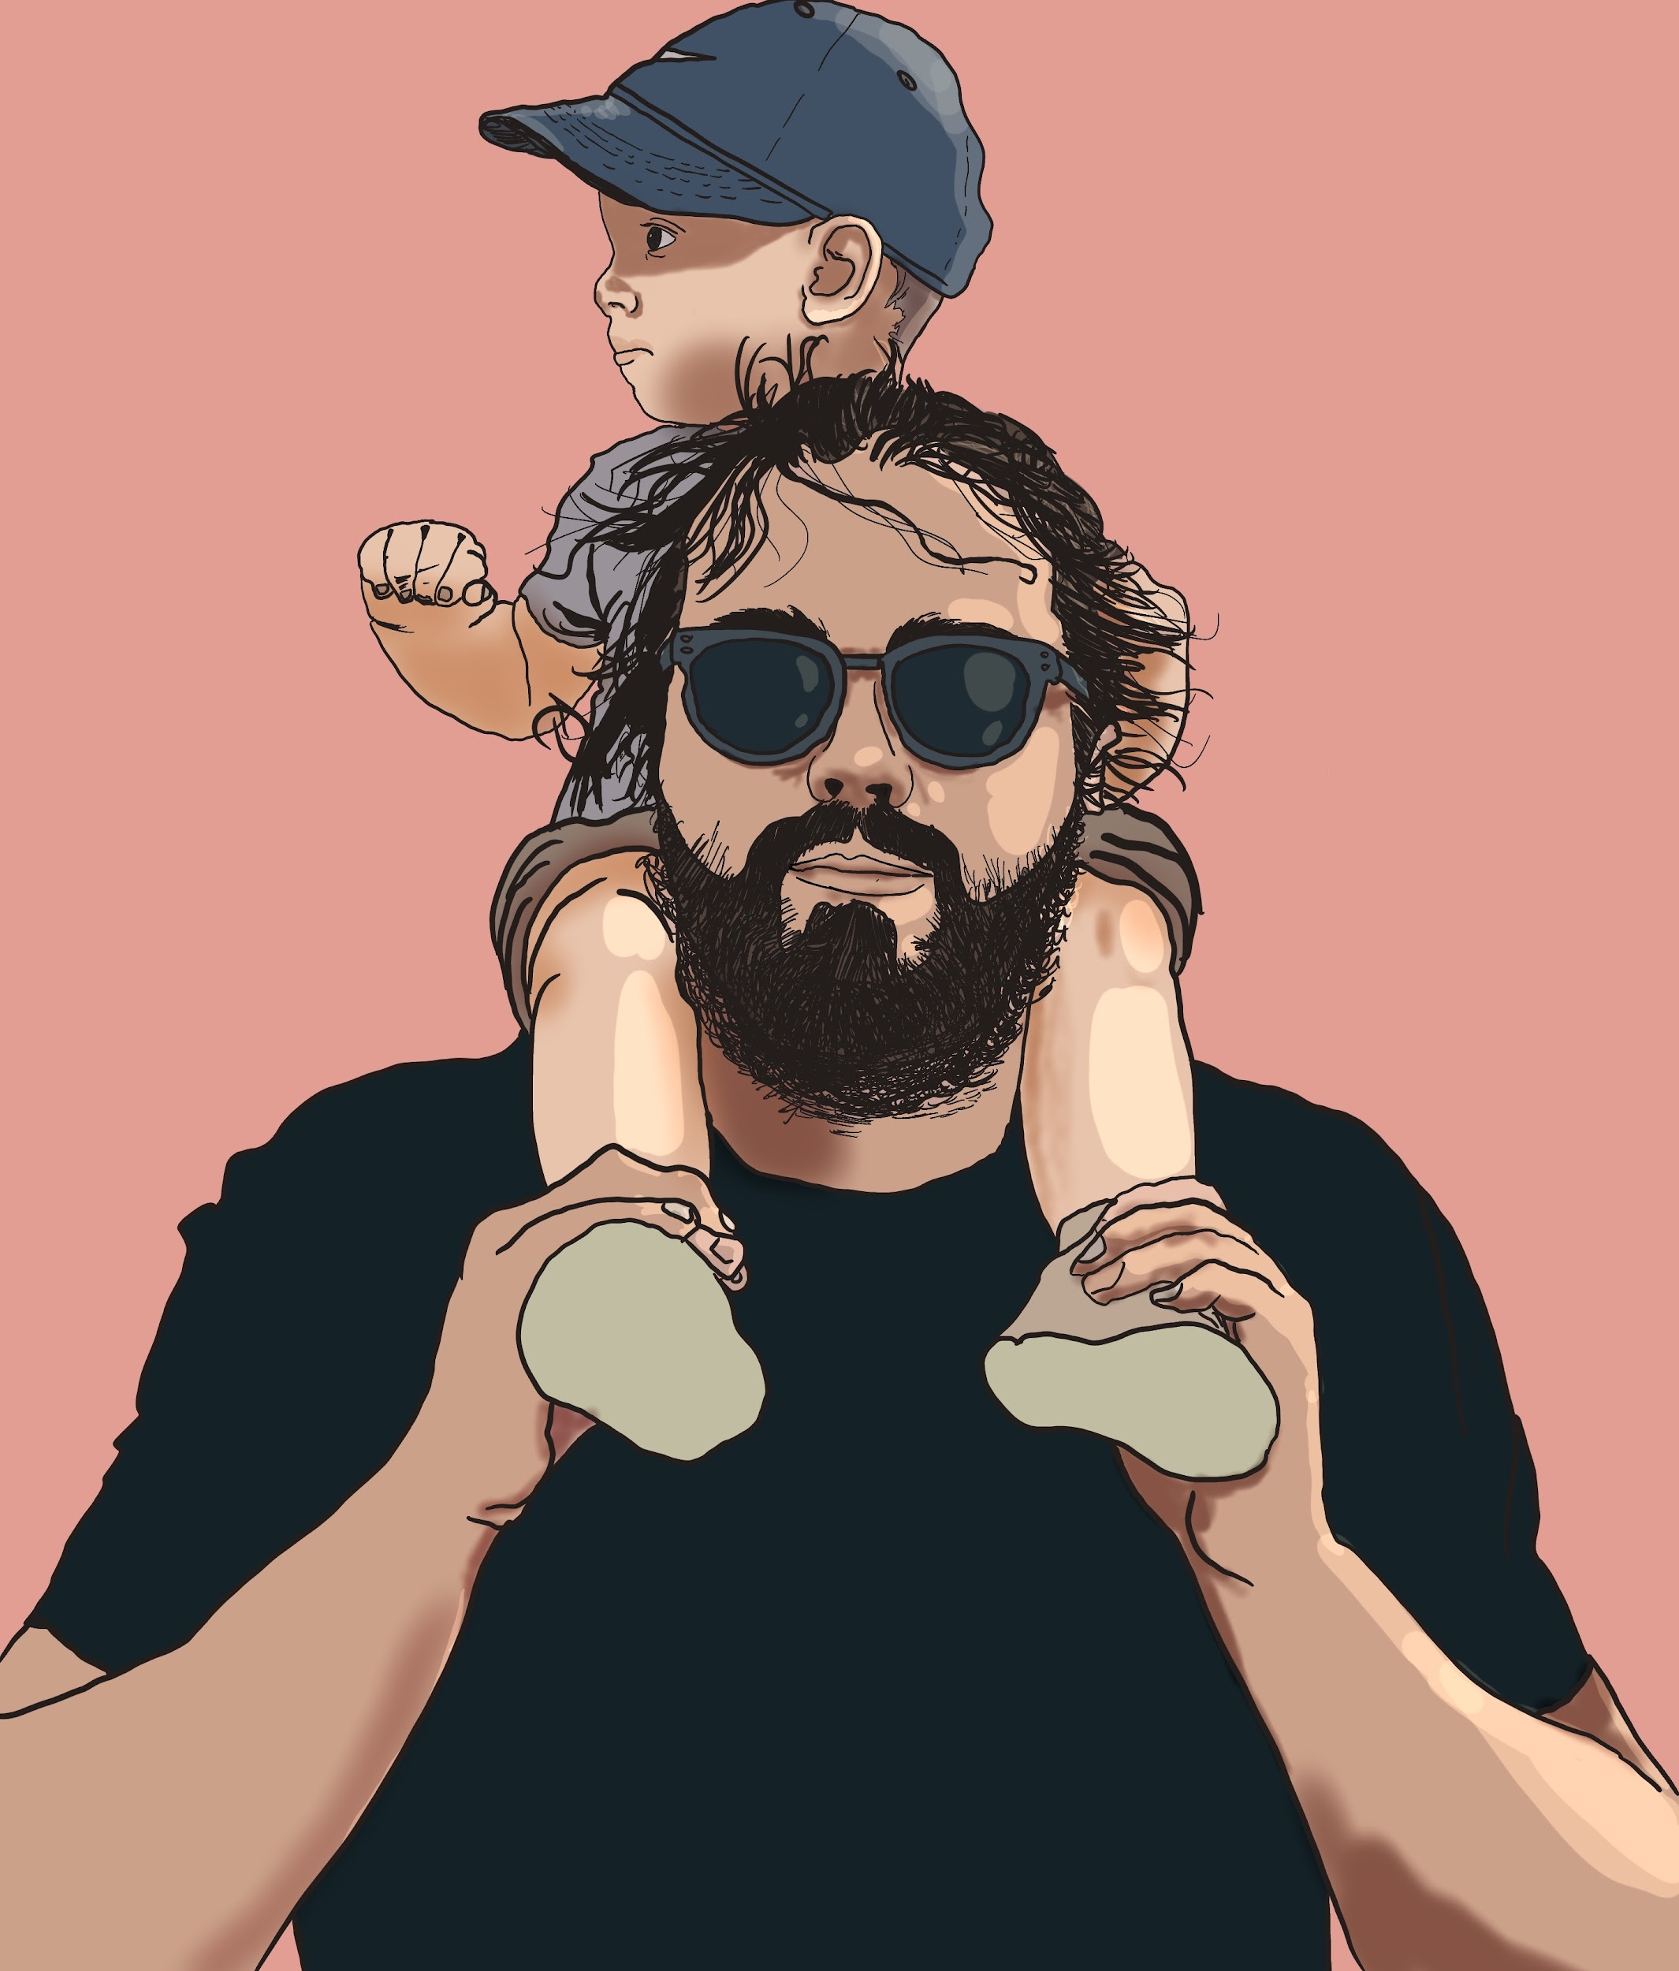

Slide 3
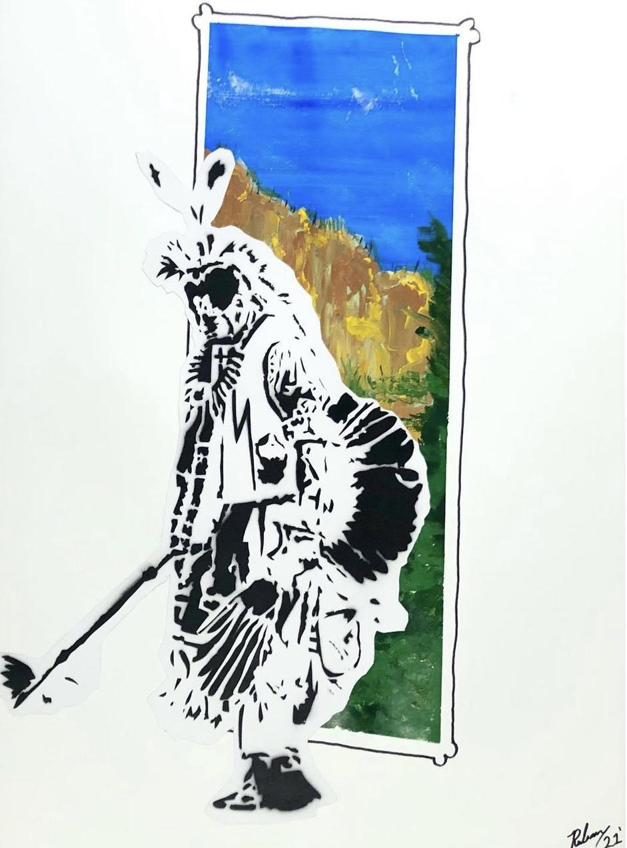
History
Art+Activism
Community & Representation
Indigenous Futurism

Slide 5
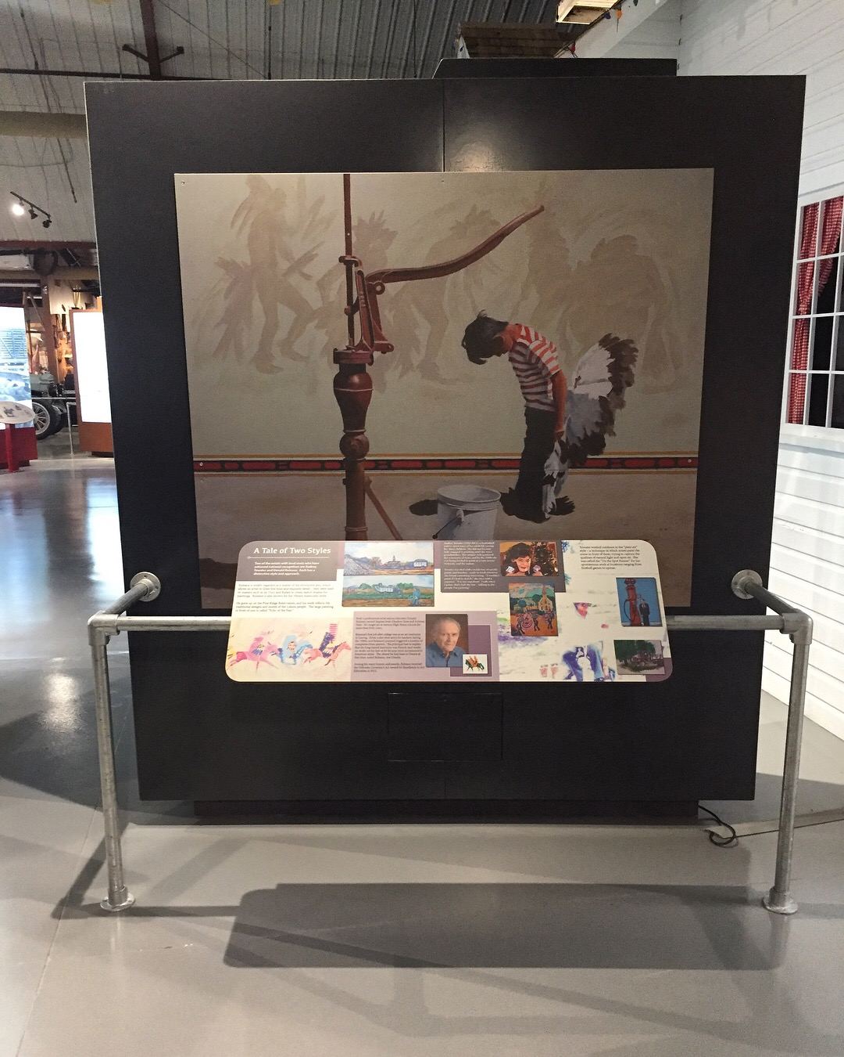

Slide 6
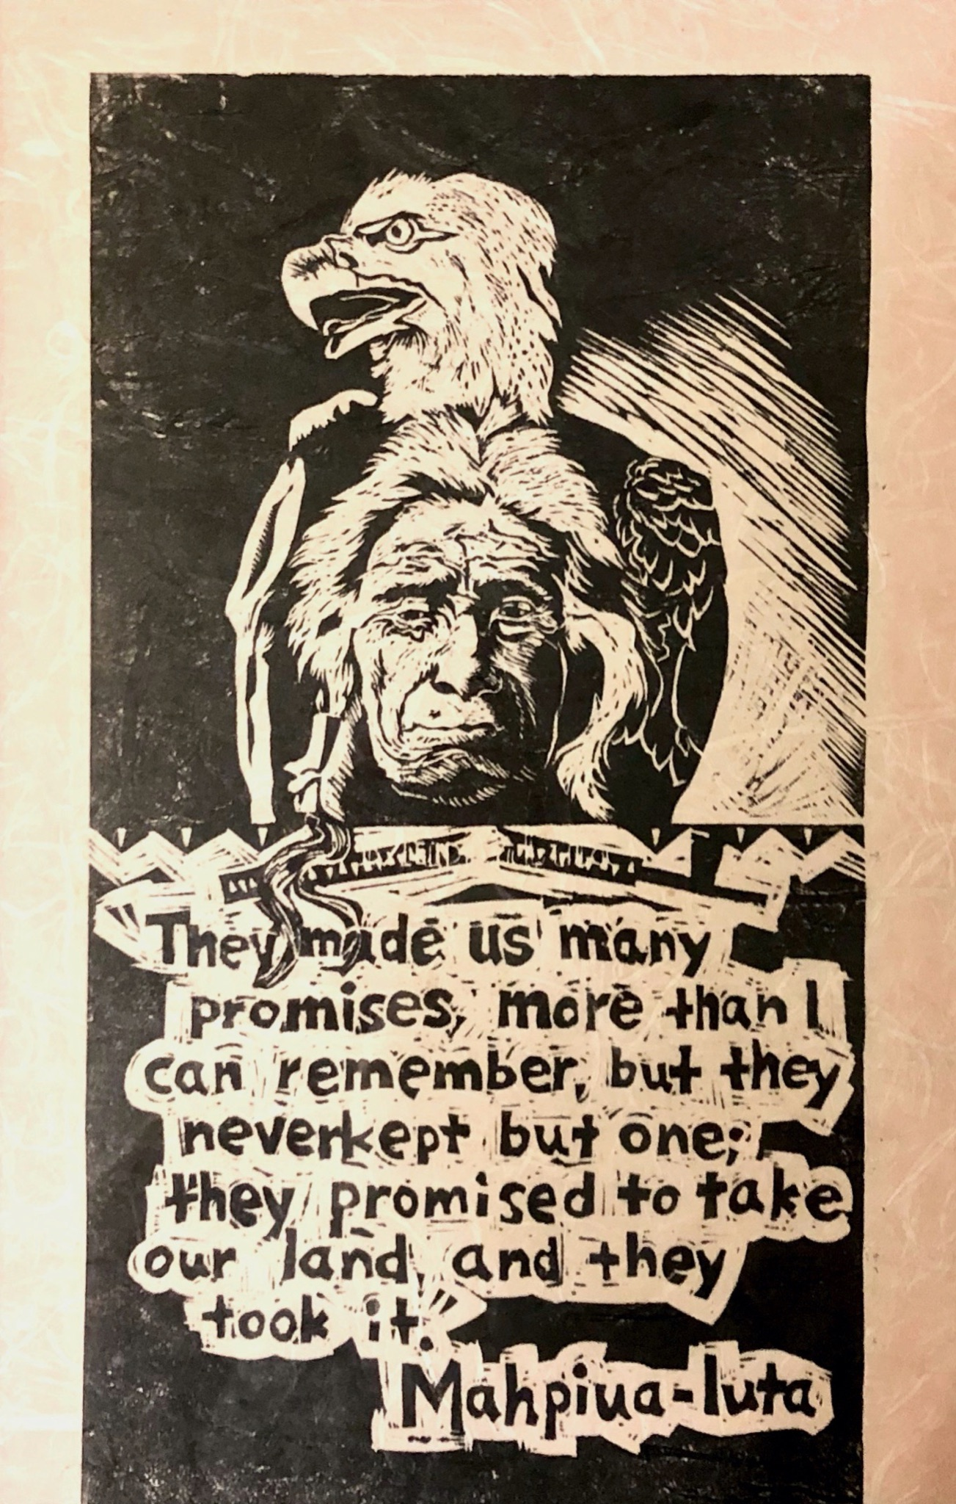
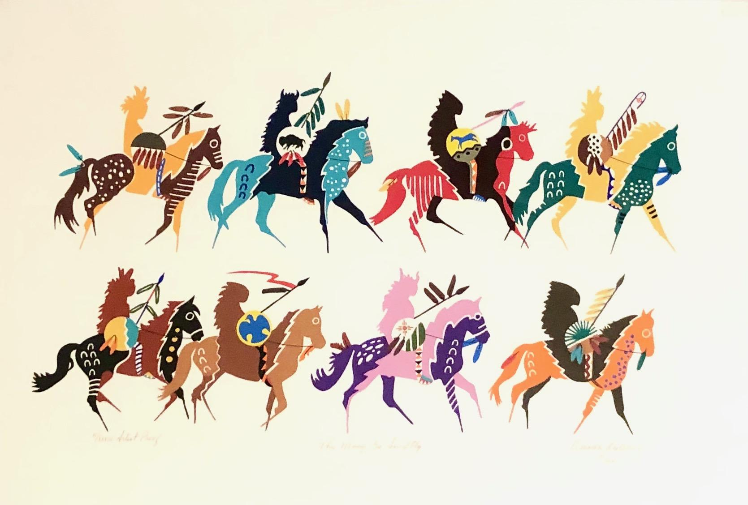
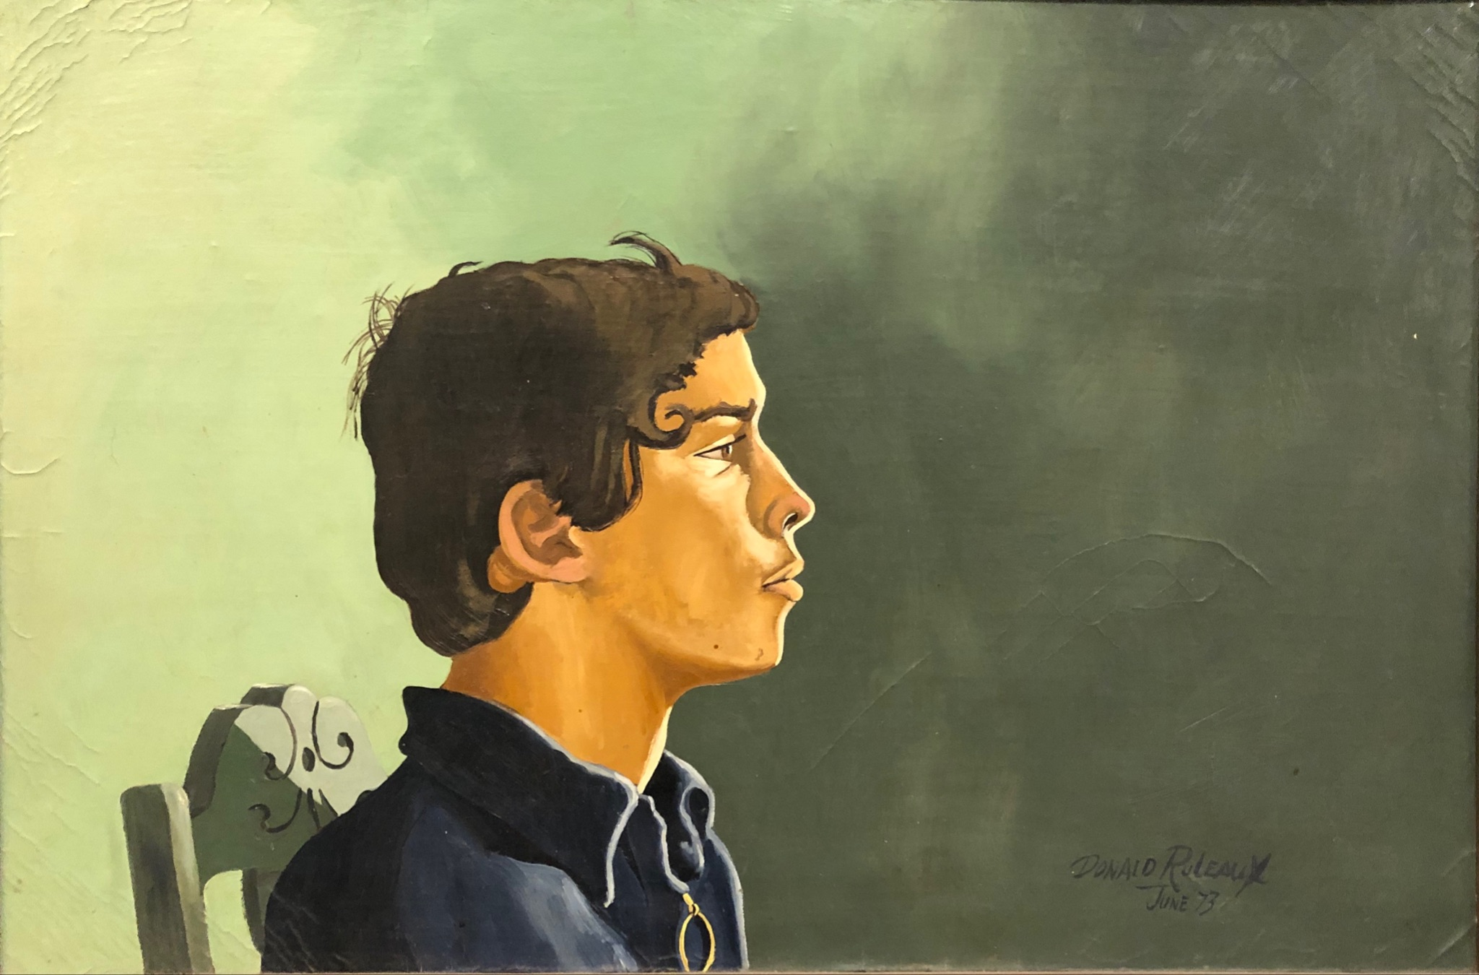

Slide 7
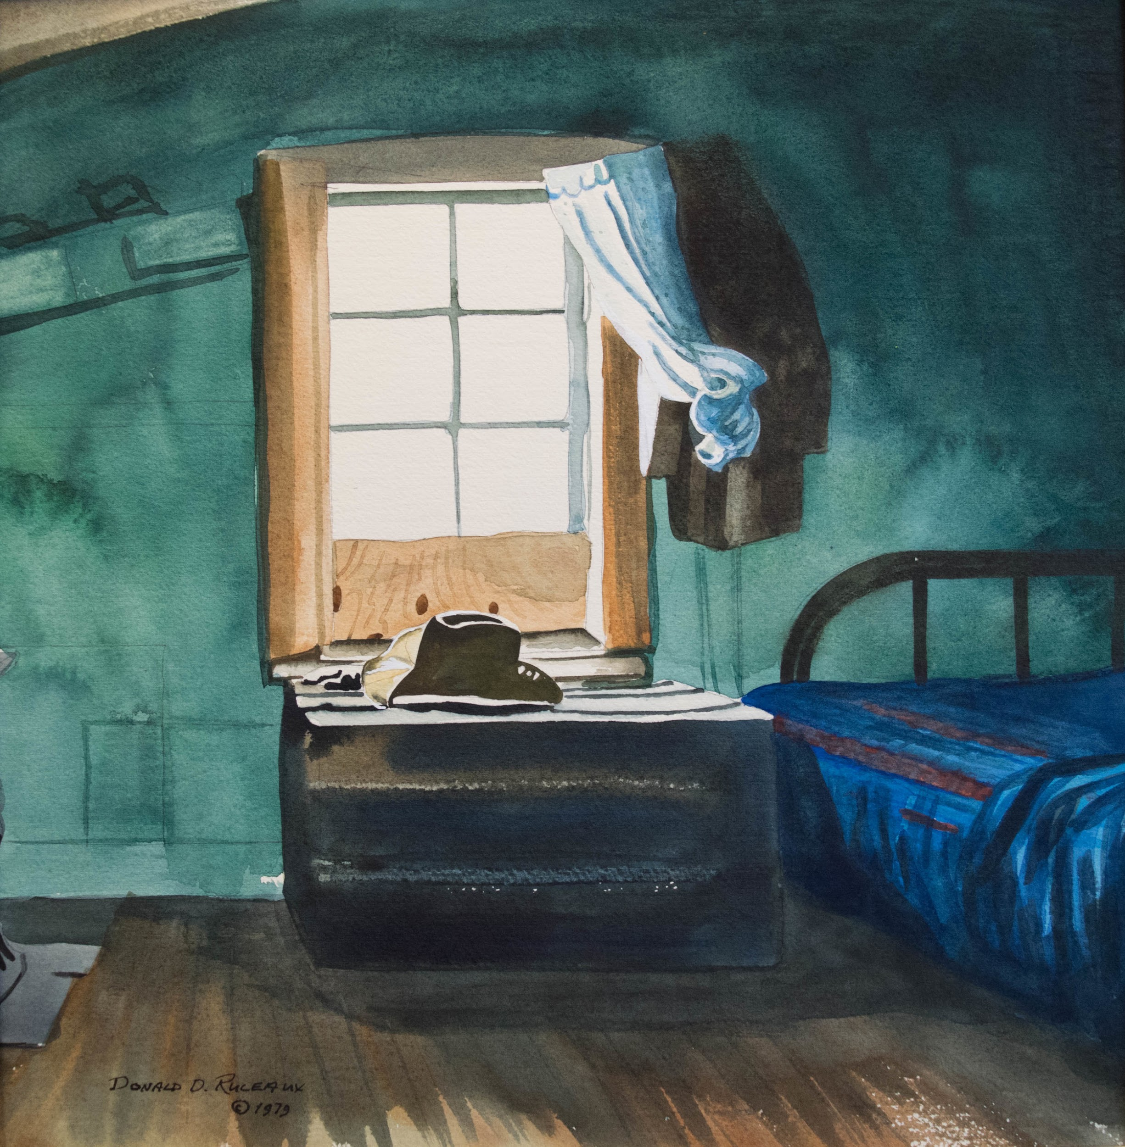
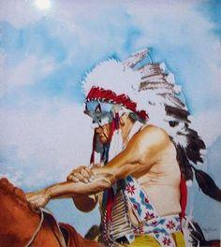

Slide 8
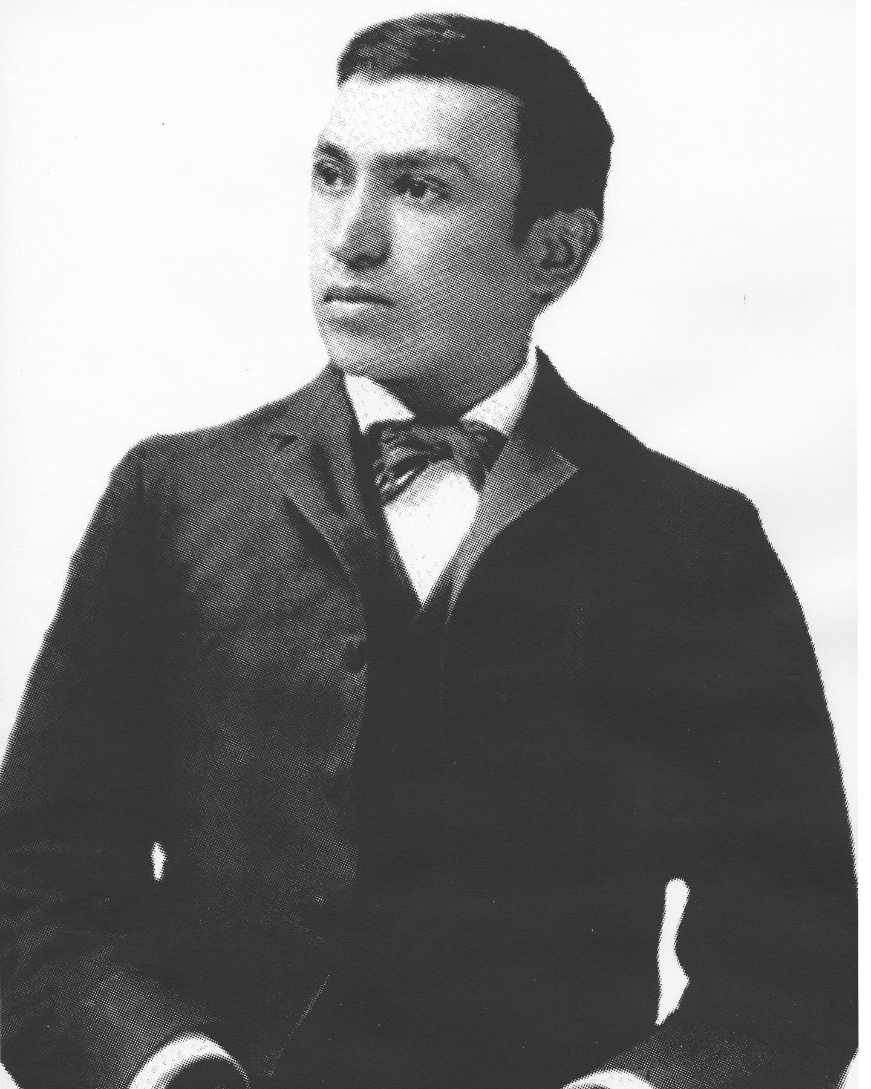

Slide 9
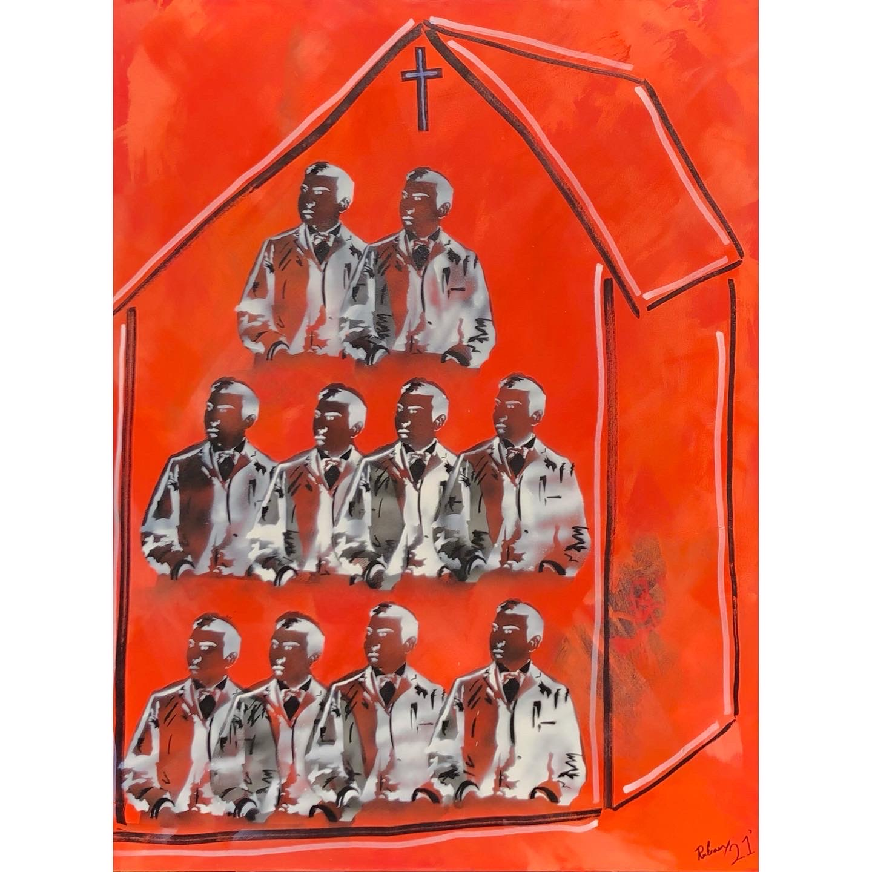

Slide 10
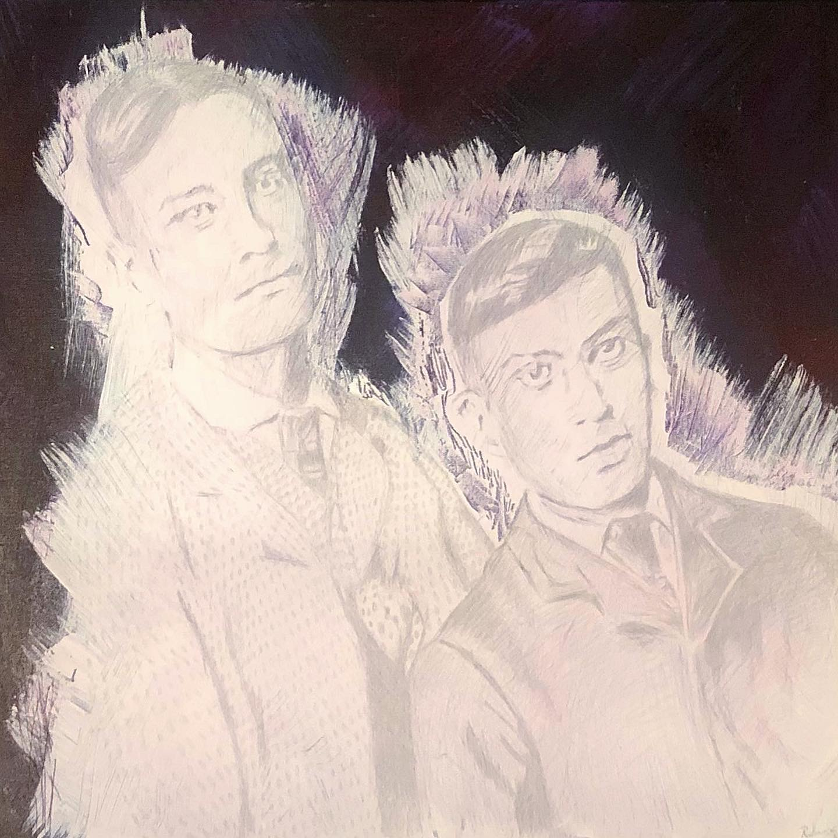
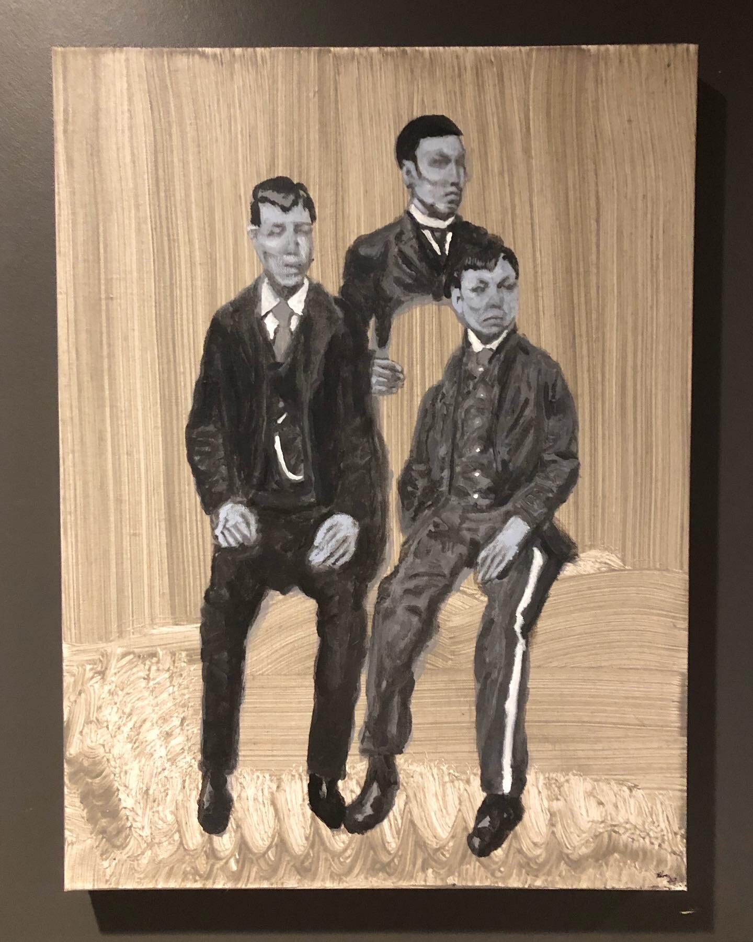

Slide 11
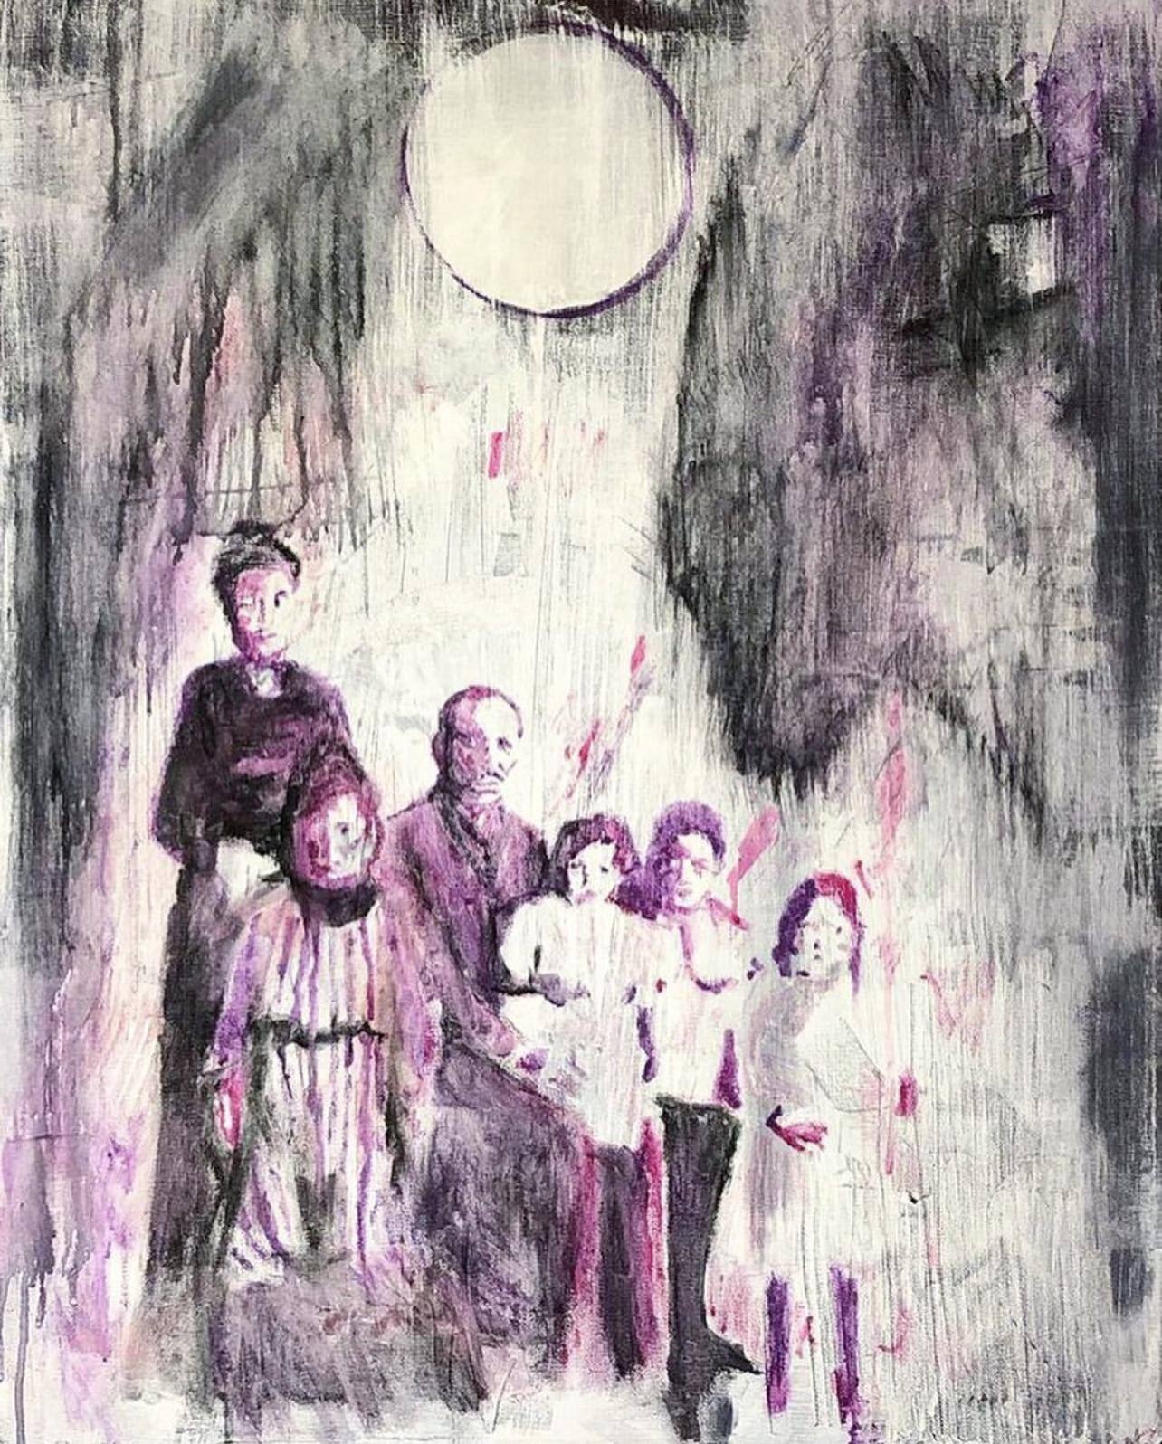
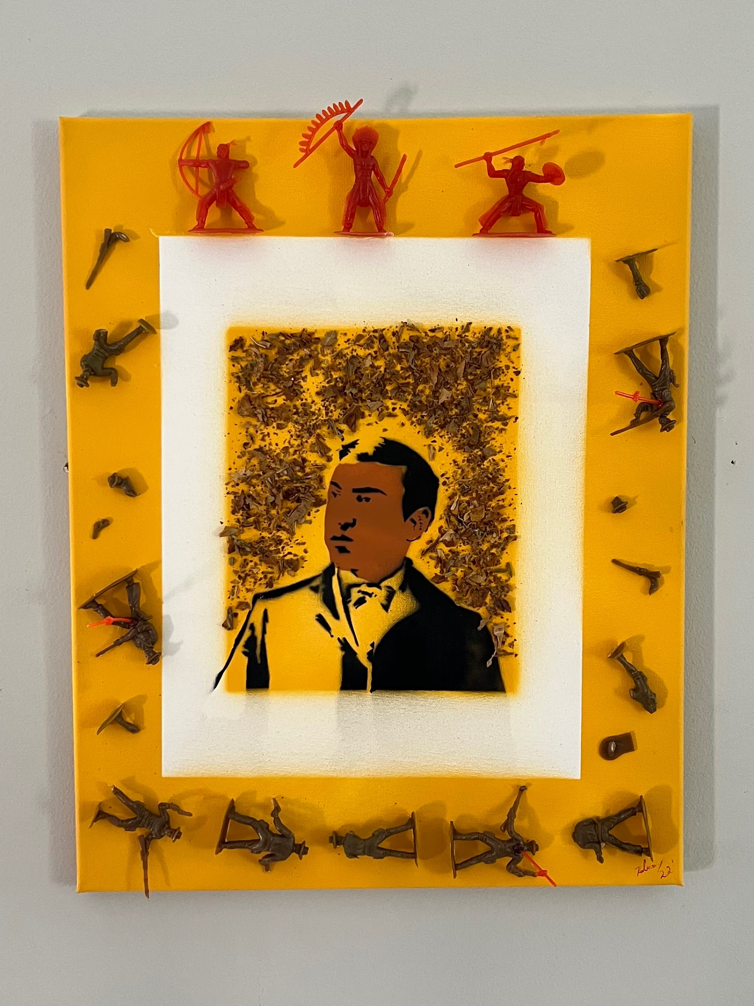

Slide 12
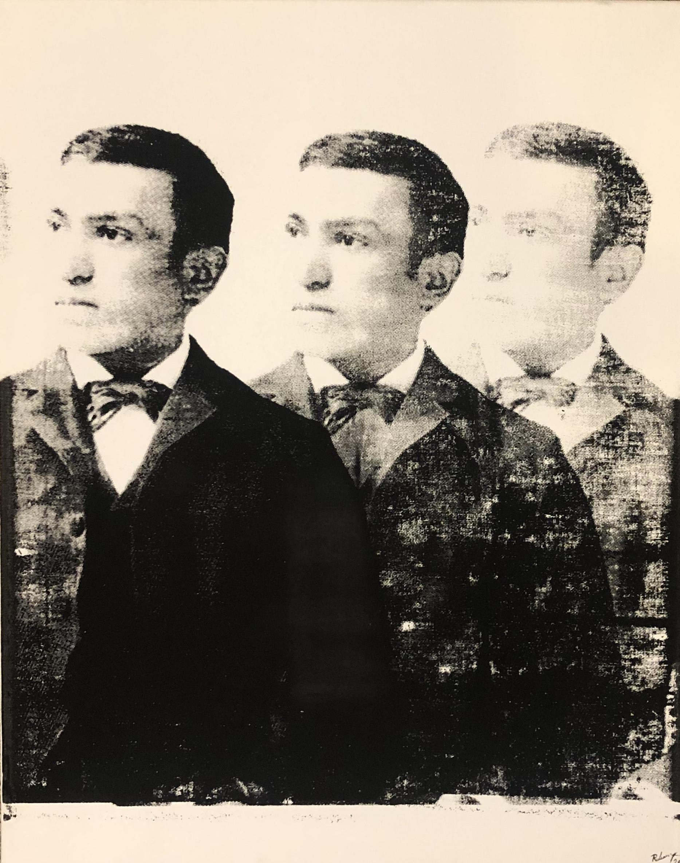
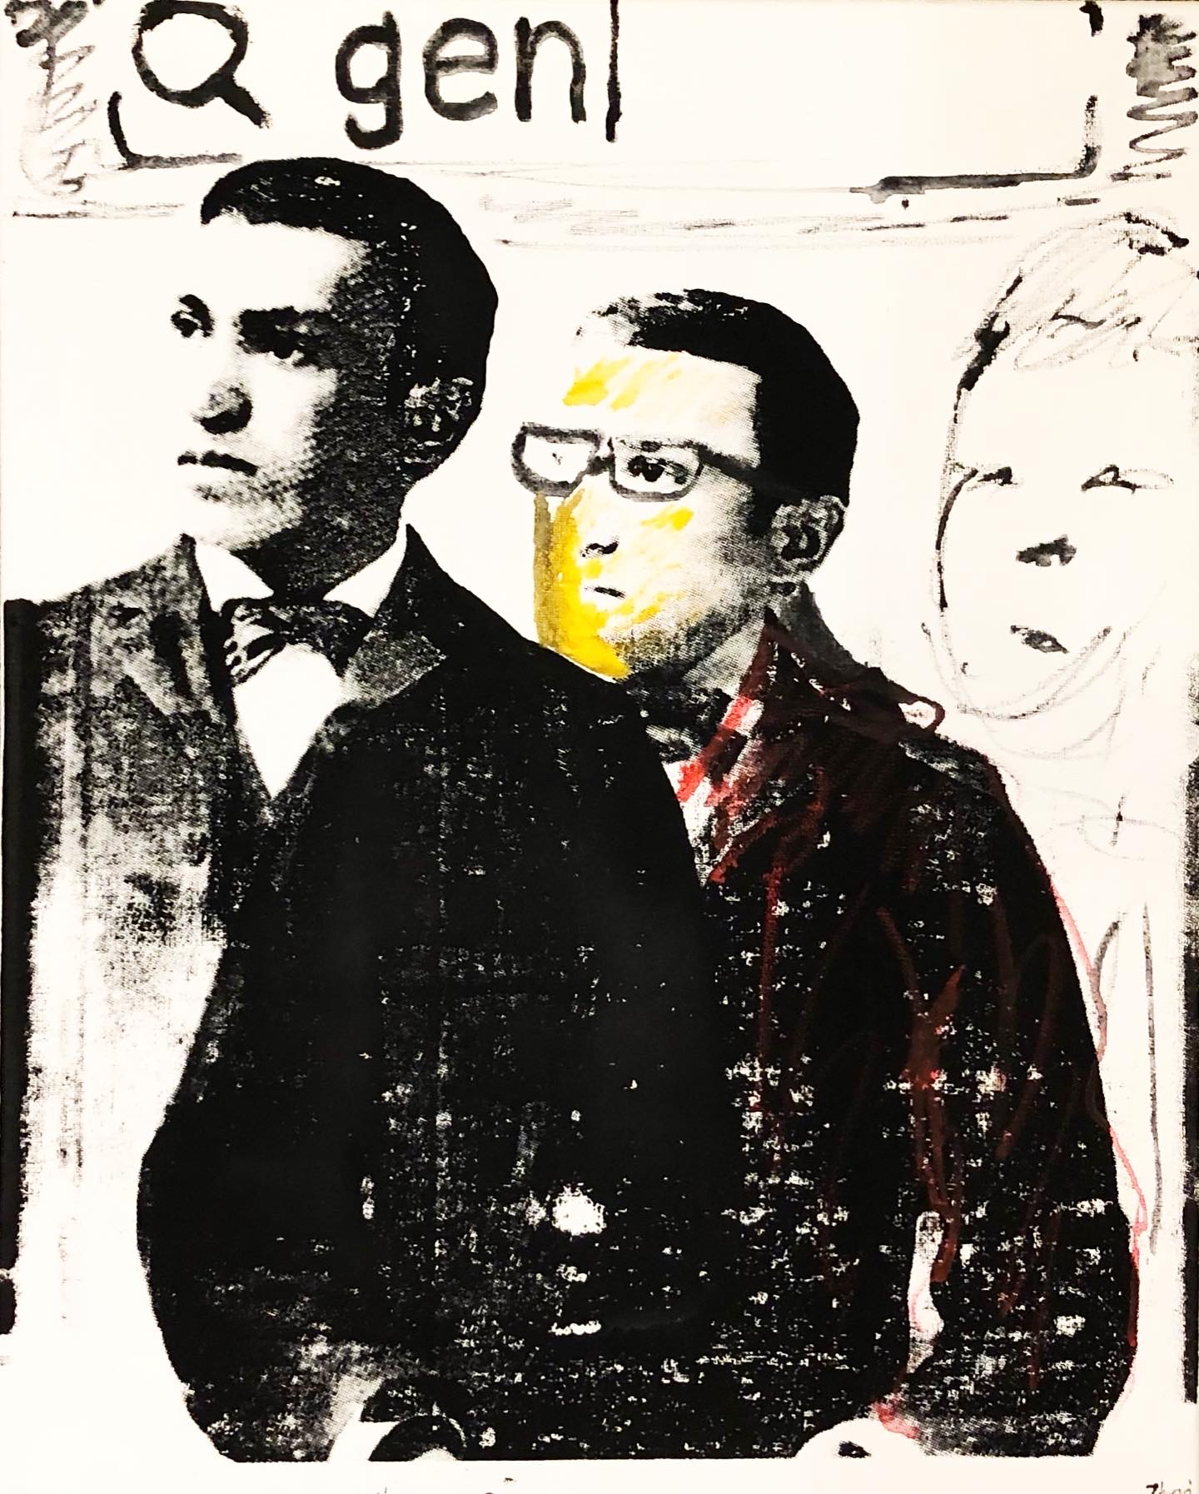
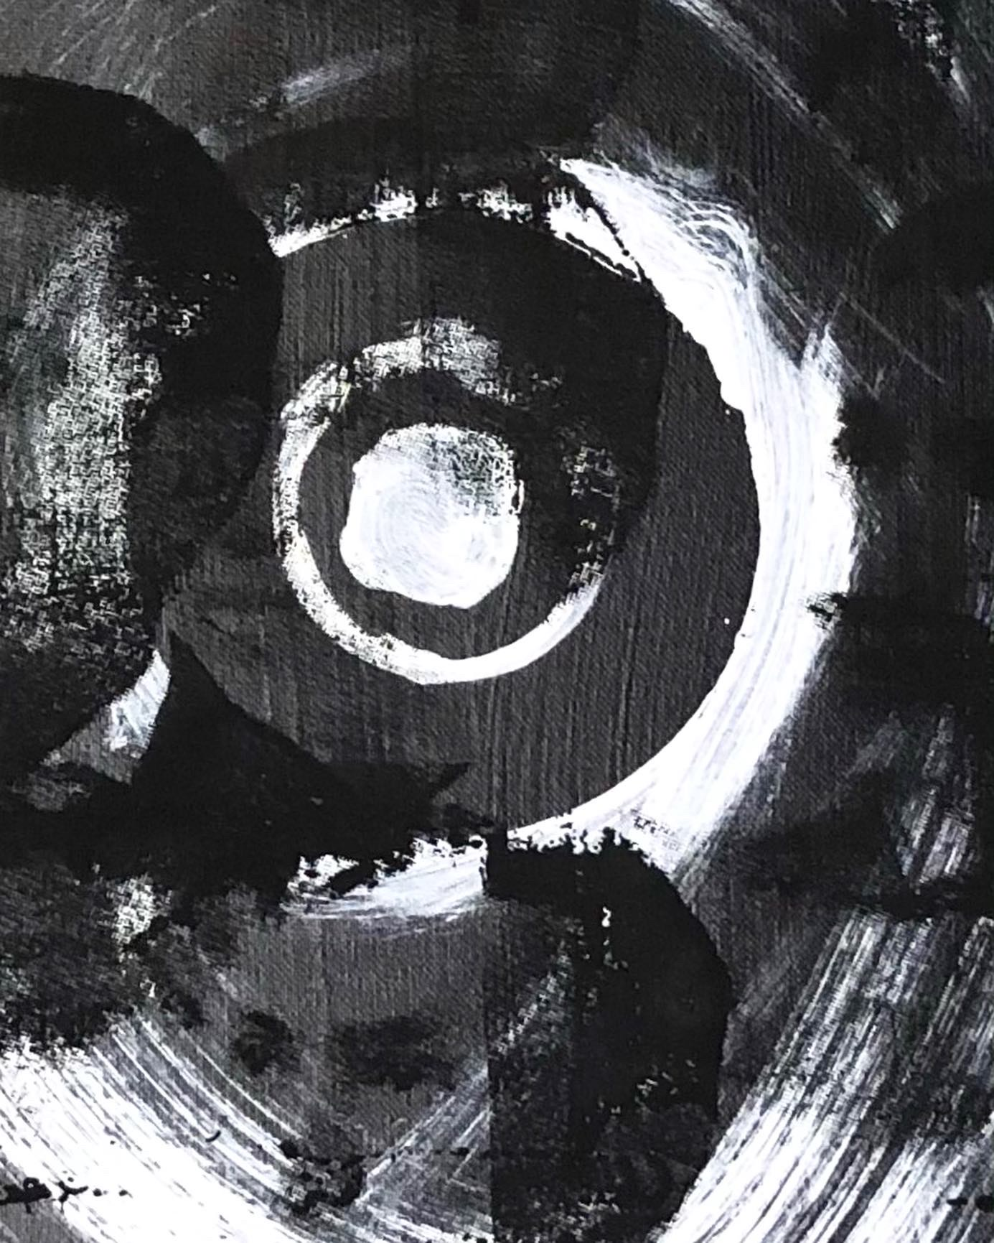
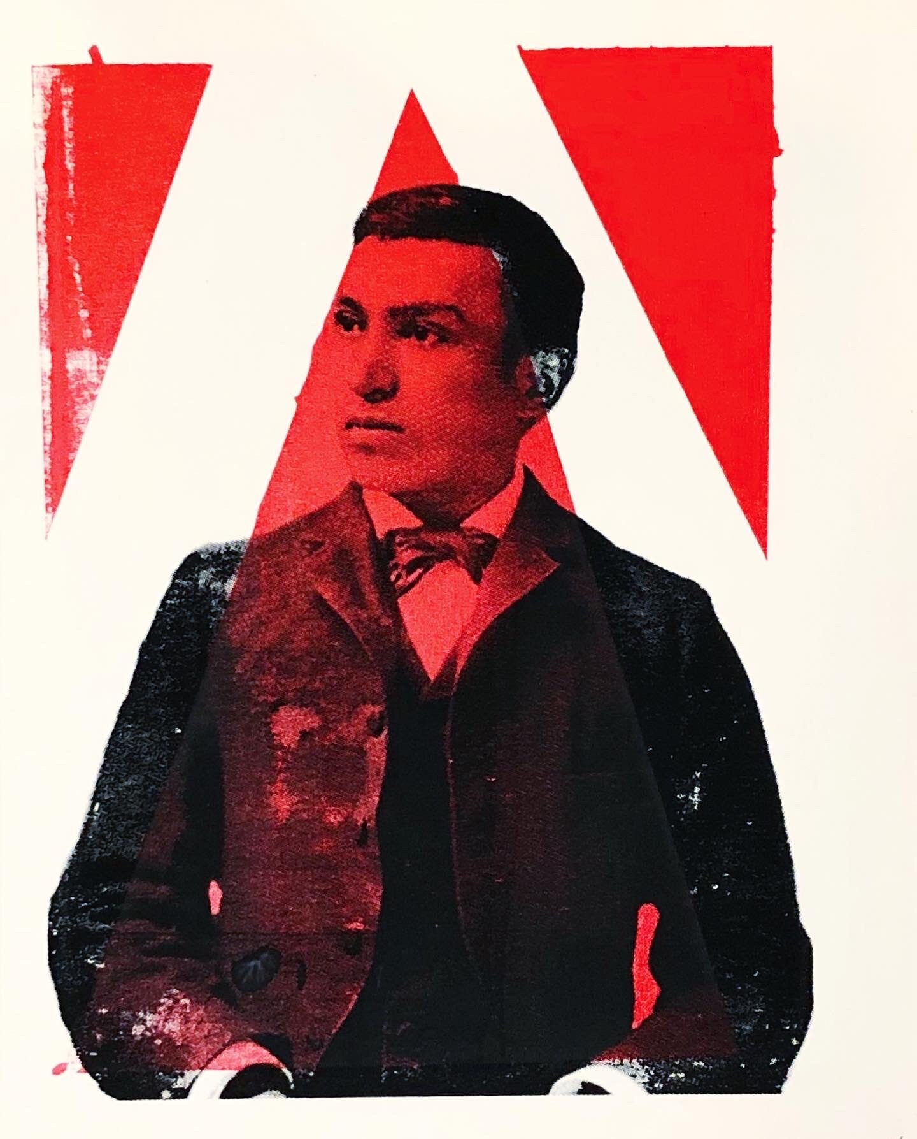
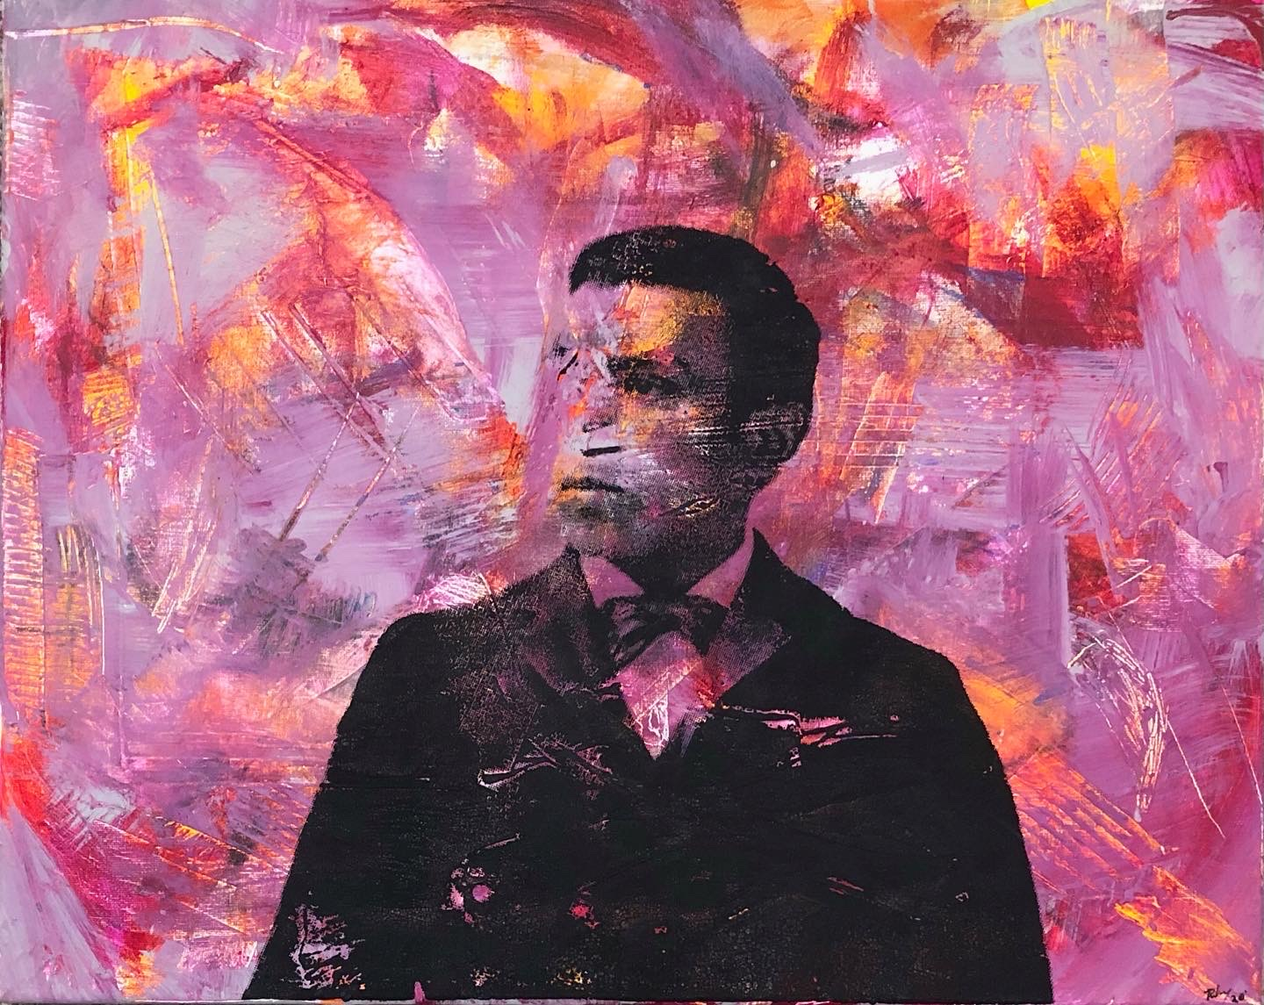
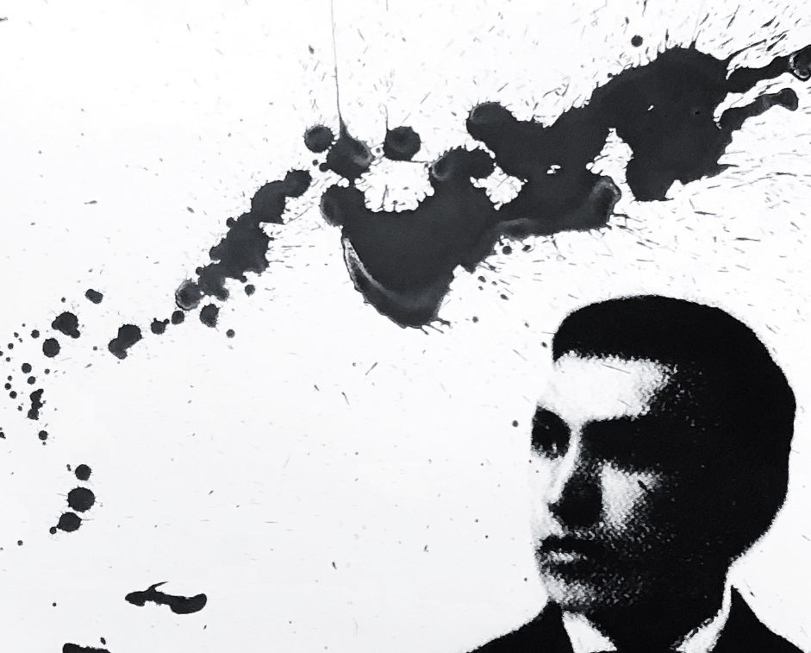
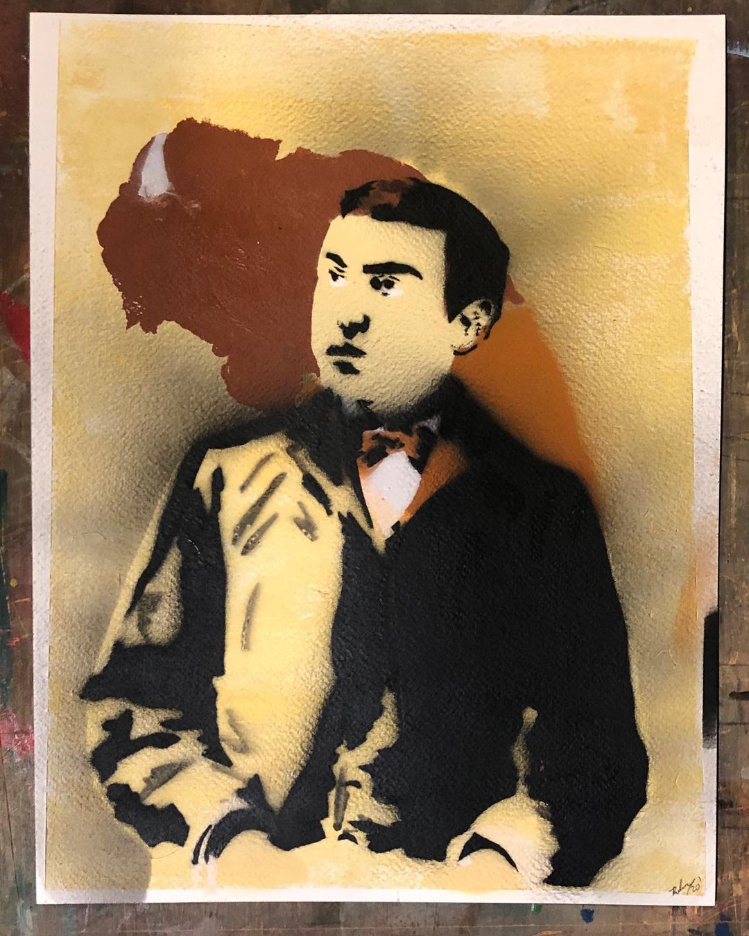

Slide 13
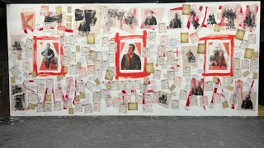

Slide 15
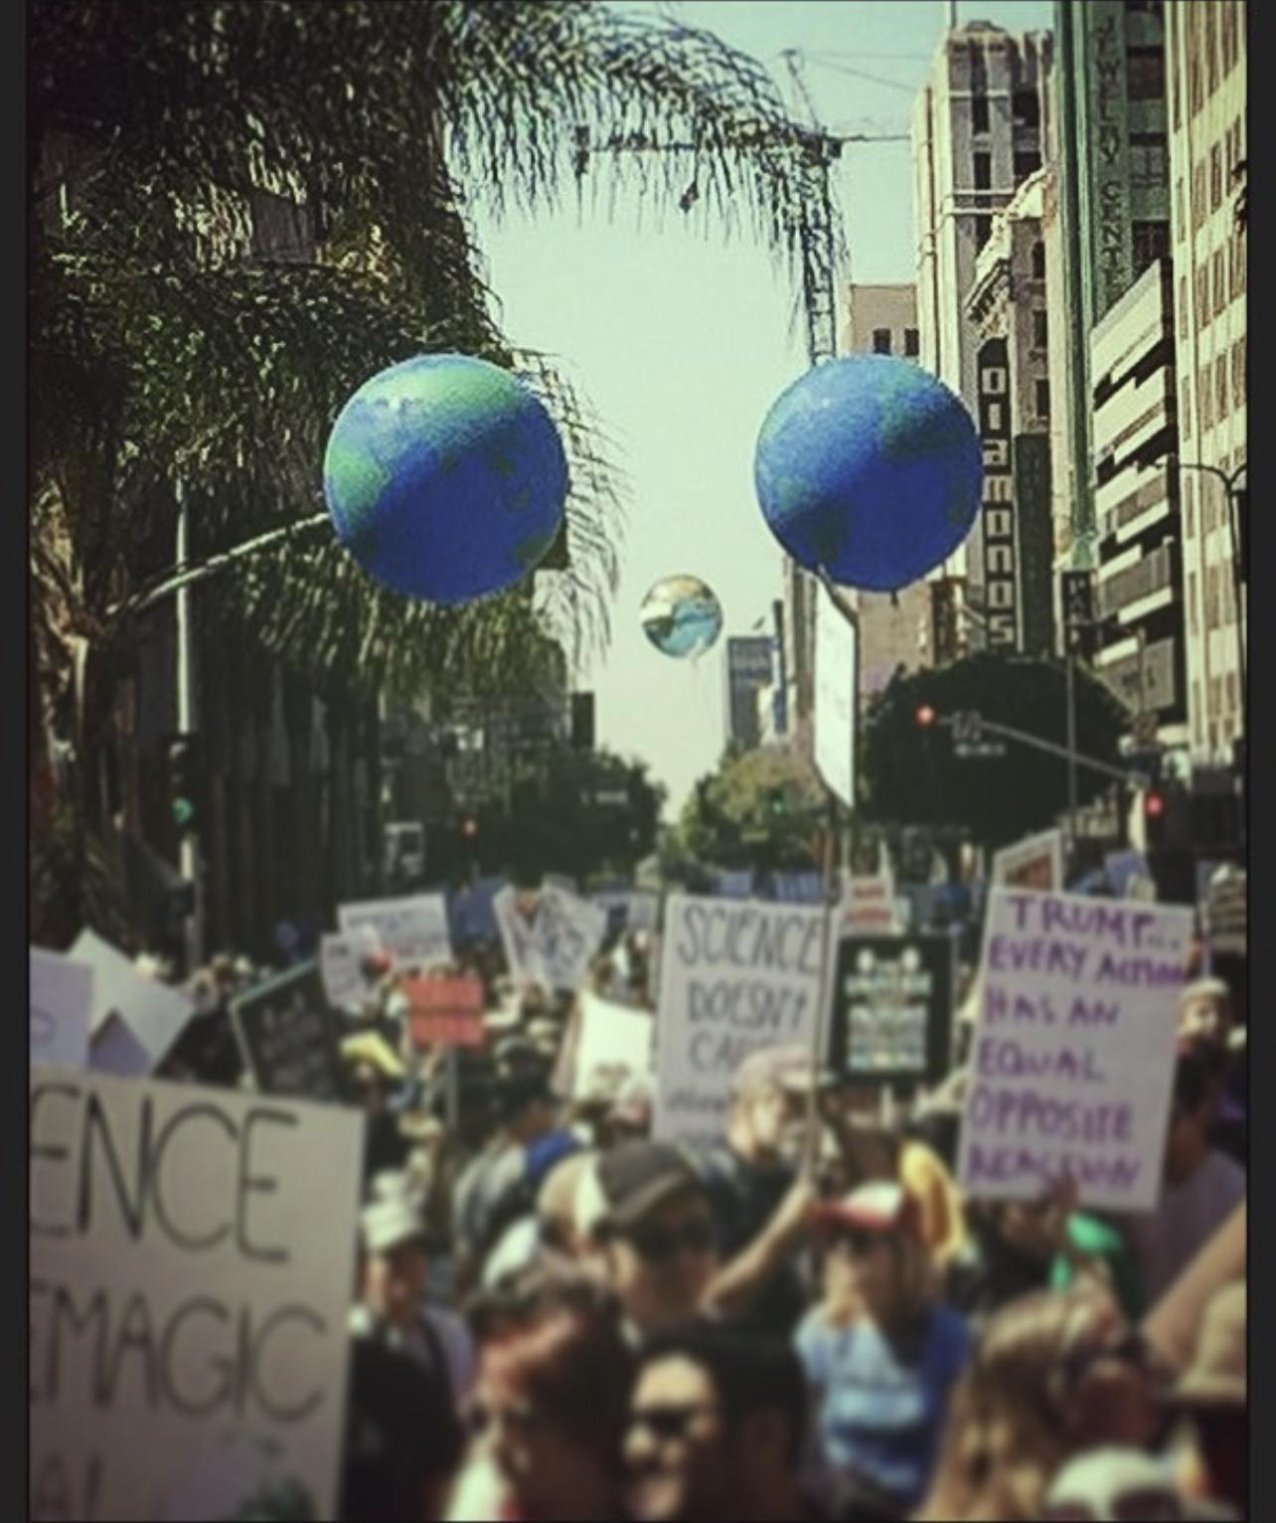
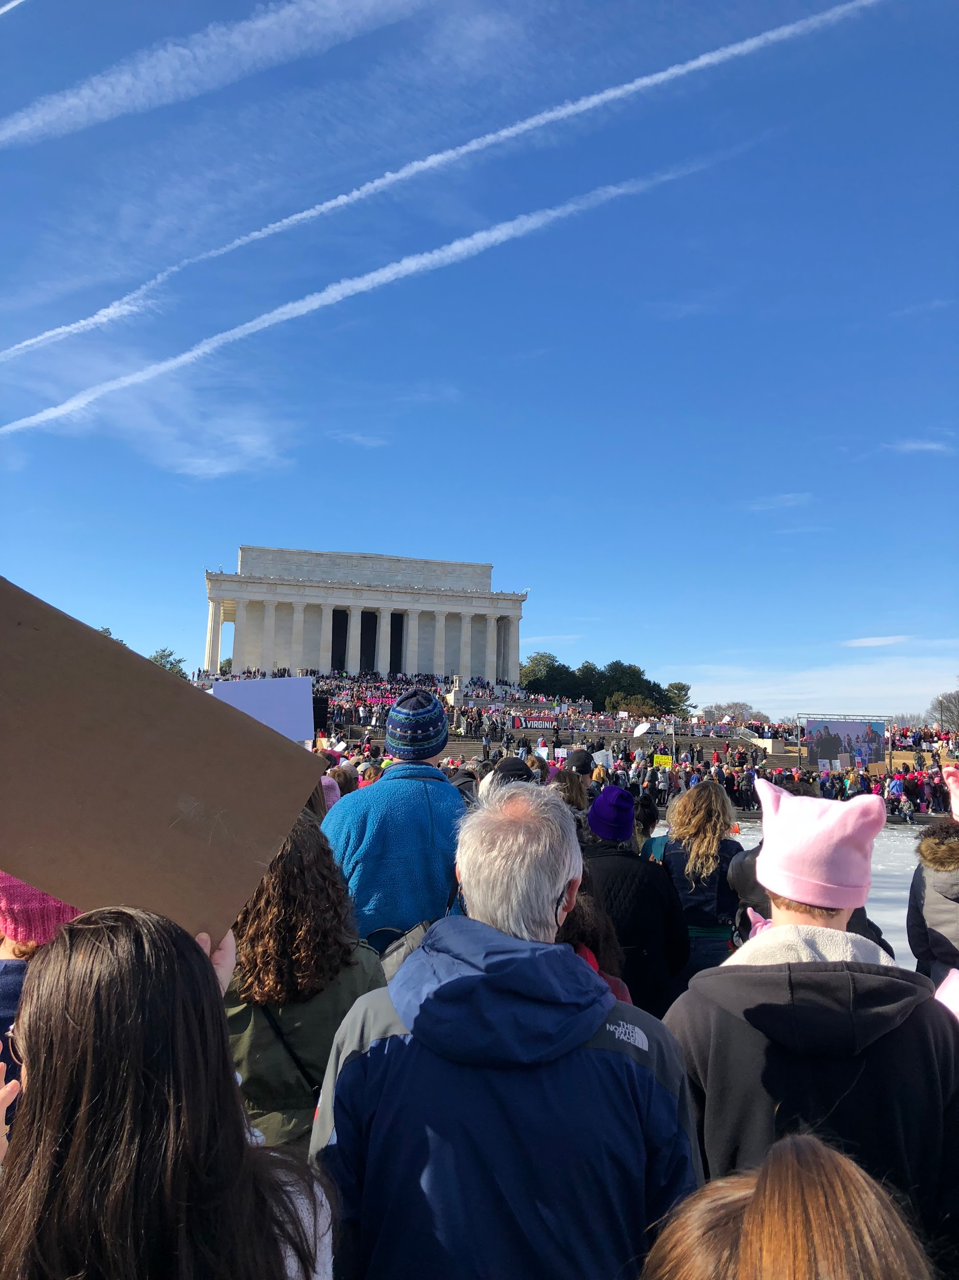
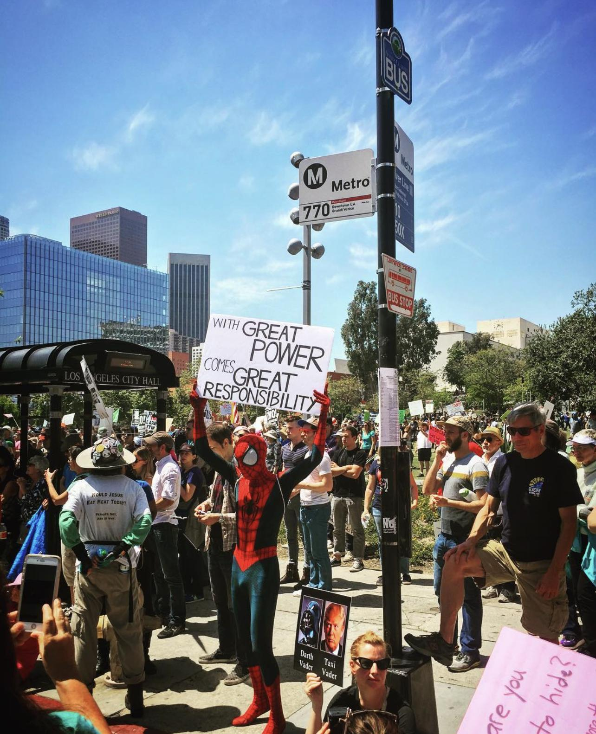
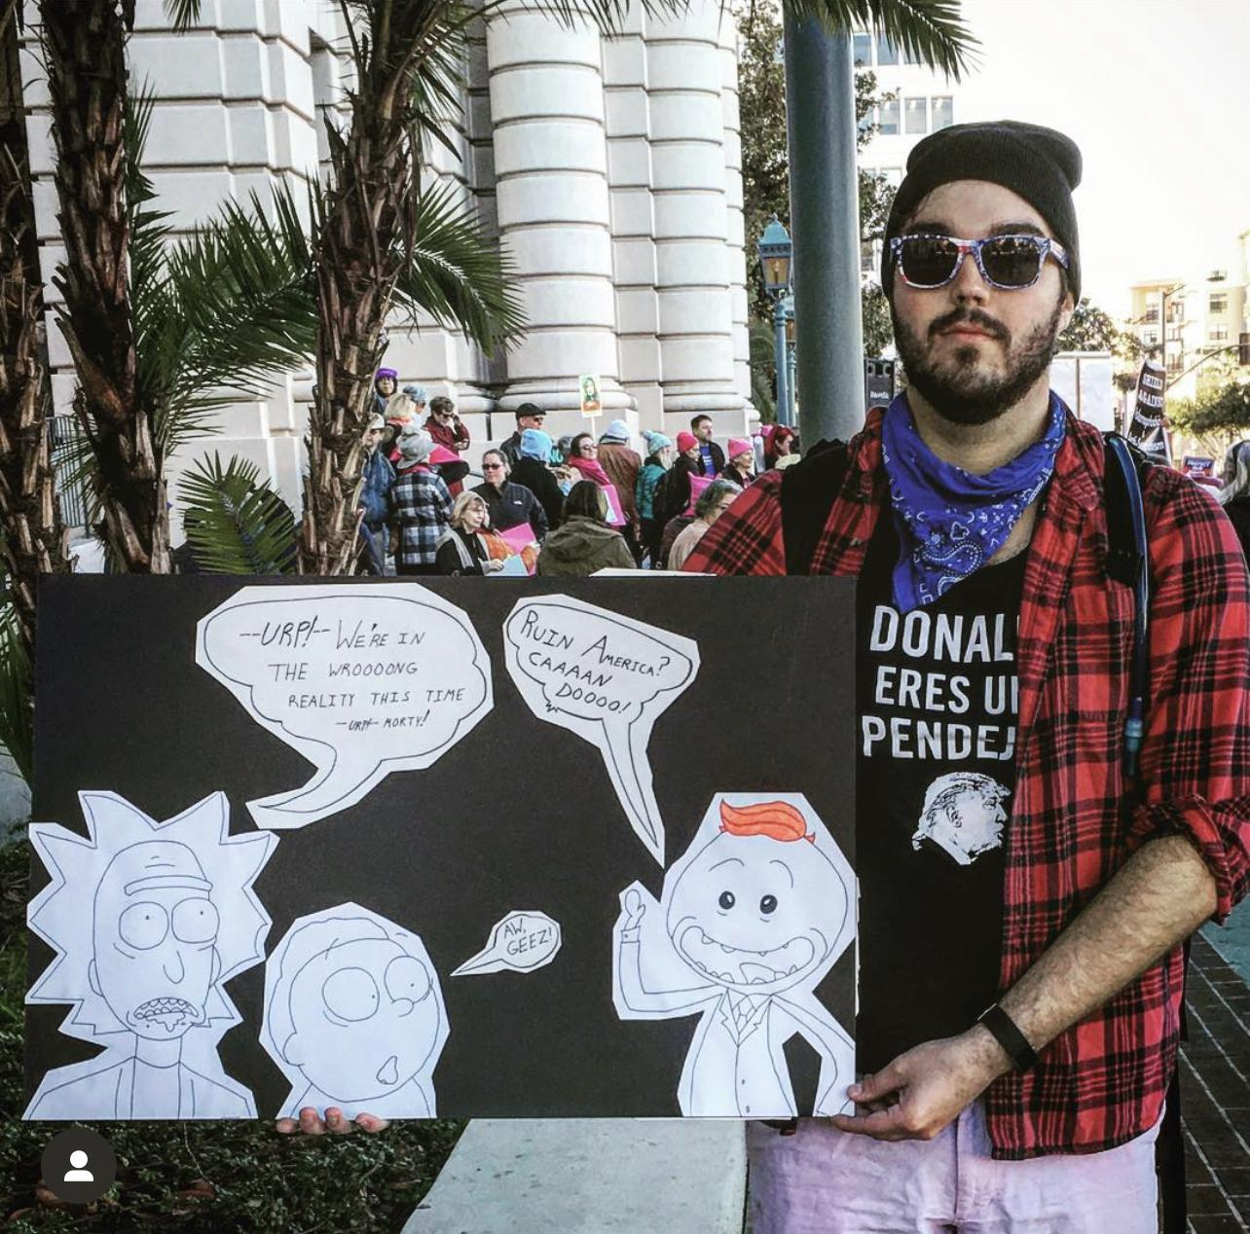

Slide 16
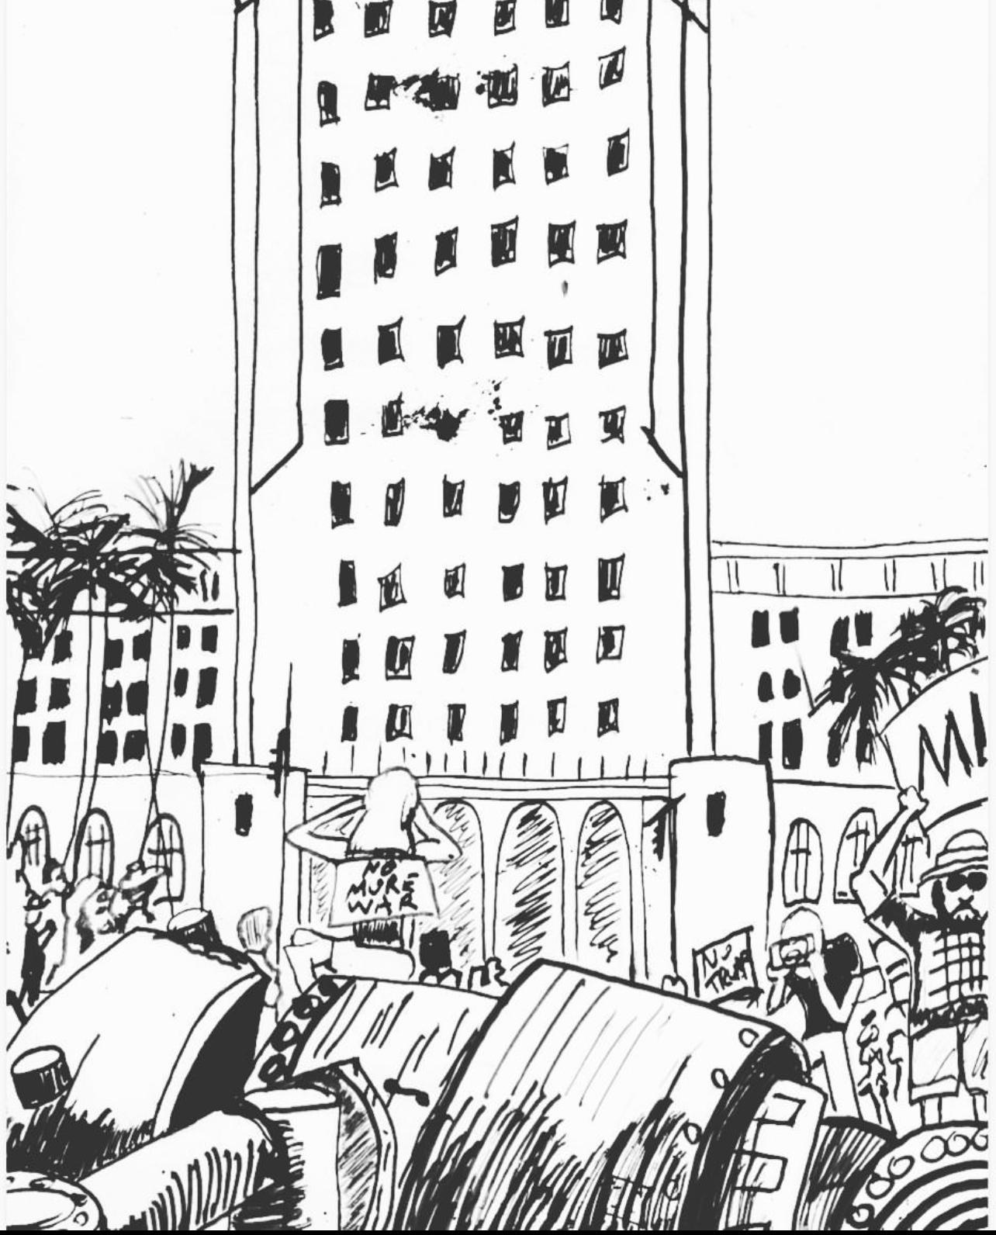
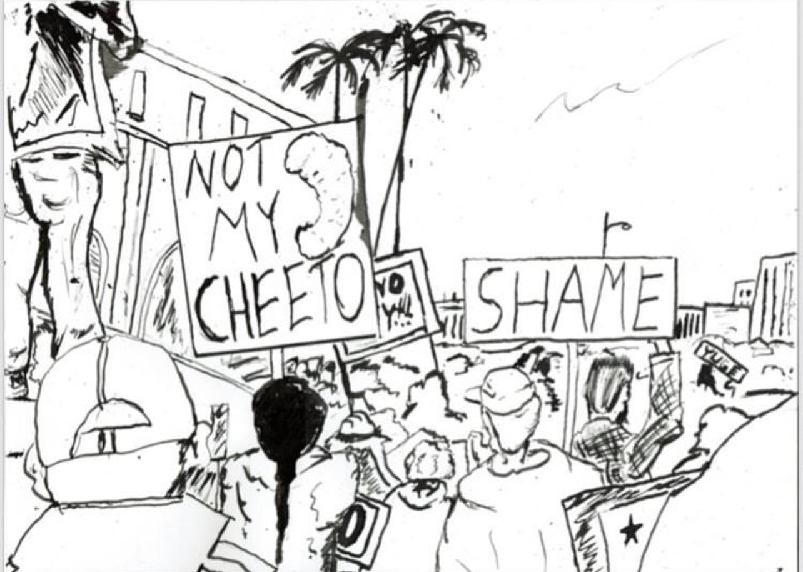
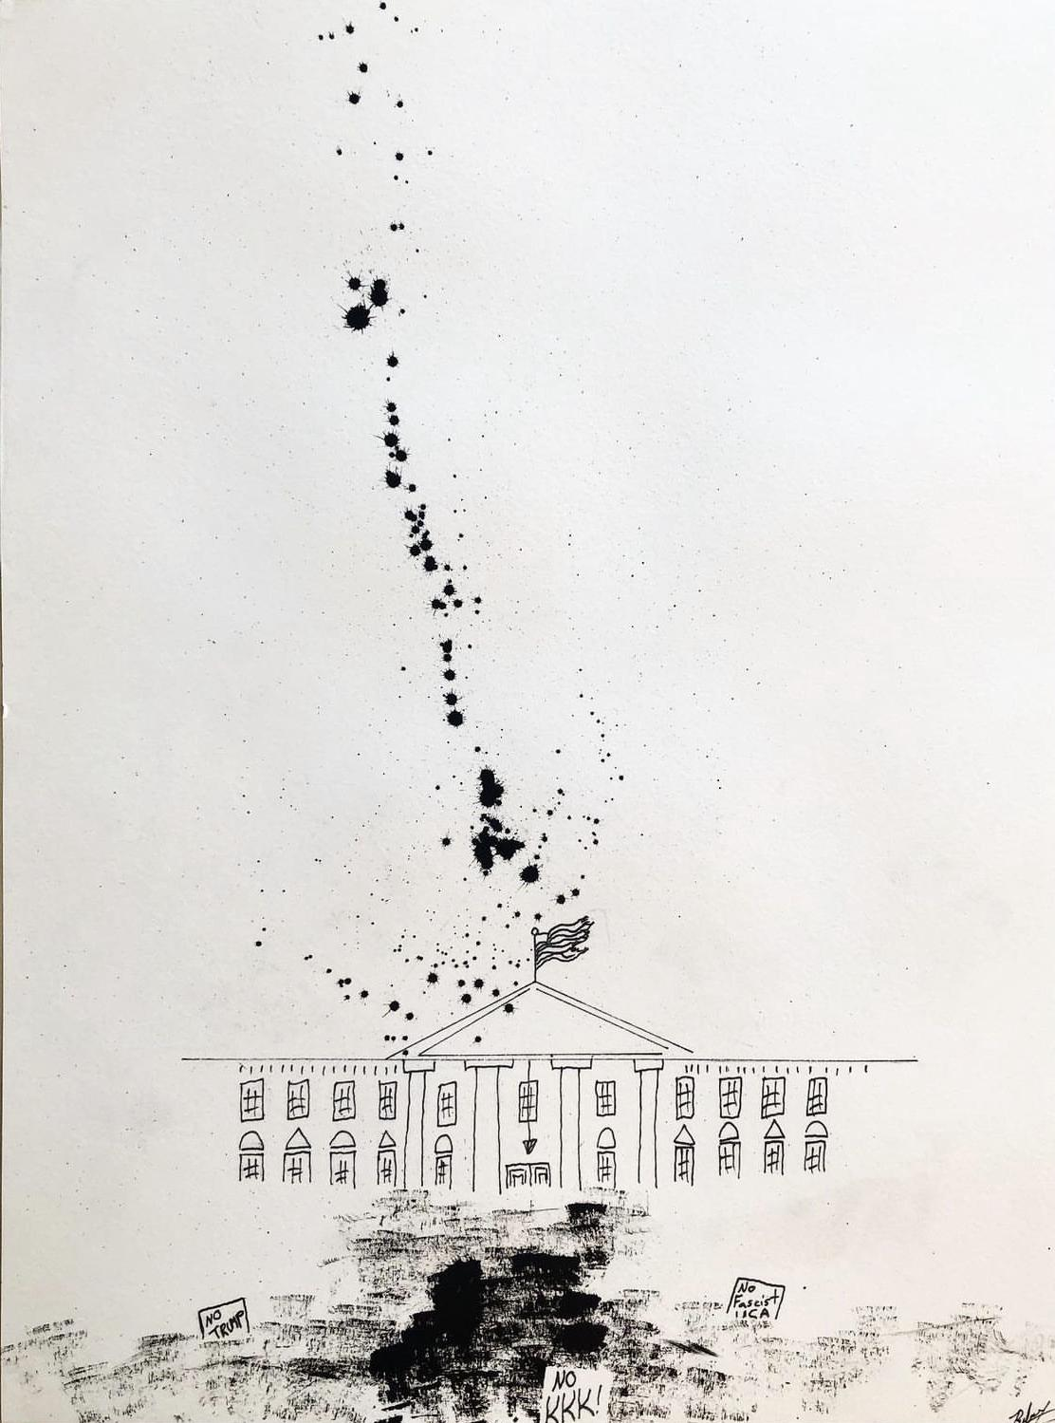

Slide 17
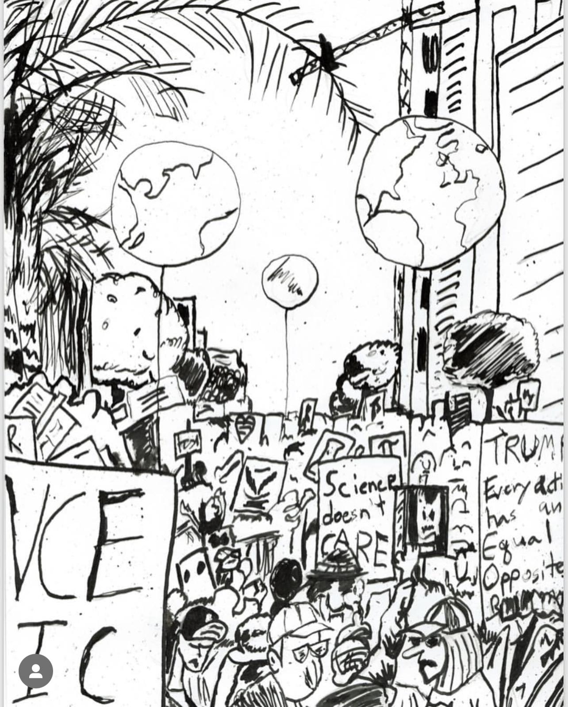
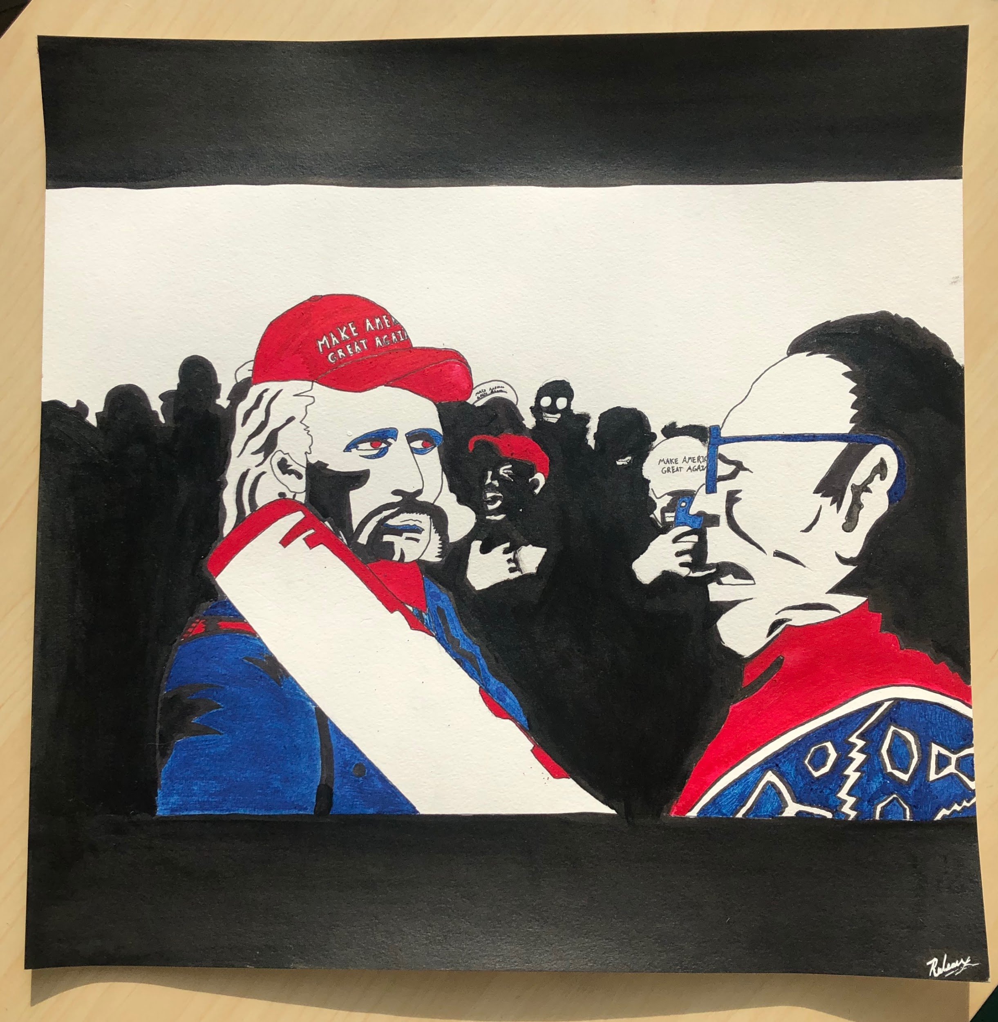

Slide 18
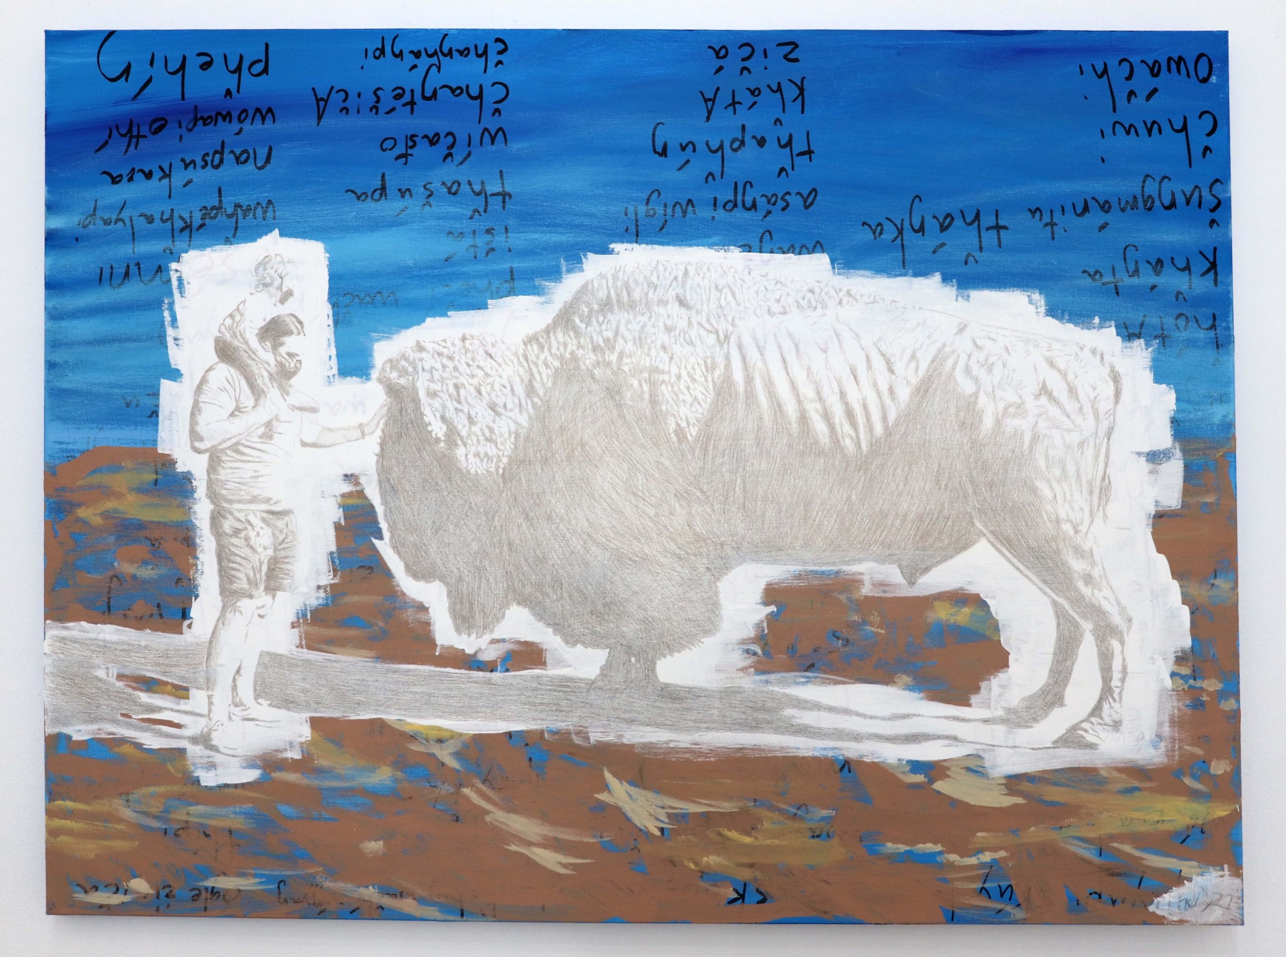

Slide 19
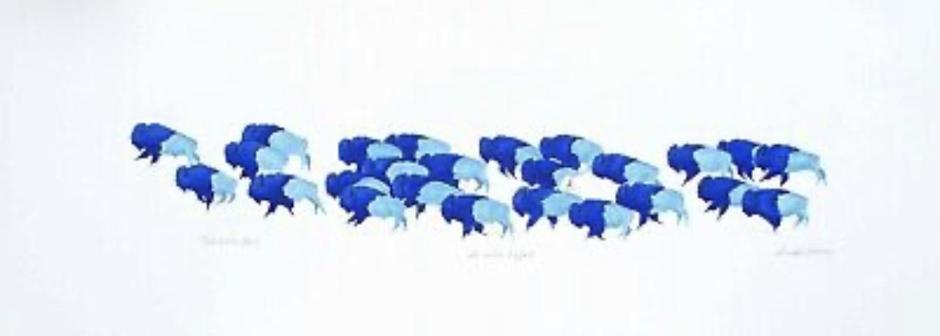

Slide 20
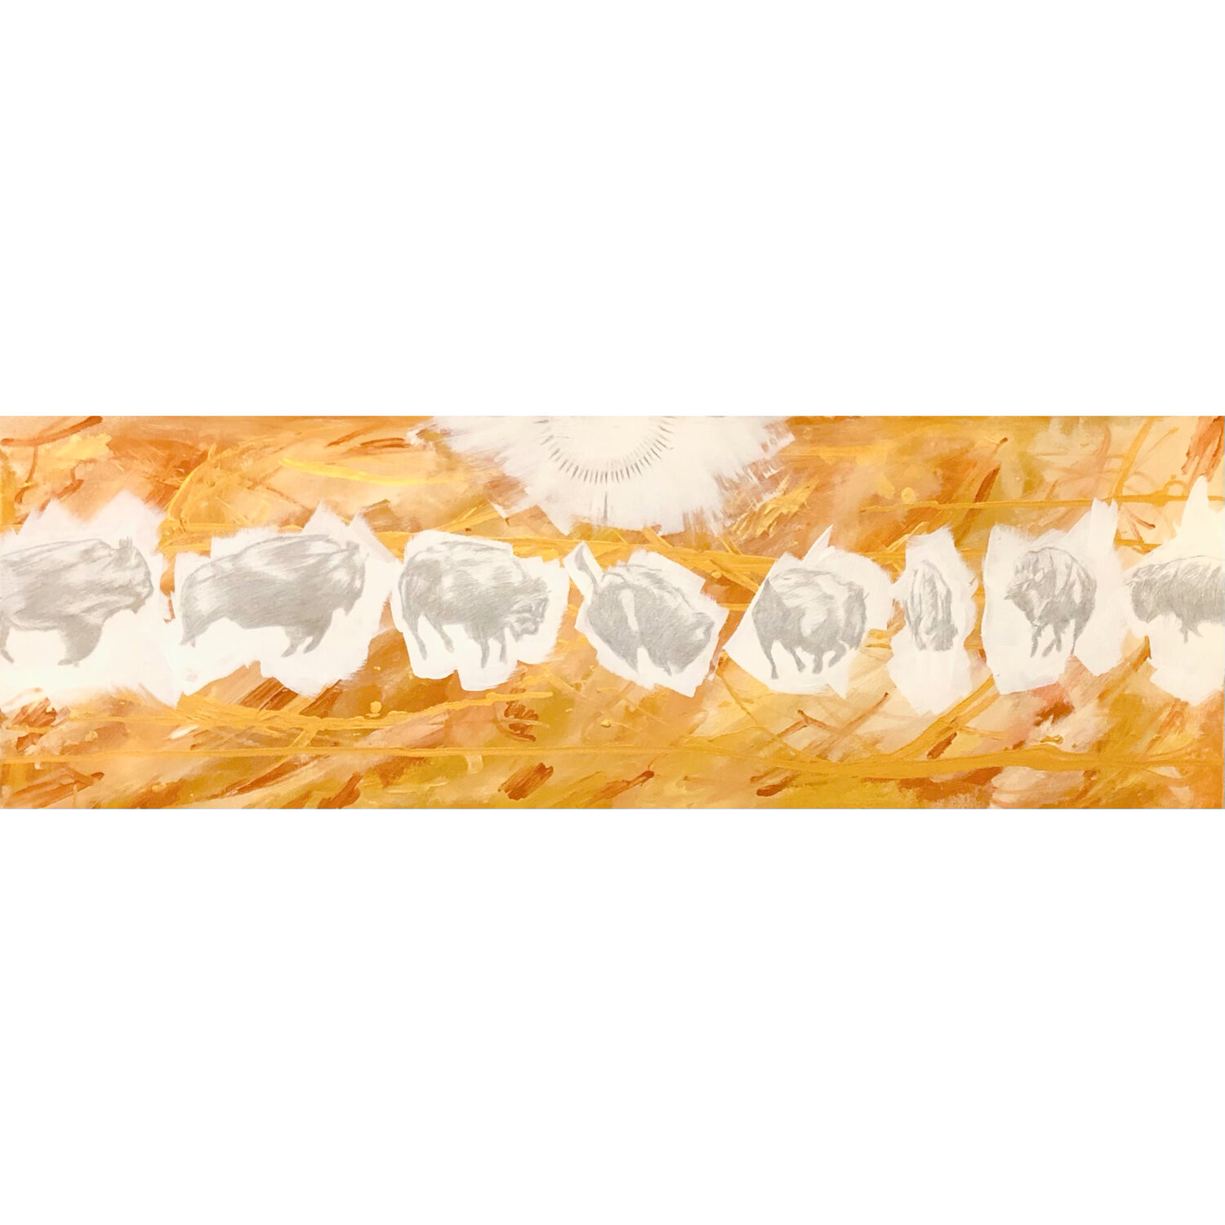
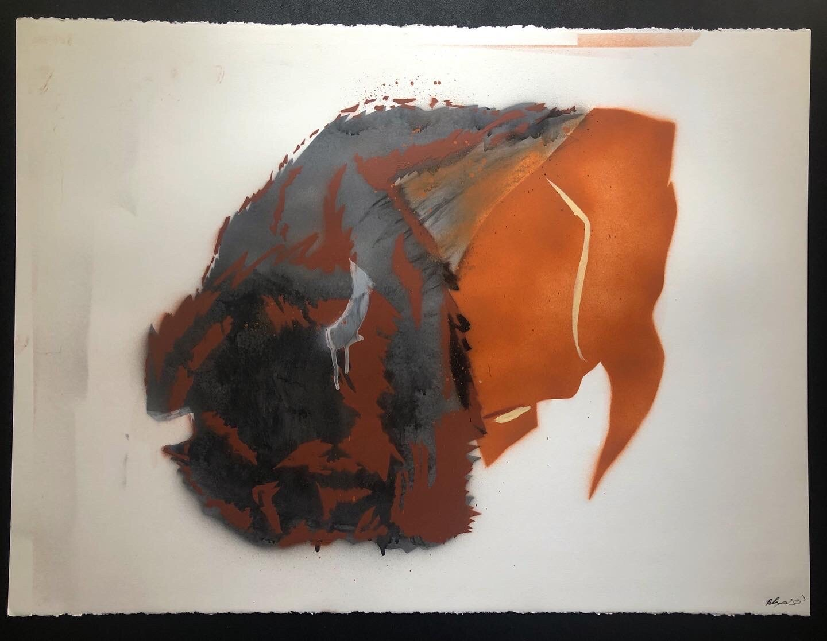
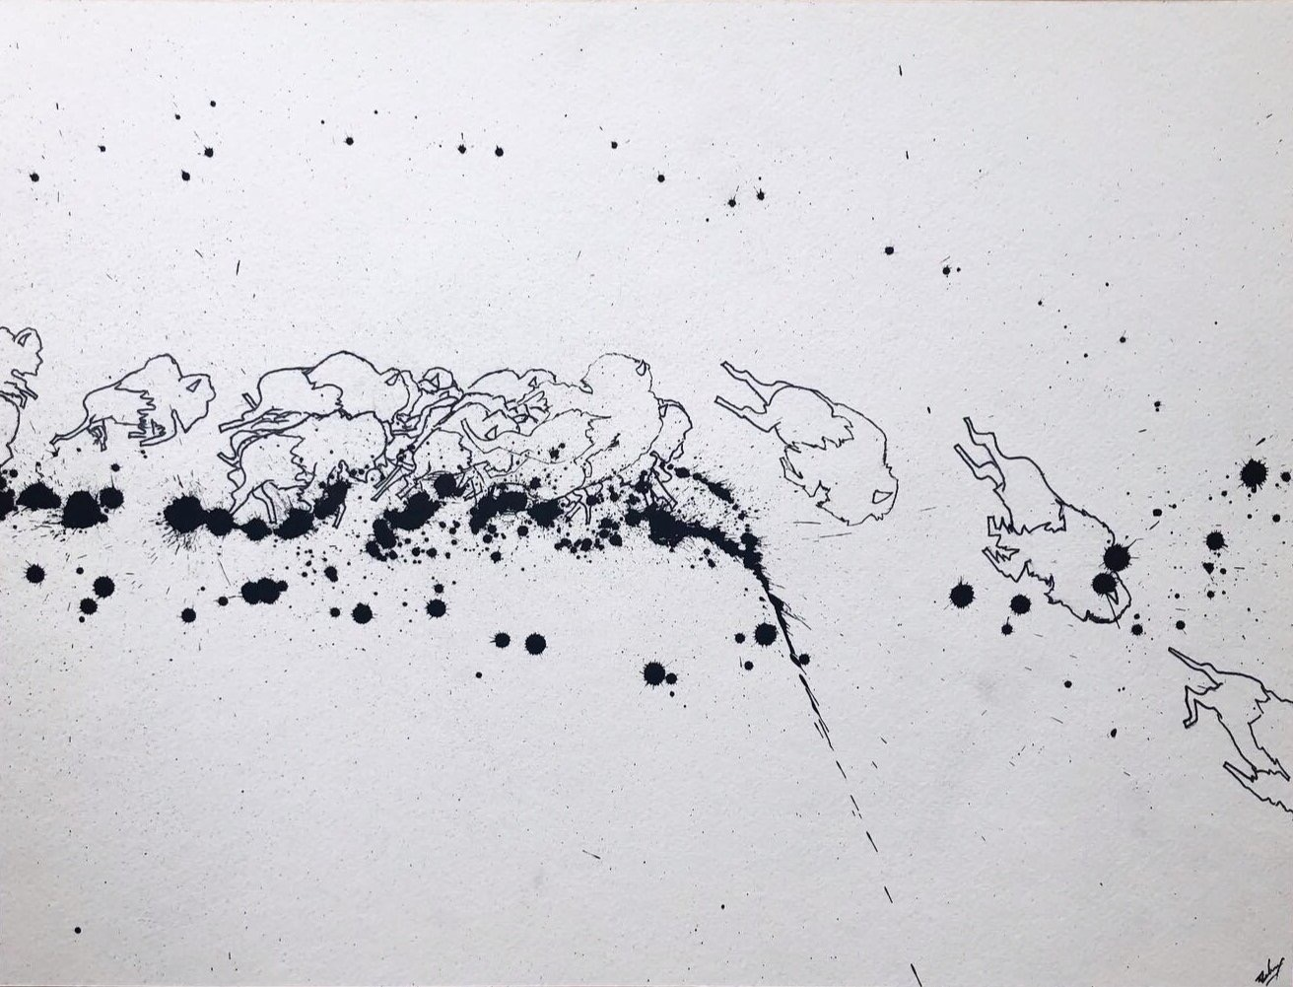

Slide 21
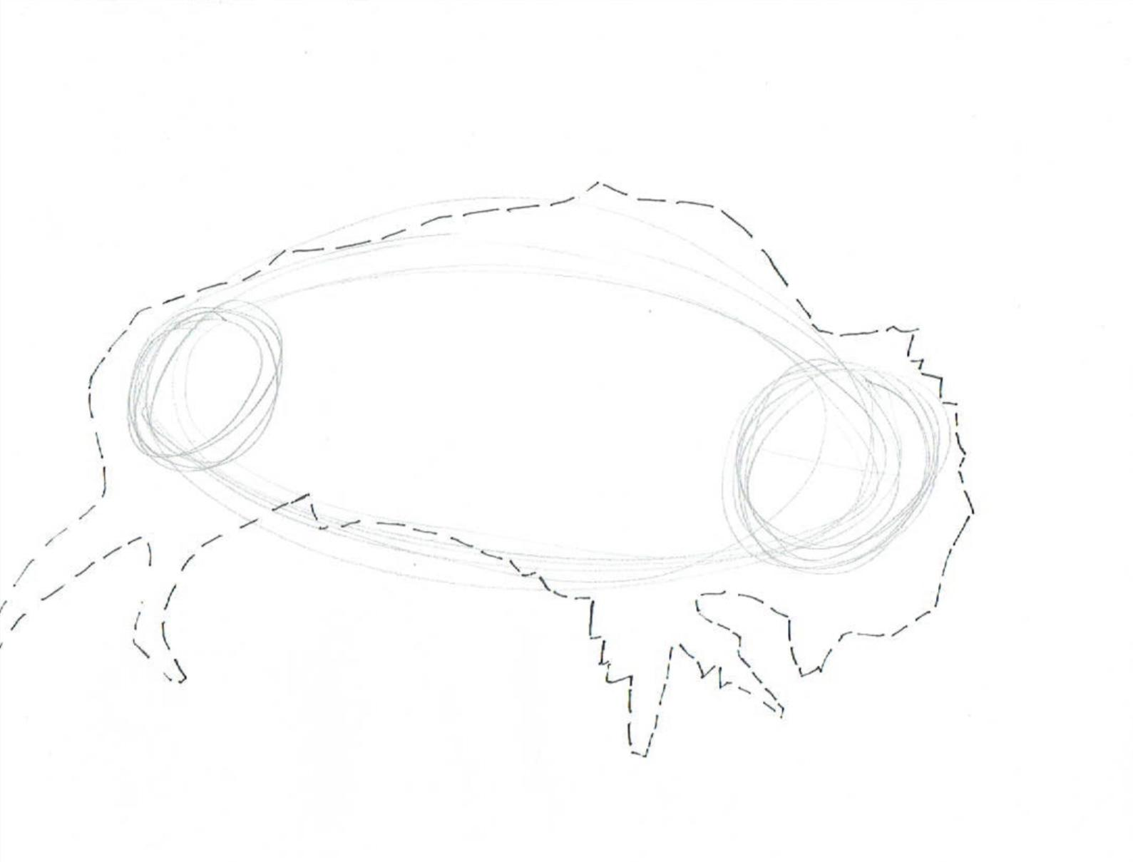

Slide 22
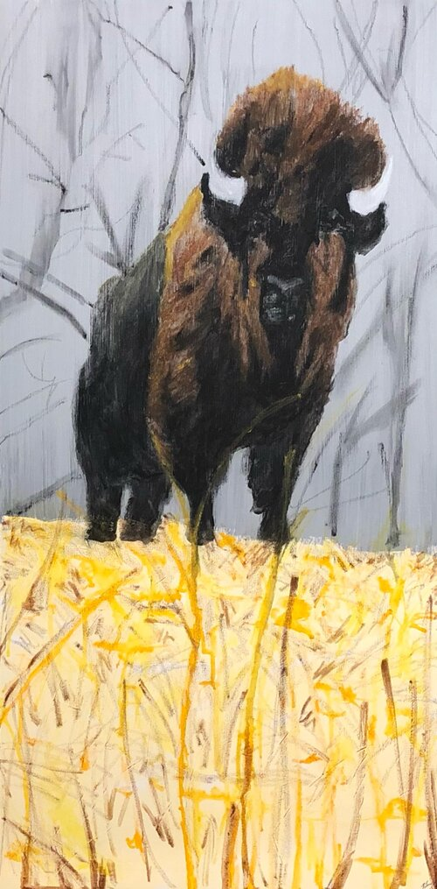
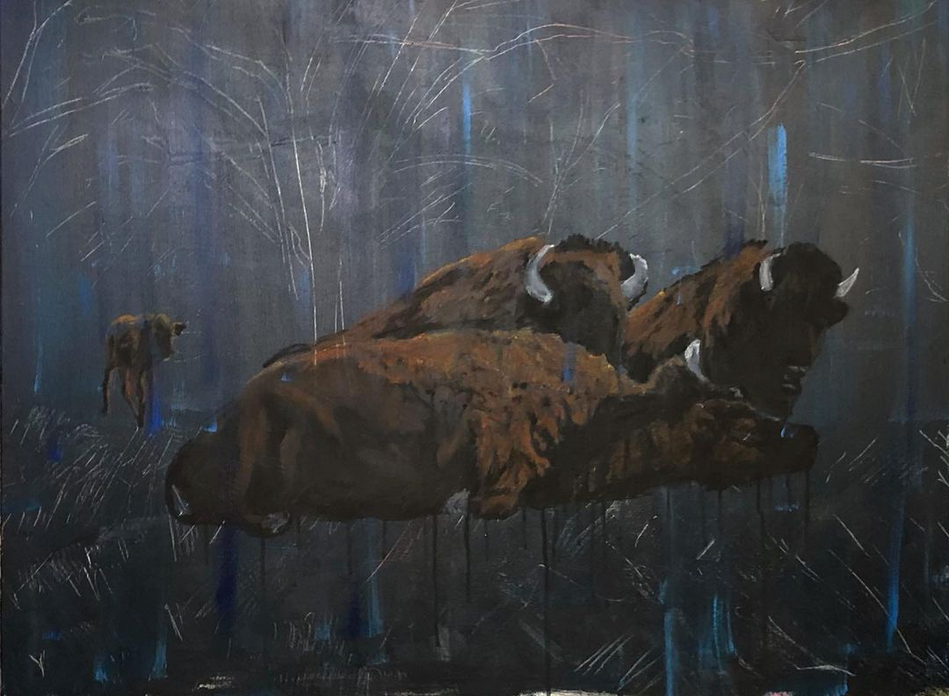

Slide 23
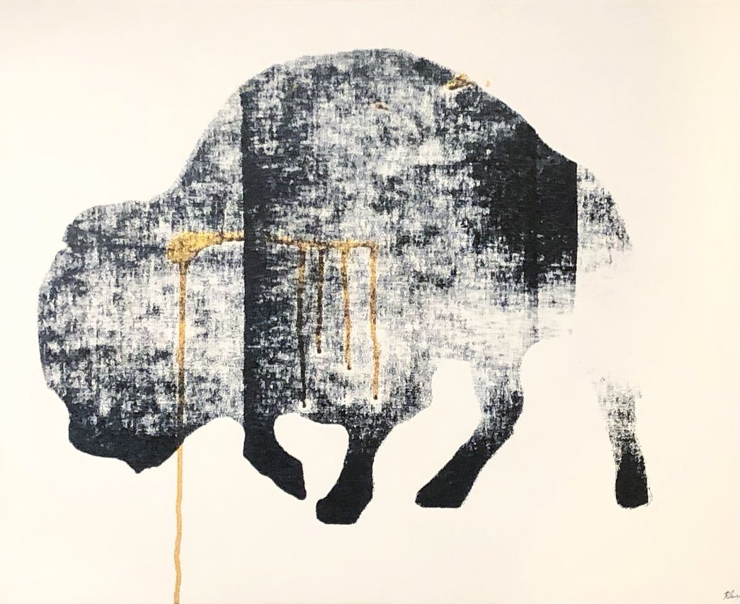
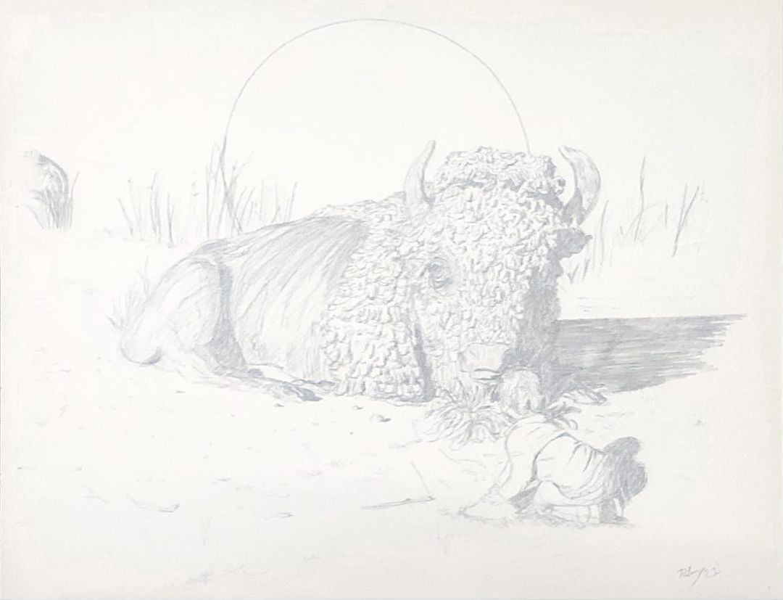
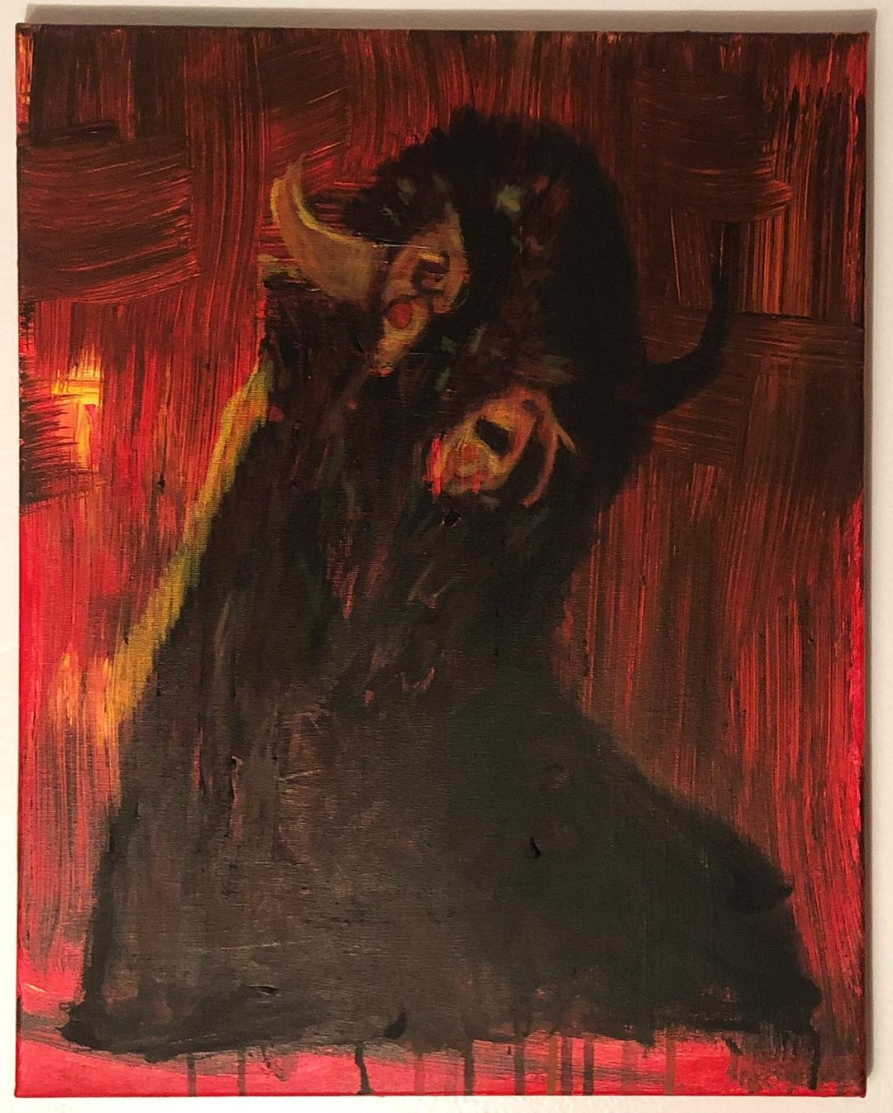

Slide 24
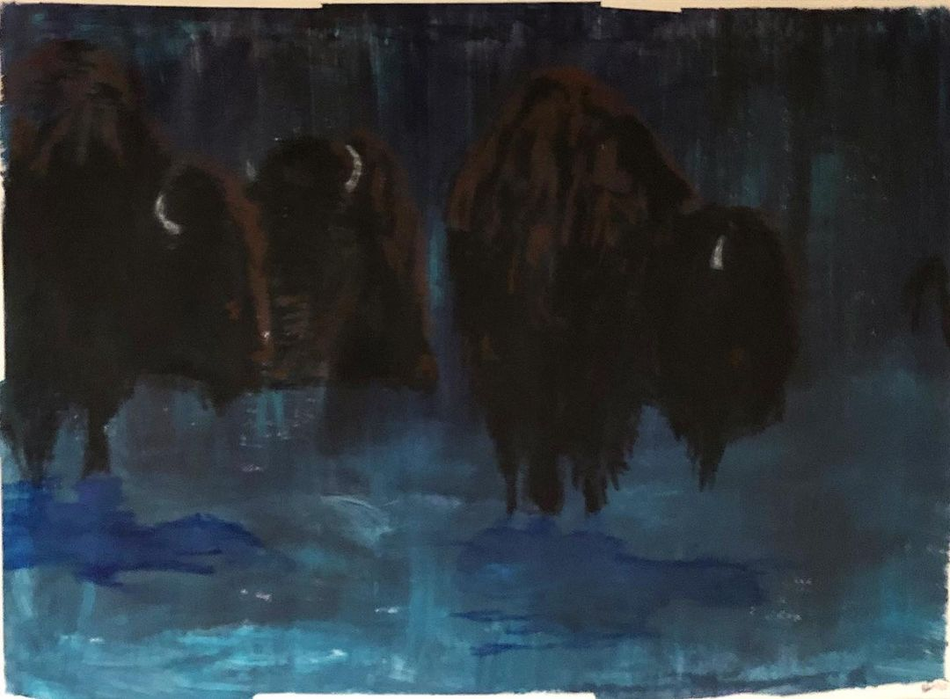
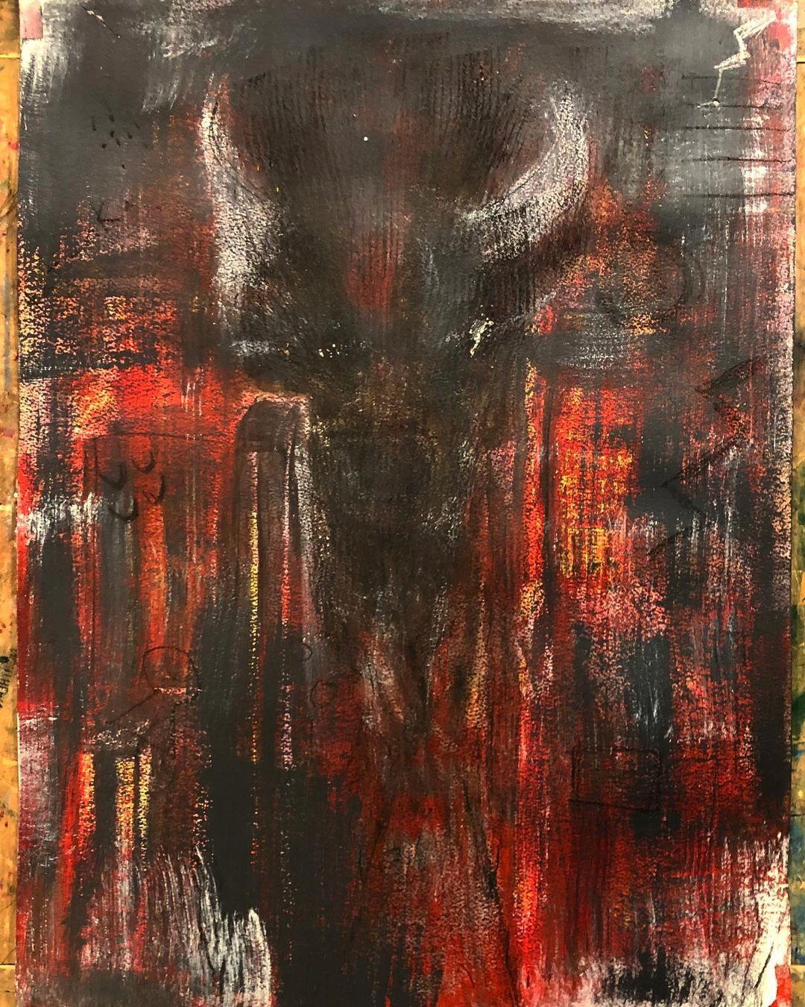

Slide 25
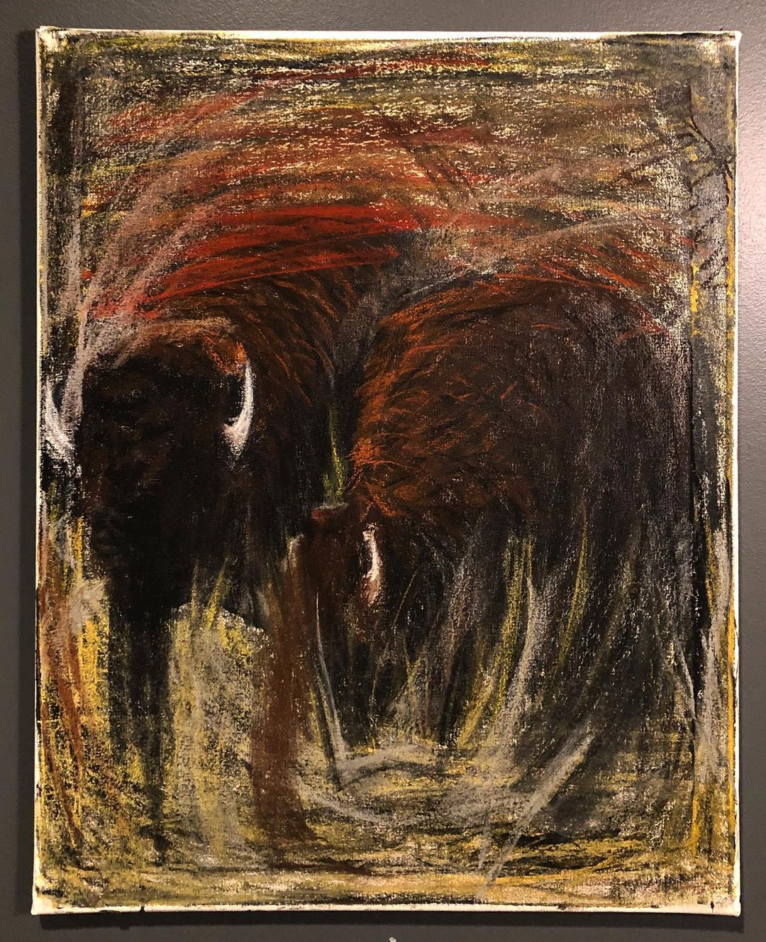
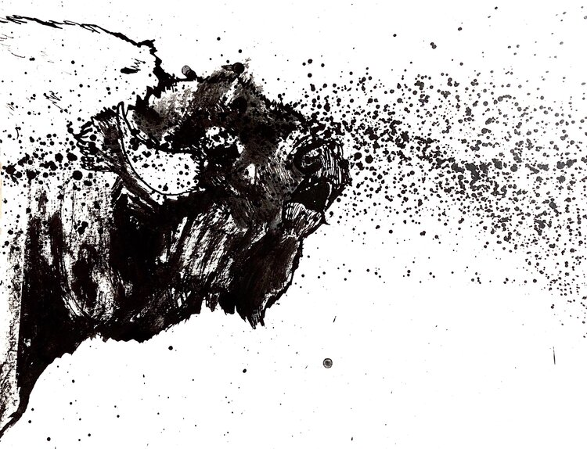

Slide 26
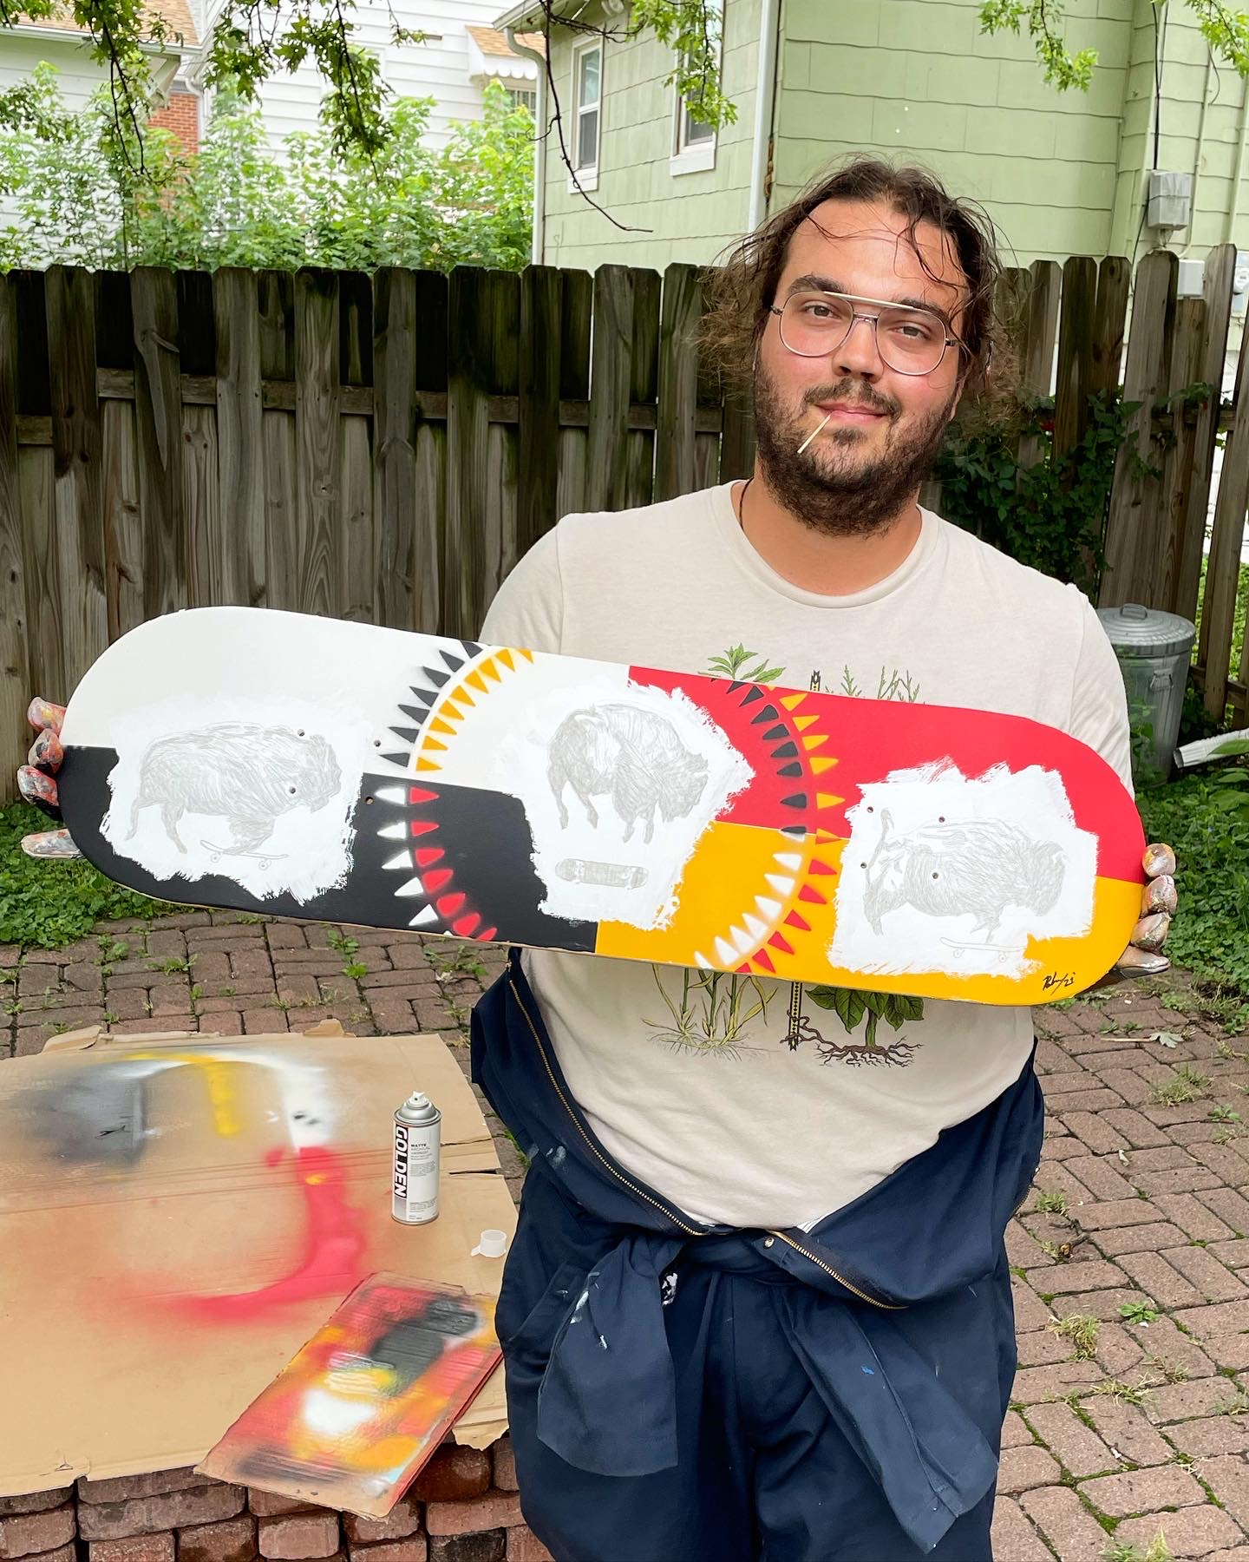
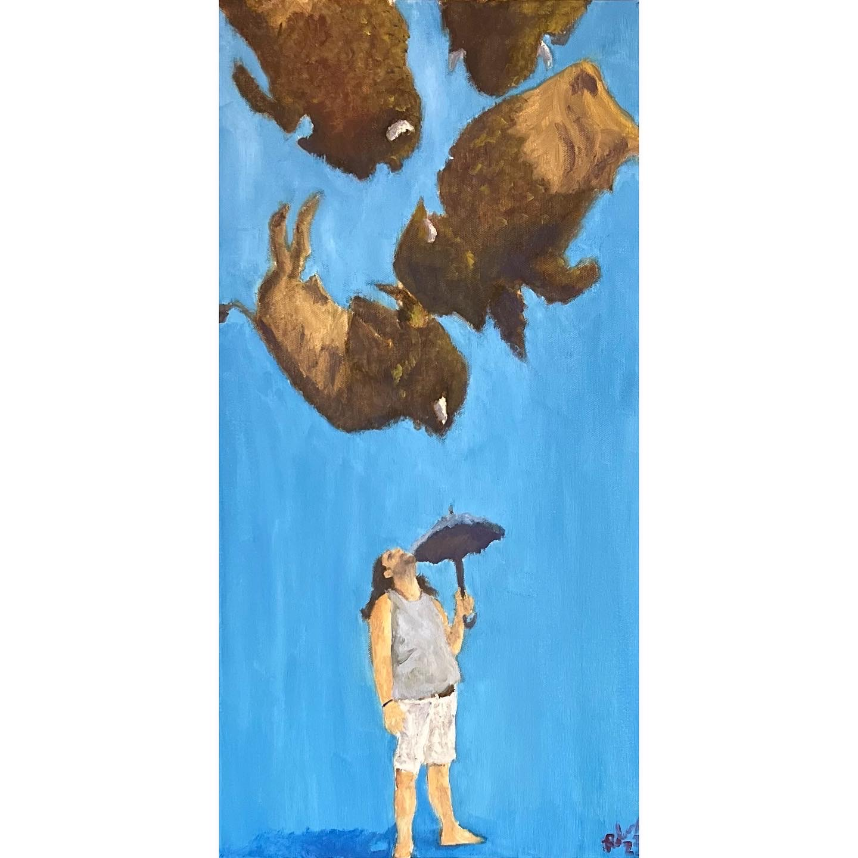

Slide 28
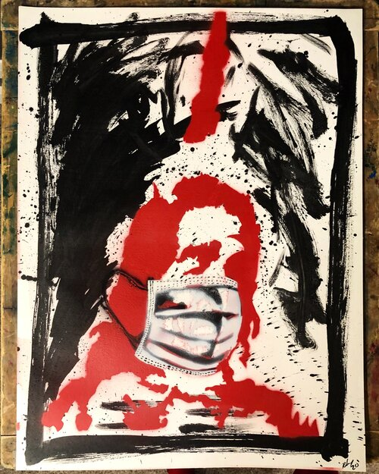
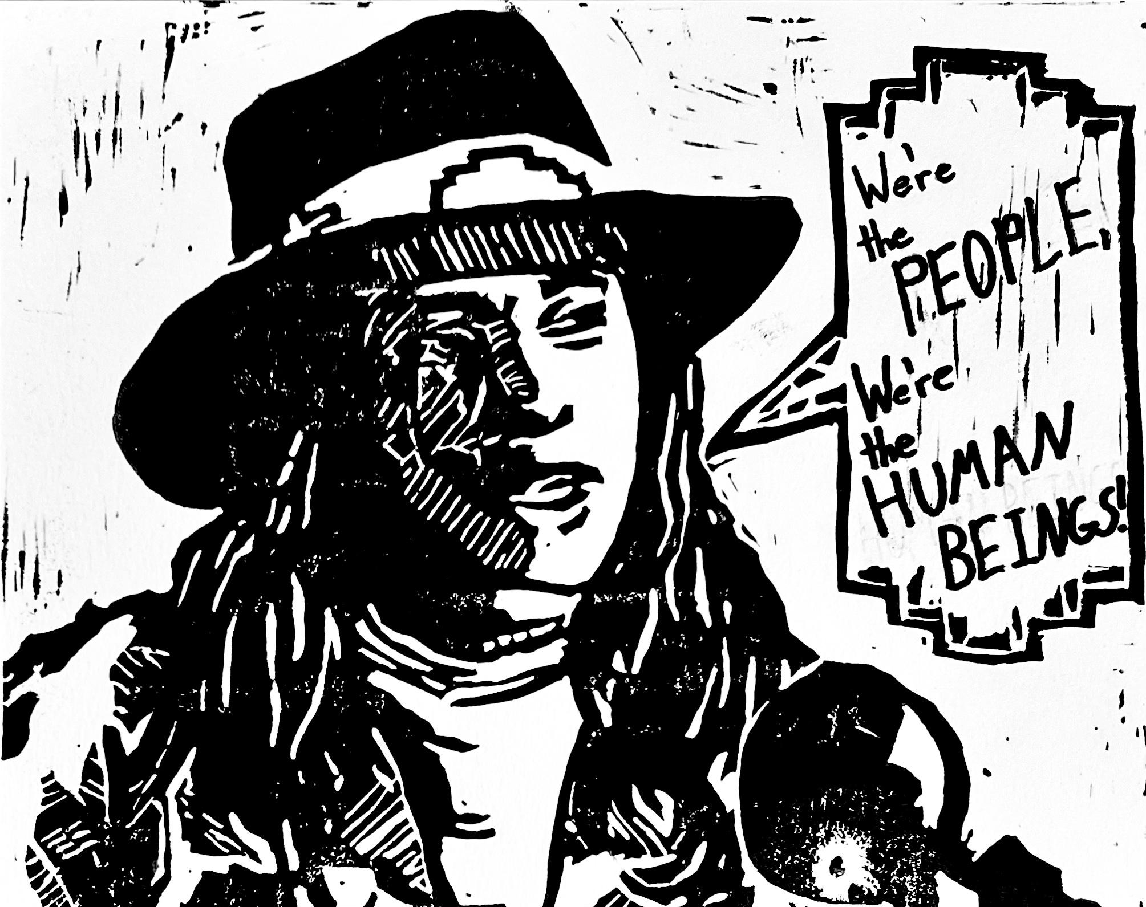

Slide 32
#NATIVESVOTE2020
“Our communities have untapped power because of our history, our ancestors — we must use it in many ways from the streets to the ballot box.”

Slide 35
“In 2020, Native Americans, who comprise six per cent of the Arizona population, voted in numbers never before seen and are largely credited with turning the state blue.”
- The New Yorker

Slide 36
Indigenous Futures Survey 2.0
IFS is a multi-year Native-led research project designed to illuminate the experiences, systemic challenges, and priority issues of Native peoples today.
Notes:
https://www.tiktok.com/@nathanielruleaux/video/7048547801059593518
https://www.instagram.com/reel/CaaAyIhgmil/?utm_source=ig_web_copy_link

Slide 38
Niskithe Prayer Camp
“Today, we are here holding prayer space in a peaceful manner in an attempt to bring light to our cultural and spiritual practices.
“We are here today so that those who attempted to erase our voice, erase our history, erase our identity will know that they will never win.”

Slide 48
Notes:
https://www.tiktok.com/@nathanielruleaux/video/7221545767301926186

Slide 49
Unceded Artist Collective
A community and directory of Indigenous artists who live and create on the unceded land of the Umaha and the Oceti Sakowin (aka the colonized Omaha Metro).
While honoring the past and fighting for the future we seek to take, create and indigenize space for our underrepresented and overlooked relatives.

Slide 53
Lately, the news has felt particularly doomy, dominated by fears of a looming apocalypse due to climate change or nuclear war or artificial intelligence.
This is understandable — any of these existential threats could irrevocably change the world, and what would lie beyond is unknowable.
Native people know a thing or two about that; the world as we knew it ended long ago, and it continued to end again and again and again. Yet we also know that there’s a future even after the apocalypse has come and gone.
Rather than conceptualizing time as a linear march toward calamity (or, for optimists, toward the dream of utopia), it can be viewed as a wheel that we cycle through repeatedly, from creation to destruction to recreation.
- B.L. Blanchard

Slide 55
nathanielruleaux.com
@nathanielruleaux

