Slide 1
Making Sense Of It All- Being Indian in a White Man’s World
Dwight Howe

Slide 2
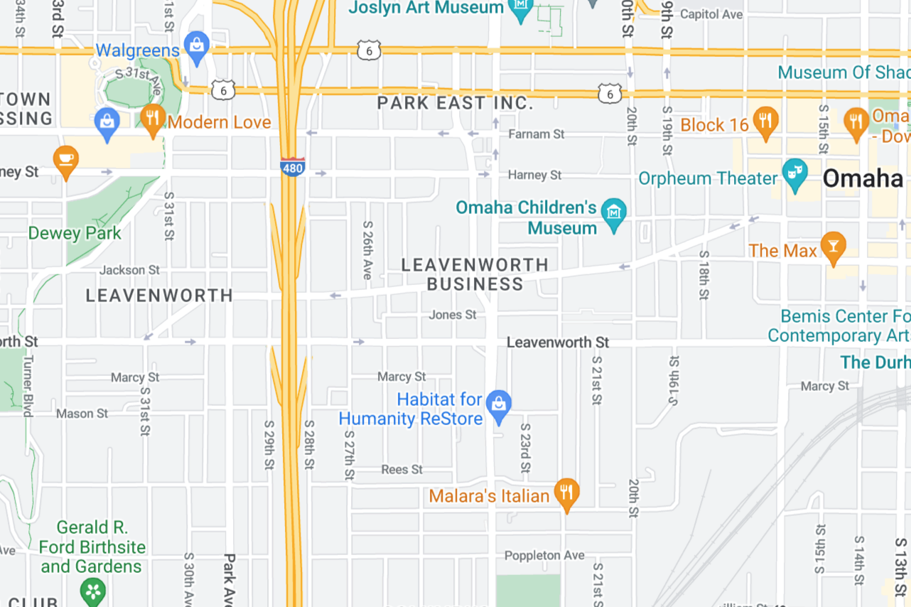
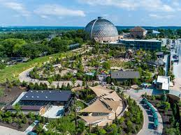
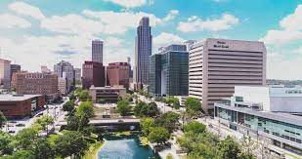
My Journey - Omaha
Downtown Omaha
Omaha Henry Doorly Zoo
Leavenworth & 23rd

Slide 3
My Culture:
The Guiding North Star

Slide 4
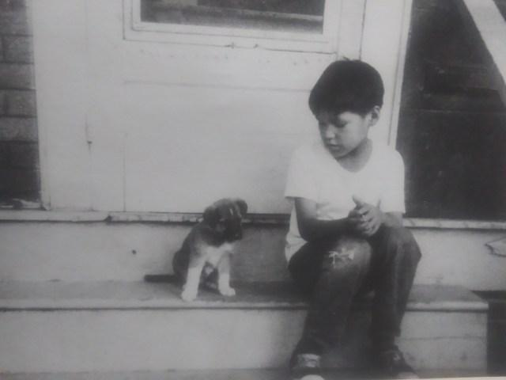

Slide 5
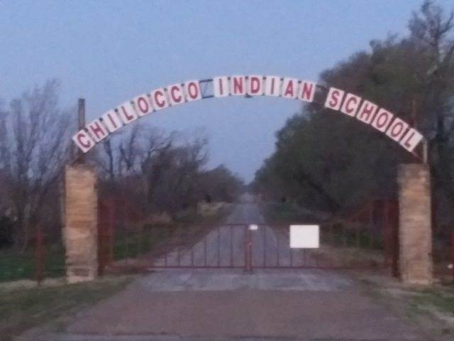

Slide 6
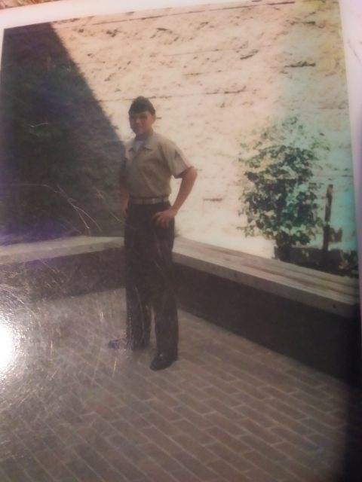

Slide 7
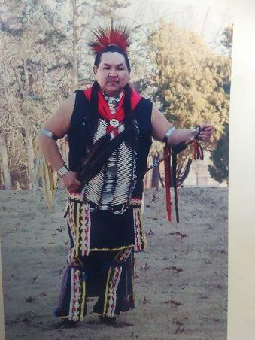

Slide 8
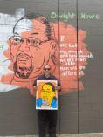

Slide 9
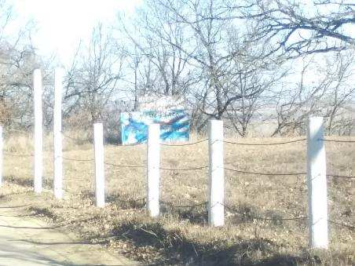

Slide 10
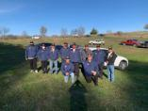

Slide 11
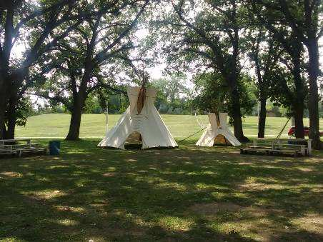

Slide 12
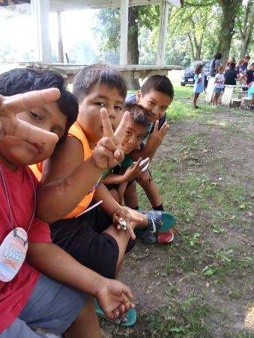

Slide 13
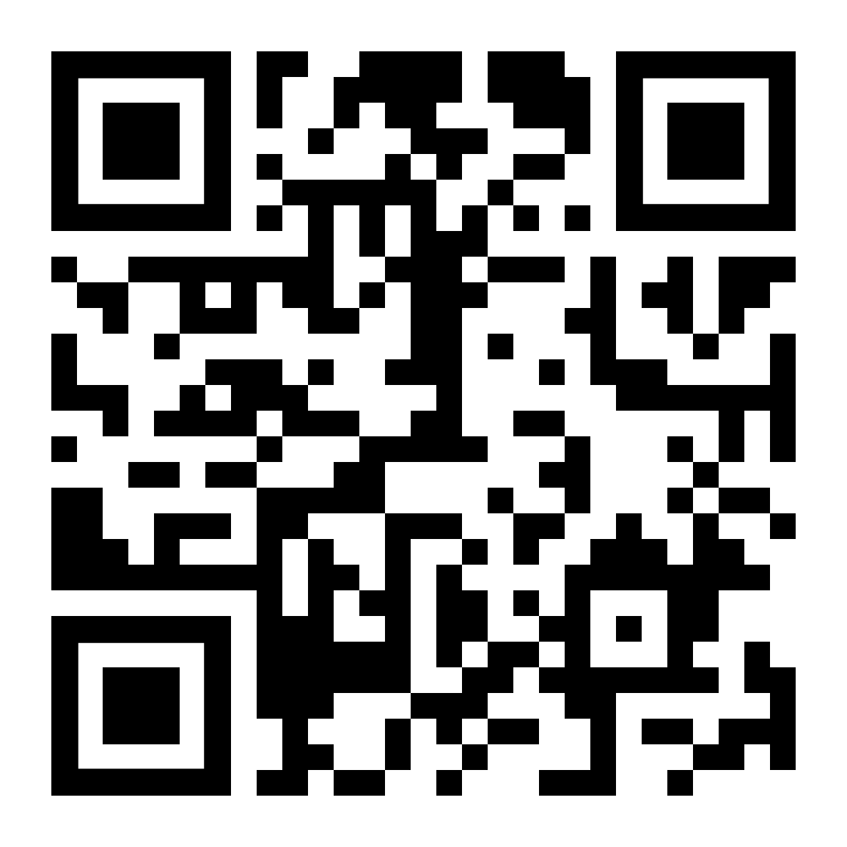
Please fill out the provided paper version of the breakout session evaluation, or scan the QR code to the right to access the virtual version.

