Slide 1
Careers in Sports Medicine
Kerry Waple, MEd, ATC, CSCS
Sports Medicine Coordinator
Certified Athletic Trainer
Certified Strength and Conditioning Specialist

Slide 2
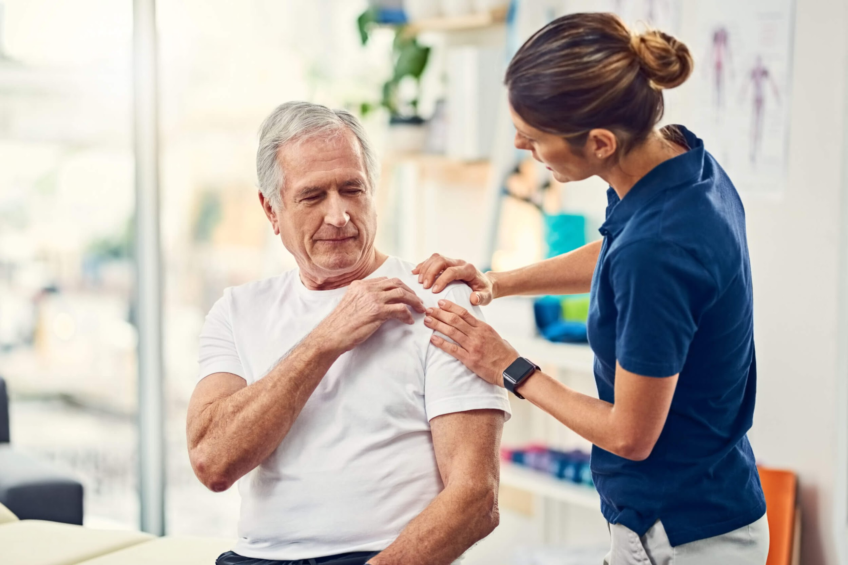
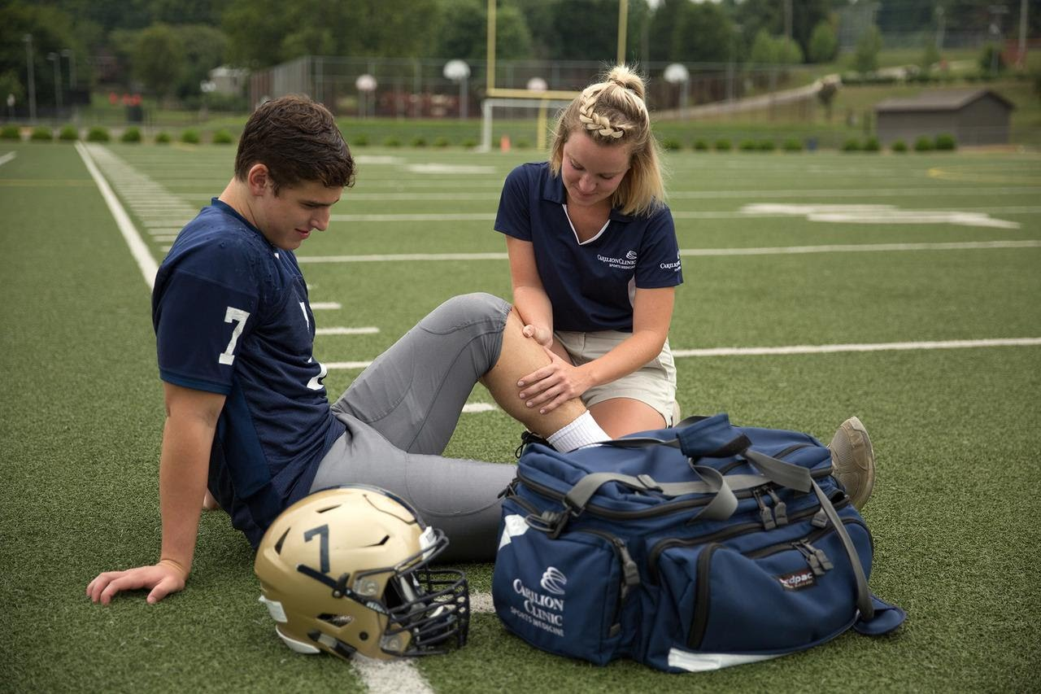
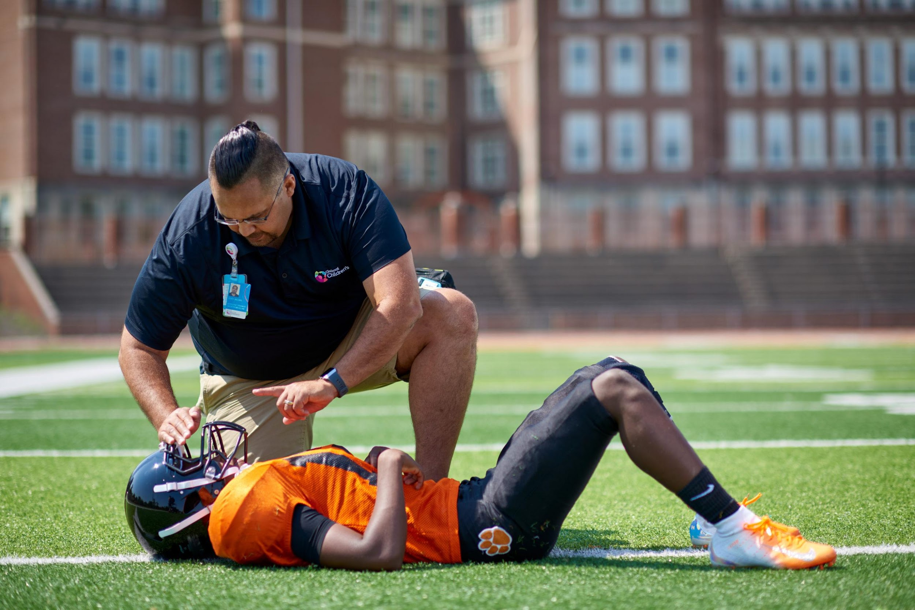
What is Sports Medicine?
Sports Medicine is a term that is claimed by a variety of professions
Traditionally the term refers to:
Athletic Trainers
Primary Care Sports Medicine
Orthopedic Surgeons
Working with athletes, as well as the general public, to return them to the pre- injury state without deconditioning

Slide 3
What is Athletic Training?
Injury Prevention
Health Promotion
Examination, Assessment, Impression
Immediate and Emergency Care
Therapeutic Rehabilitation/Modalities
Health Care Administration, Risk Management, Professional Responsibility

Slide 5
How do you become a Certified Athletic Trainer (ATC)
College degree – accredited program
Now requiring 5 years that will include a masters degree
Off campus experiences in a variety of settings
Pass National Certification Exam
Board of Certification
State Licensure Exam
Continuing education requirements

Slide 6
Where do AT’s work?
Traditional Setting
High School
College/University
Clinical
Industrial
Professional
Physician Extender (ATPPS)
Notes:
ATPPS Athletic Trainer in a Physicians Practice Setting

Slide 7
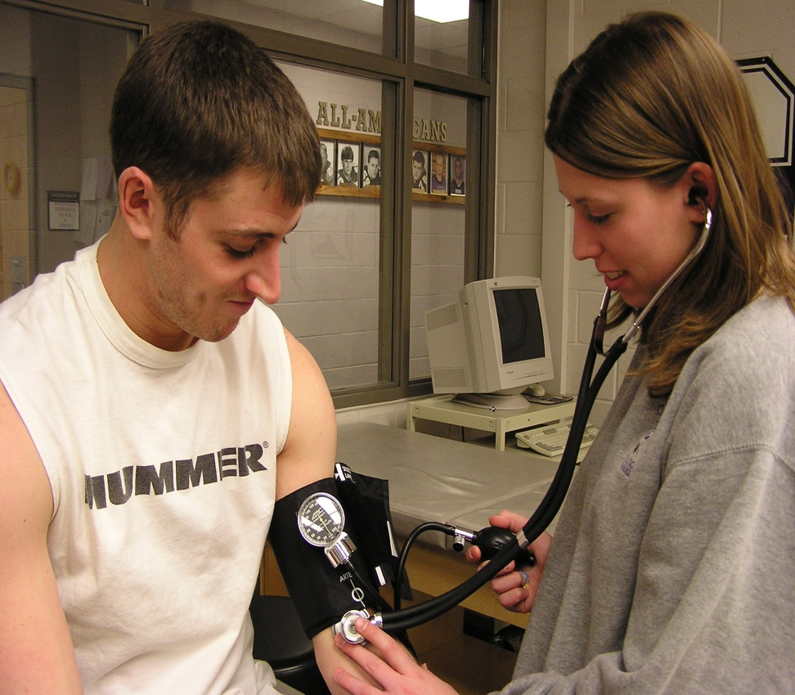
High School Setting
Responsible for health and wellbeing of athletes (minors)
PPE
Injury evaluation
Treatment and rehabilitation
Communicate with coaches and parents
Design IPP
ALL SPORTS

Slide 8
College/University Setting
NCAA Rules and Regulations
Commonly 2-3 sport seasons per AT
Adults over 18, make own health care decisions
Speak more with coaches than parents
Team physician relationship
Documentation standards
Travel required
May teach as well in accredited curriculums

Slide 9
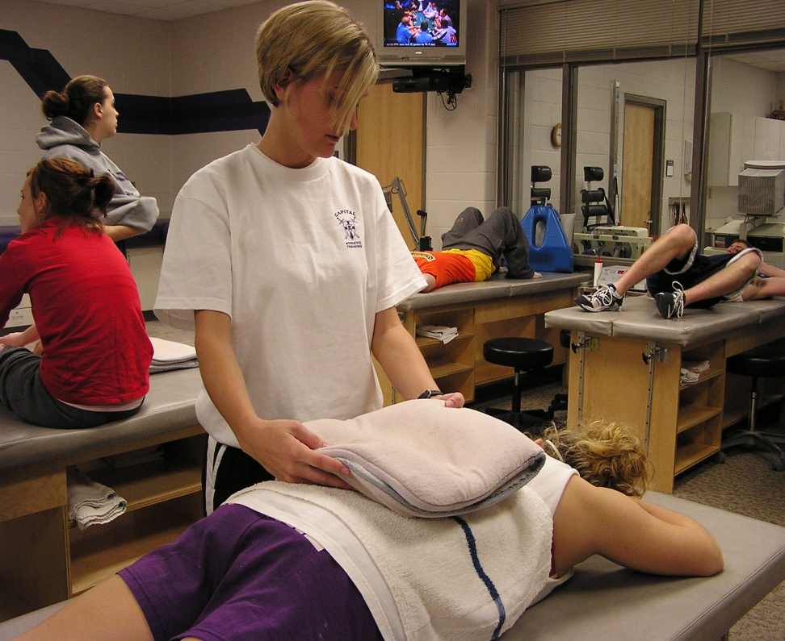
College/University Setting

Slide 10
College/University Setting

Slide 11
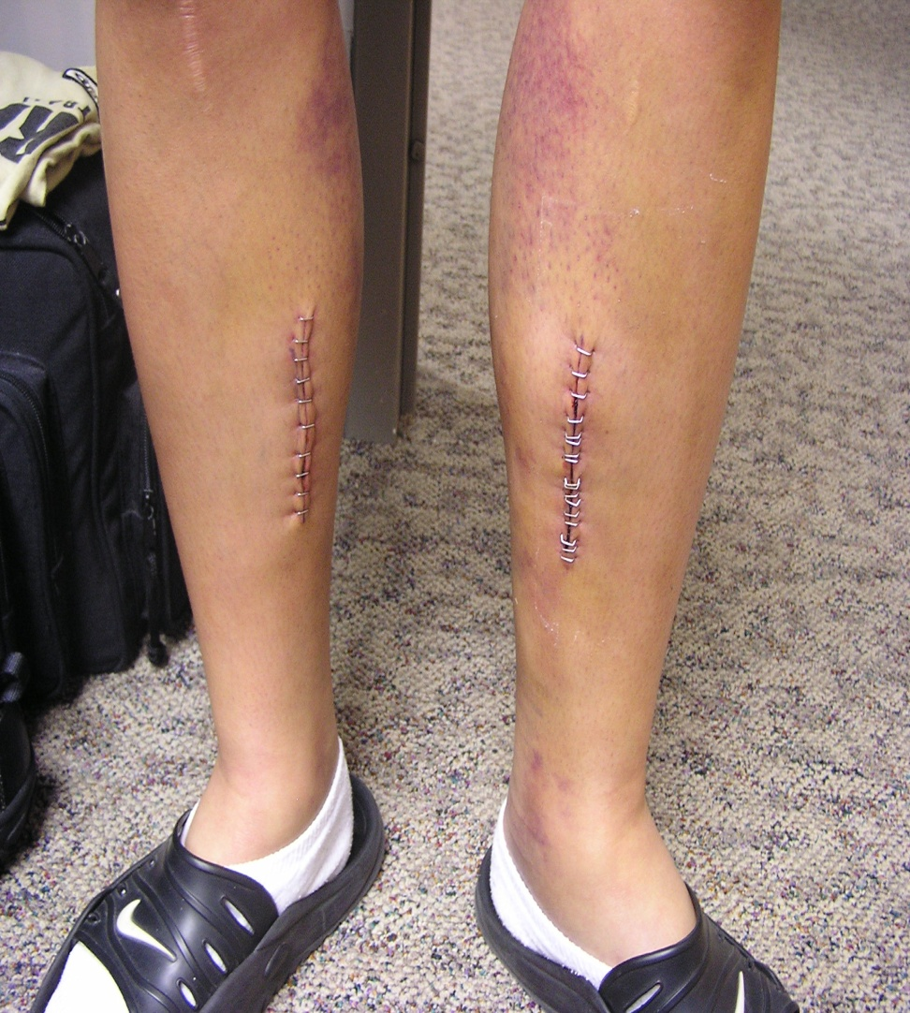
College/University Setting

Slide 12
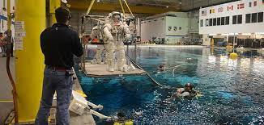
Clinical and Industrial Settings
Primary responsibilities:
Treatment and rehabilitation
Get patient or employee back to work
Work ergonomics/injury prevention
Boeing, Google, Amazon, NASA, General Motors, etc.

Slide 13
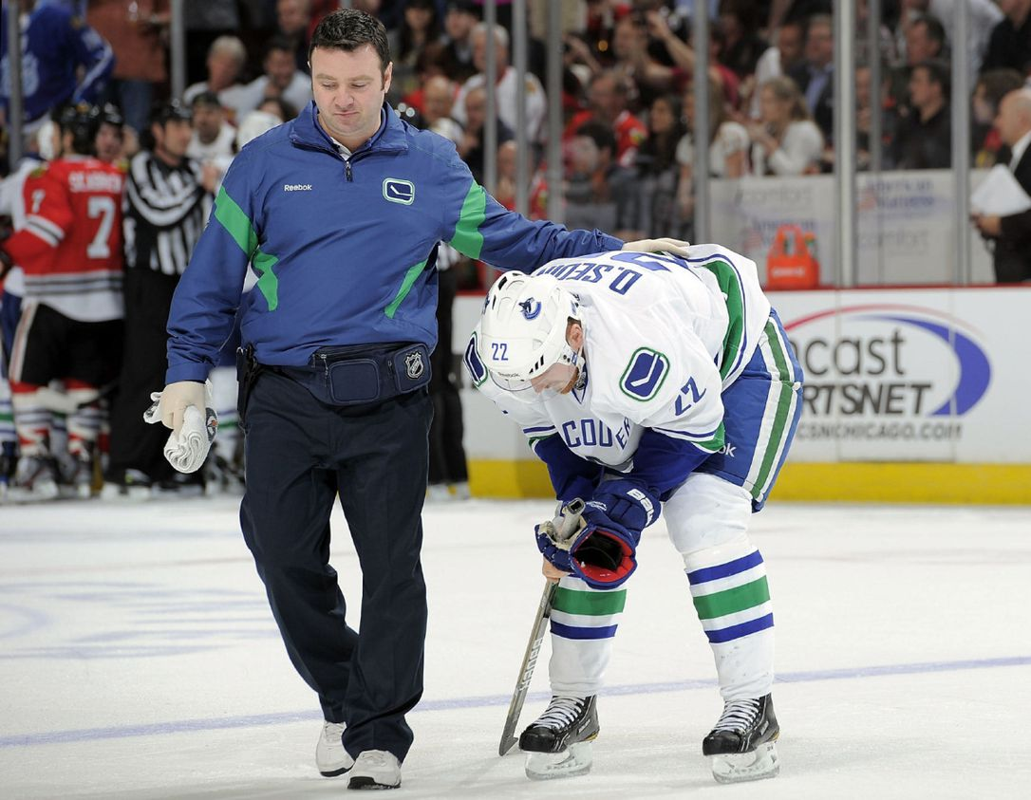
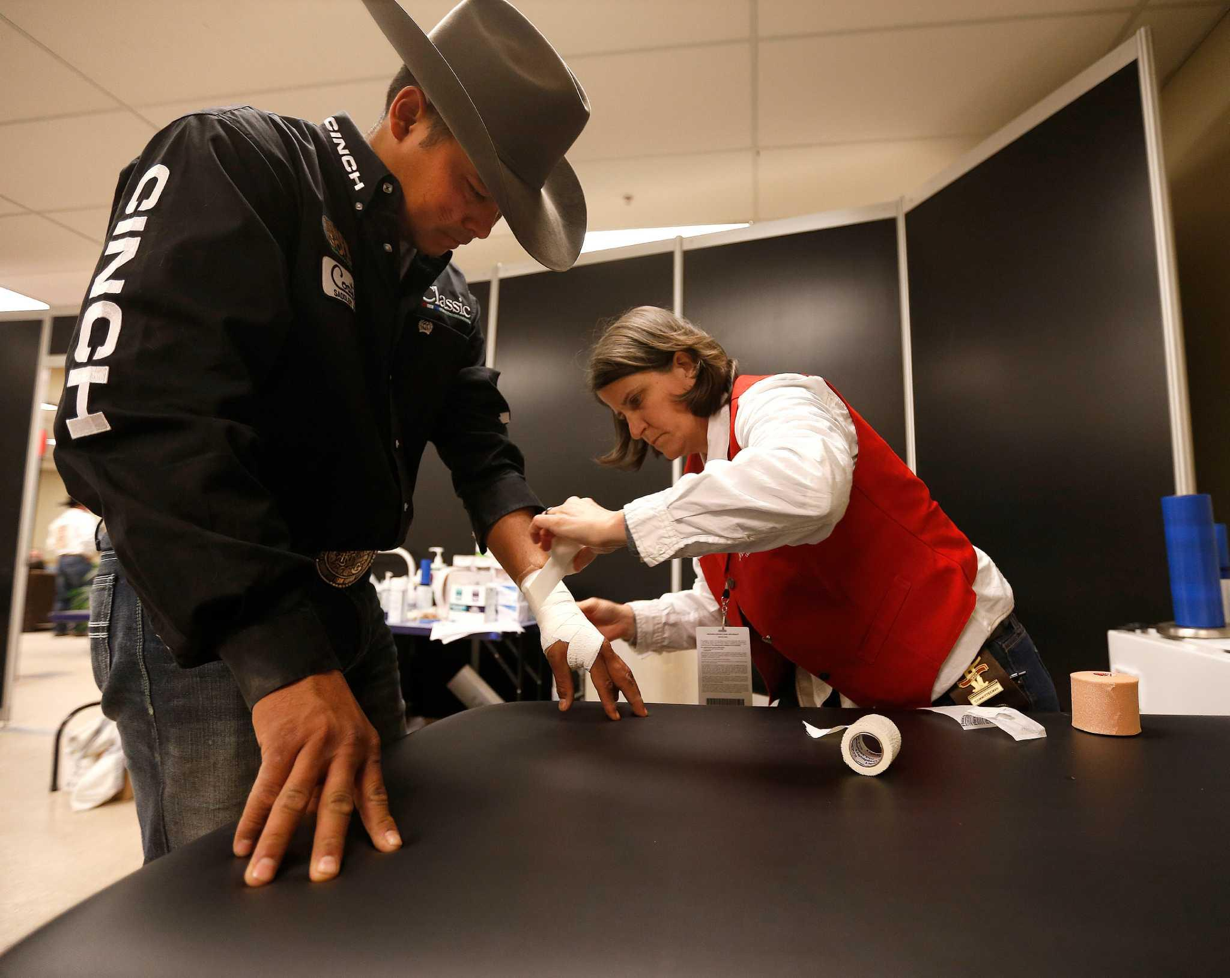
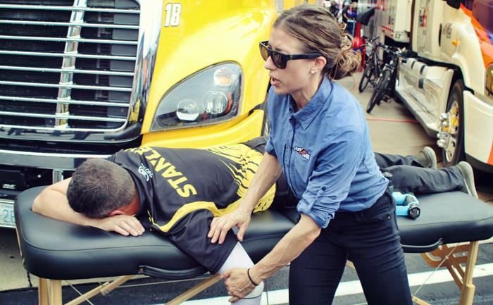
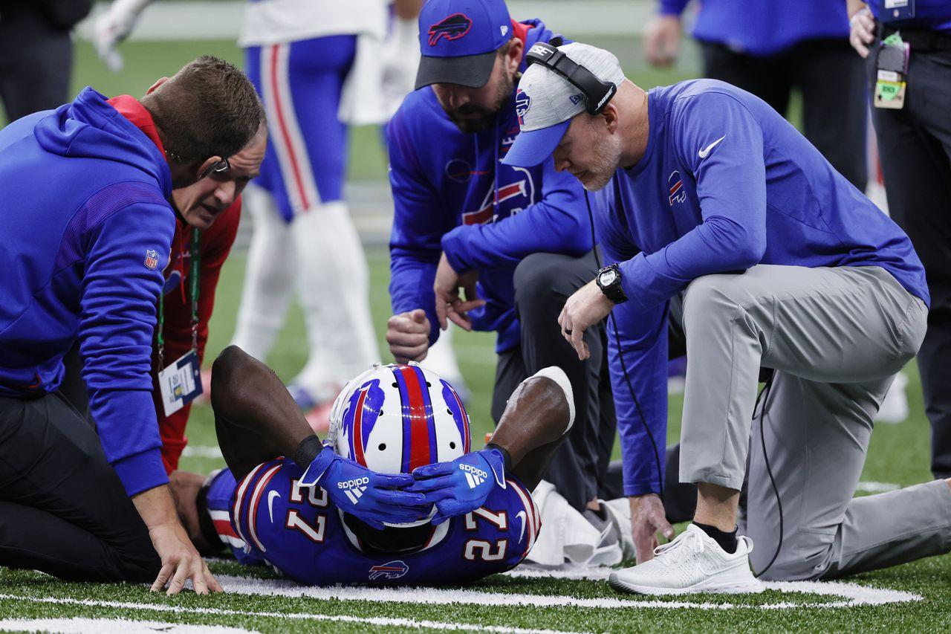
Professional Setting
Major Leagues
NFL, NHL, NBA, WNBA, MLB, MLS, PGA
Performing Arts
NYC Rockettes, Cirque du Soleil, Ballet
Professional
Nascar, Rodeo, X-Games

Slide 14
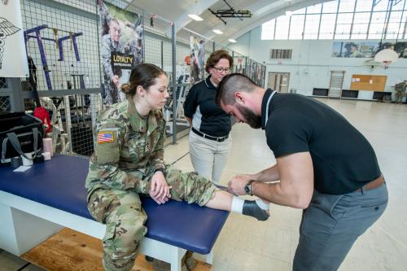
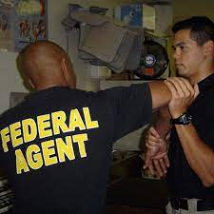
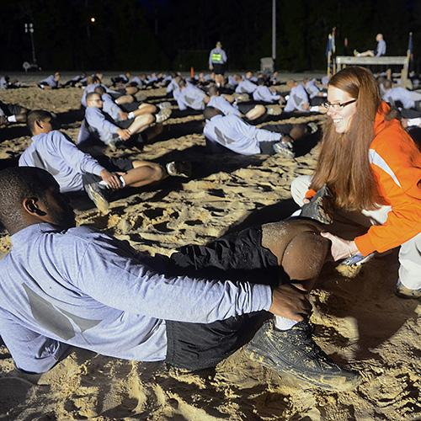
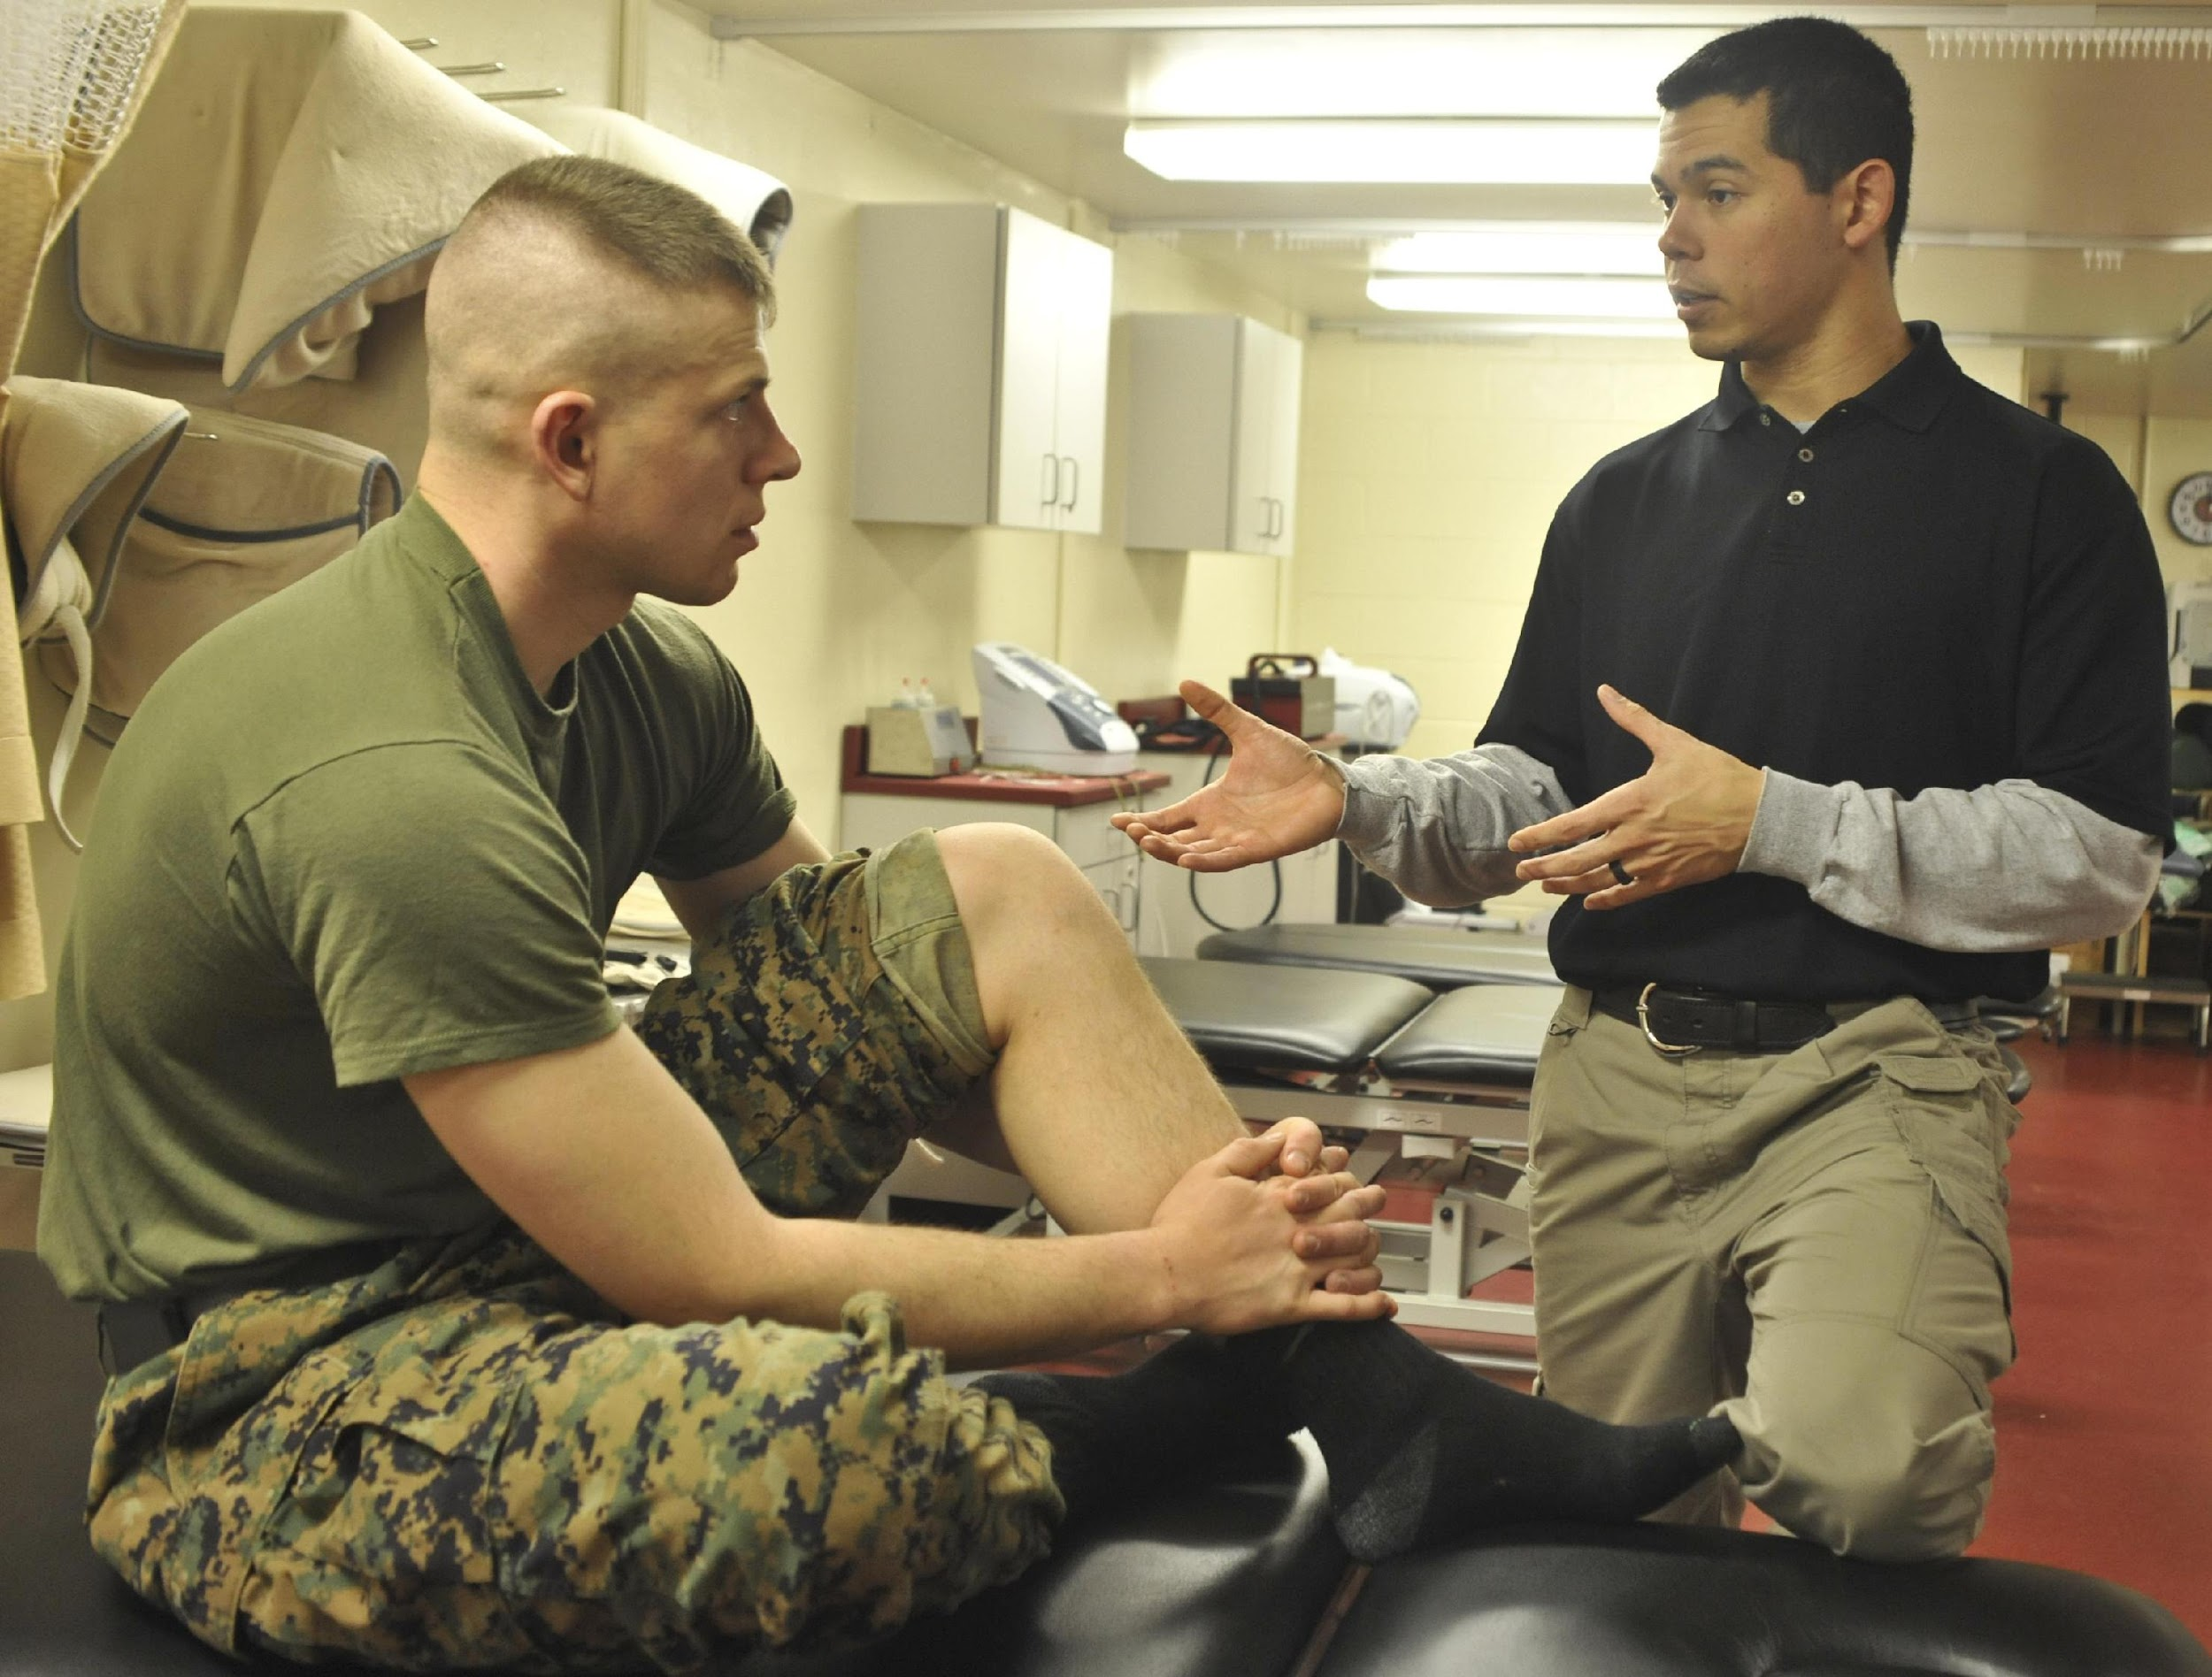
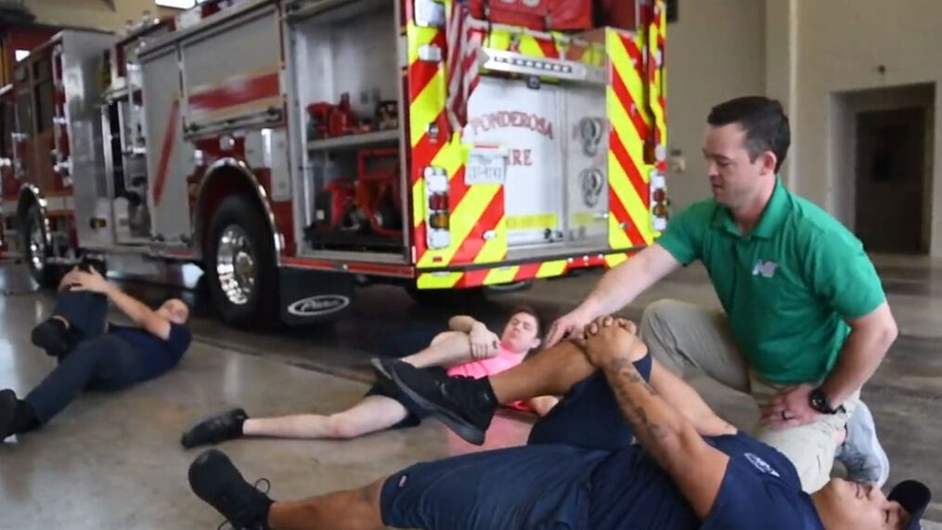
Professional Setting
Military
Army, Navy, Air Force, Marines
Embedded in troops and missions
Police/Fire

Slide 15
Professional Setting
US Olympic Committee
Pan American Games
Olympic and Para-Olympic Games
National and international competitions, World Cups
Sport National Governing Bodies (NGB’s)
Traditional intercollegiate sports like
Basketball, Volleyball, Tennis, Soccer, Track/Field, Wrestling, along with:
Gymnastics
Boxing
Kayaking
Cycling
Water Polo
Fencing
Judo
Wt. lifting
Skiing
Ice skating

Slide 16
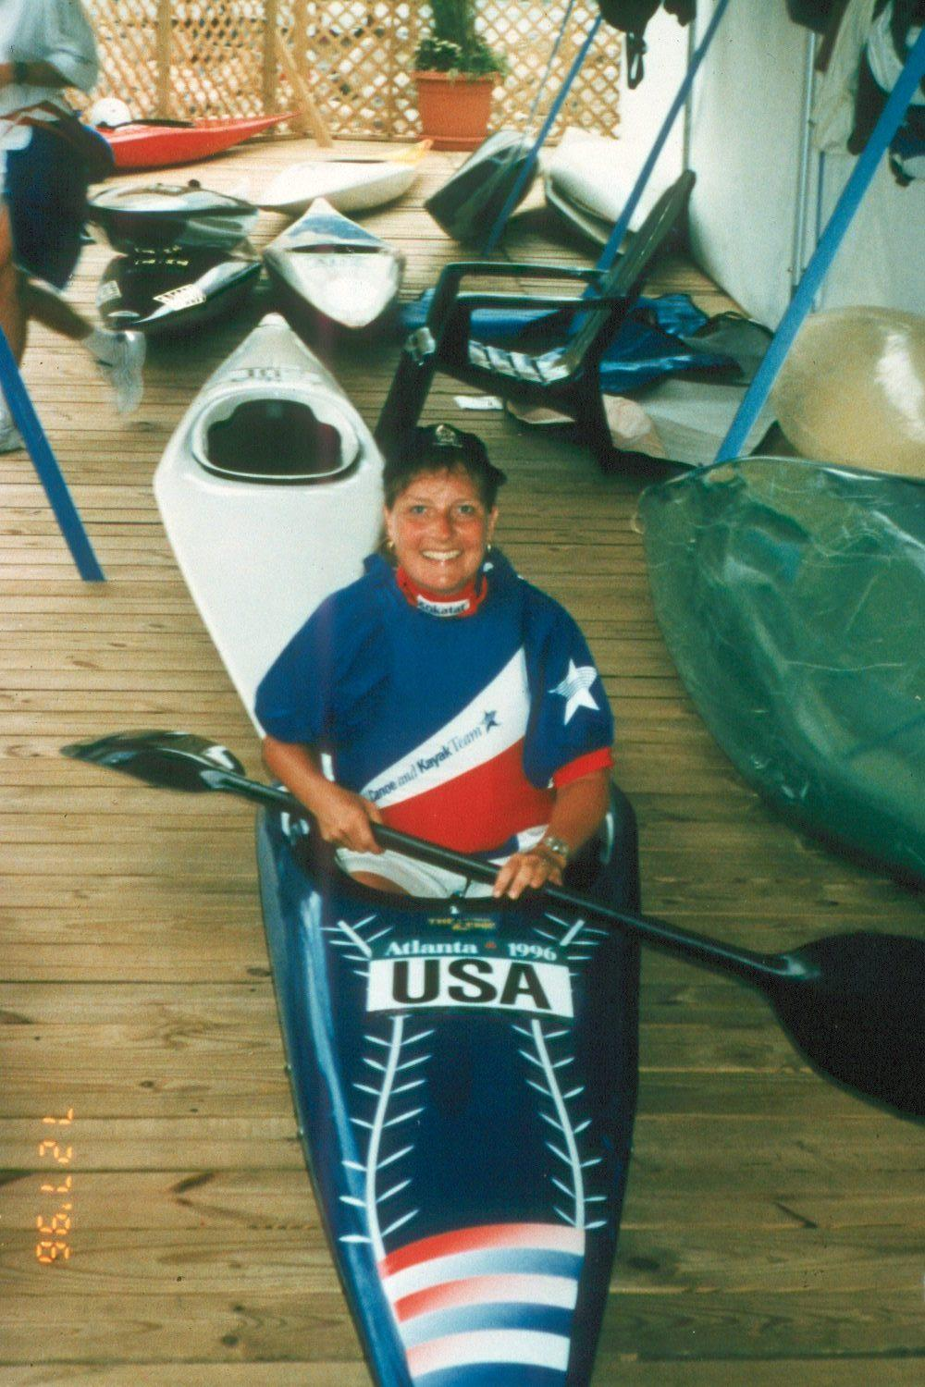
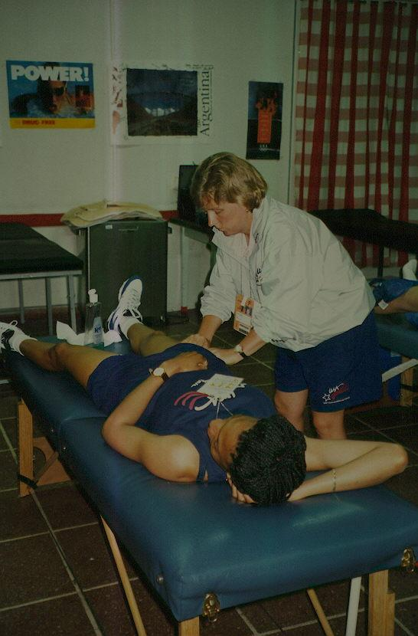
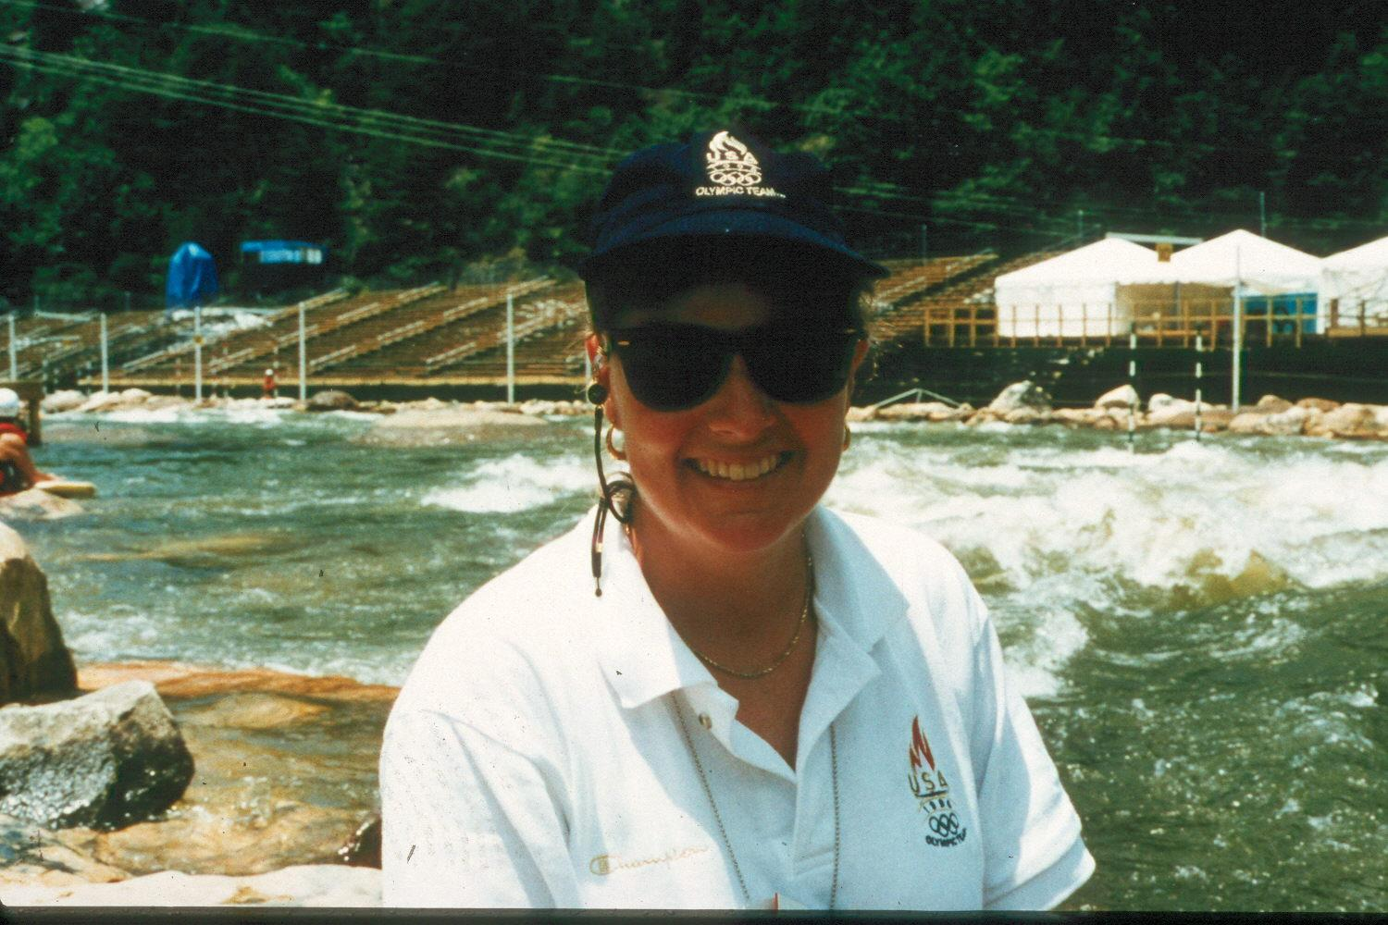
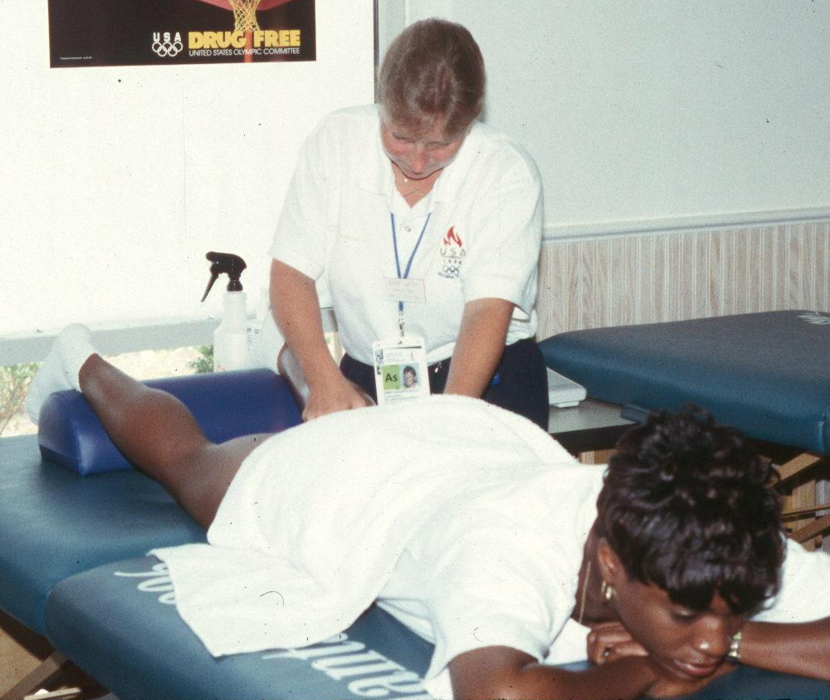
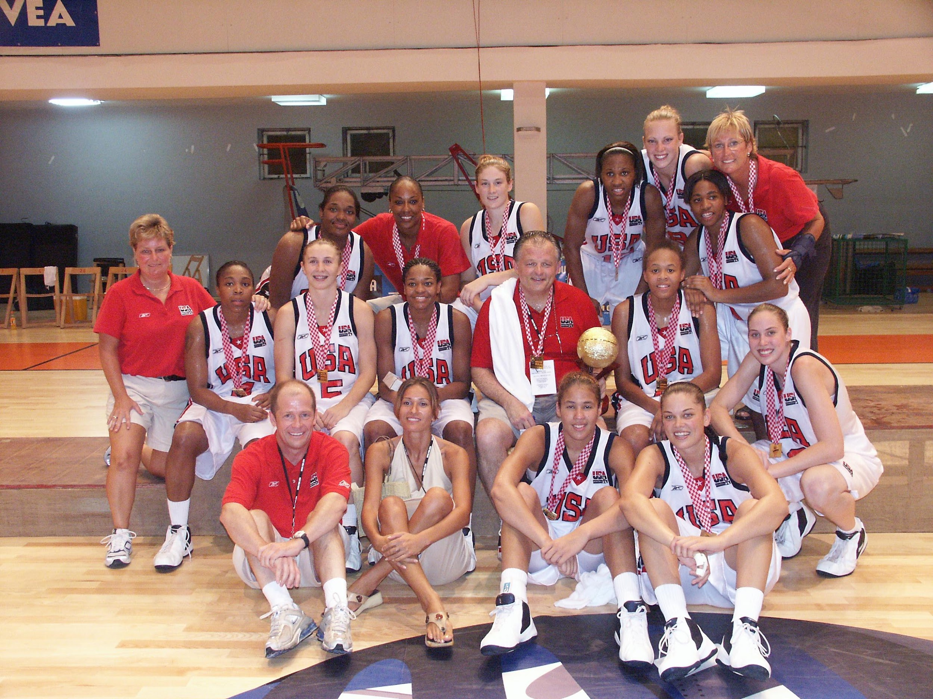
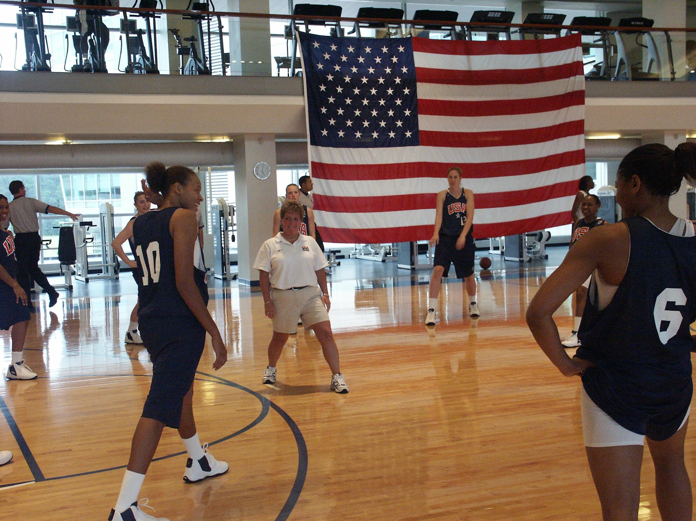

Slide 17
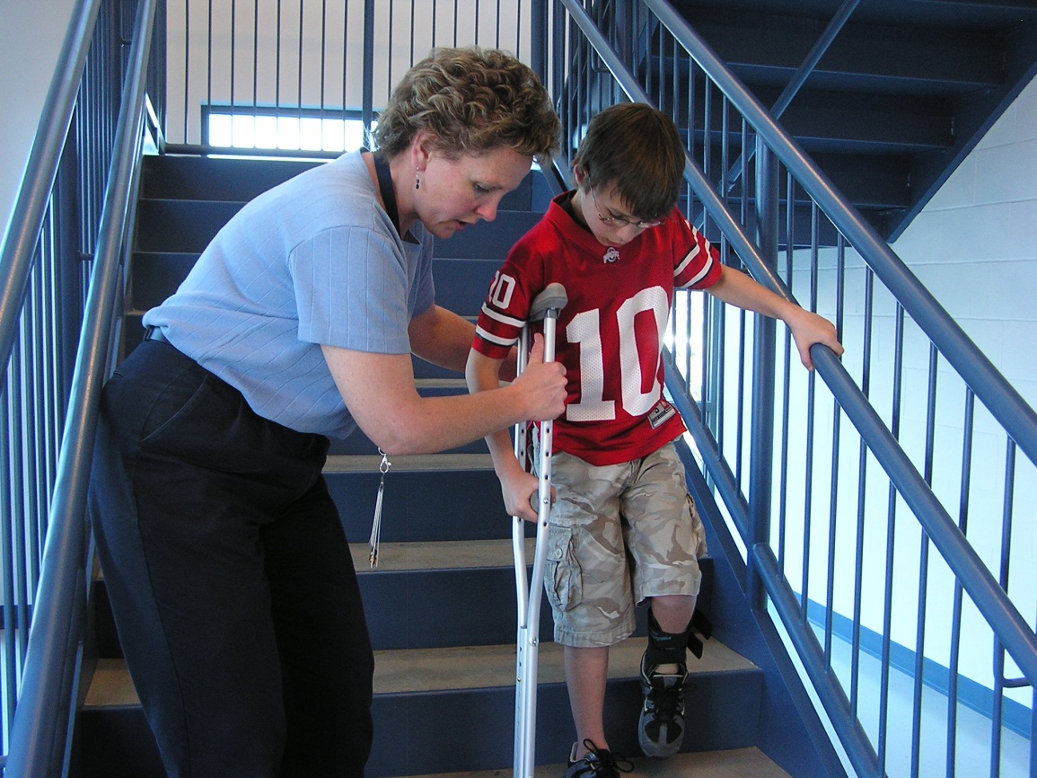
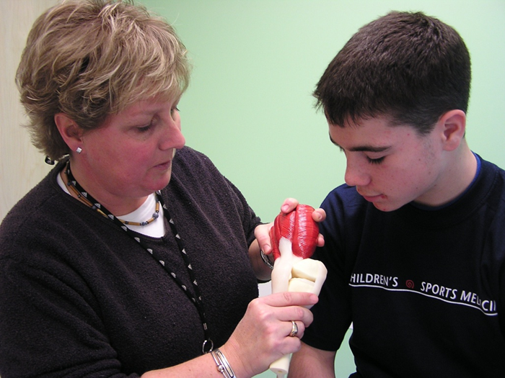
AT in a Physicians Practice Setting (ATPPS)
Goals
Improve provider efficiency
Increase through-put
Main Responsibilities
Evaluate patient
Order x-rays
Discuss injury with physician
Design home exercise programs
Apply casts/braces
Crutch fitting
Patient education
Communicate action
plan with school AT

Slide 18
Careers in Sports Medicine
Many other allied medical professions also may use this name based on the type of injuries they see……
Physical Therapists
Doctors' degree level now – treats all types of movement disorders
Board certified specialties available (sports, orthopedics, etc)
Occupational Therapists
Work to restore basic function post injury/illness
Stroke, brain injuries, severe mechanical issues
Massage Therapists
HS diploma, 10–15 month program for massage diploma, then possibly licensure
Chiropractors
Doctorate of Chiropractic medicine
Mobilization and manipulation, restore joint motion in order to restore overall health

Slide 19
My Career Path
Background
Interests
Educational decision making
Parents ideas were not my ideas
Undergraduate catalog had all majors and courses listed, now online
Looked for something that interested me (A/P, bio, etc.)
Athletic Training (AT) was listed as well, but name didn’t sound appealing
Later understood that AT was Sports Medicine!
Role Models were hard working and dedicated
They loved the profession and so did I
Choosing a major is a process of elimination!
Notes:
Background:
Buffalo NY
3 girls, large family of aunts/uncles/cousins
Liked sports, played in HS
Mom/Dad did not attend college – I was 1st to attend
Wanted to stay close to home for college
Educational decision making:
Didn’t know what I wanted to major in I was 18 and that wasn’t clear yet,
Dad wanted me to go into computer science or business – UGH!
Gave it a chance then it was my turn to decide
Course catalog

Slide 20
Education
Canisius College – Undergrad (BS)
Major Athletic Training
Tuition = Jobs/parents/loans
Took the Board of Certification Exam for AT’s and passed!
Now what?
University of Virginia - Graduate school (M.Ed.)
Major Athletic Training/Sports Medicine
15-month program
Mentor connection
Graduate Assistant
In state tuition and stipend for books/living expenses
Took out a loan for the rest
Notes:
Canisius:
Tuition – me (jobs and 2 jobs in summer), parents helped, loan for rest
Loved my major! Took Board Exam and passed
Exciting but now what
Looked to grad school – didn’t know if we could afford it.
Dr Conley – why do you want to major in something you can already do?
Virginia:
1st choice – Pete connected me and voila!
Connections were critical and this one defined my career

Slide 21
Choosing a School - Considerations
Undergraduate
Wanted to stay home and Canisius had great AT educational program
Cost savings stayed at home,
Commuted
Graduate
Top 3 for AT masters
National network of professors
Location – home/away, environment
Local network - Where do you want to live?

Slide 22
Employment
University of Pittsburgh – teaching/advising/AT
WBB, Track/Cross Country
Capital University – teaching/advising/AT
MSOC, WBB, Baseball
USOC Sports Medicine Team (4 year = quadrennium)
Pan-American Games
Olympic Games
World Championships
Moved into the hospital programming
Tough decision
Thought about other allied medical careers
Kept coming back to AT!
Friend was building pediatric sports medicine program – interesting!

Slide 23
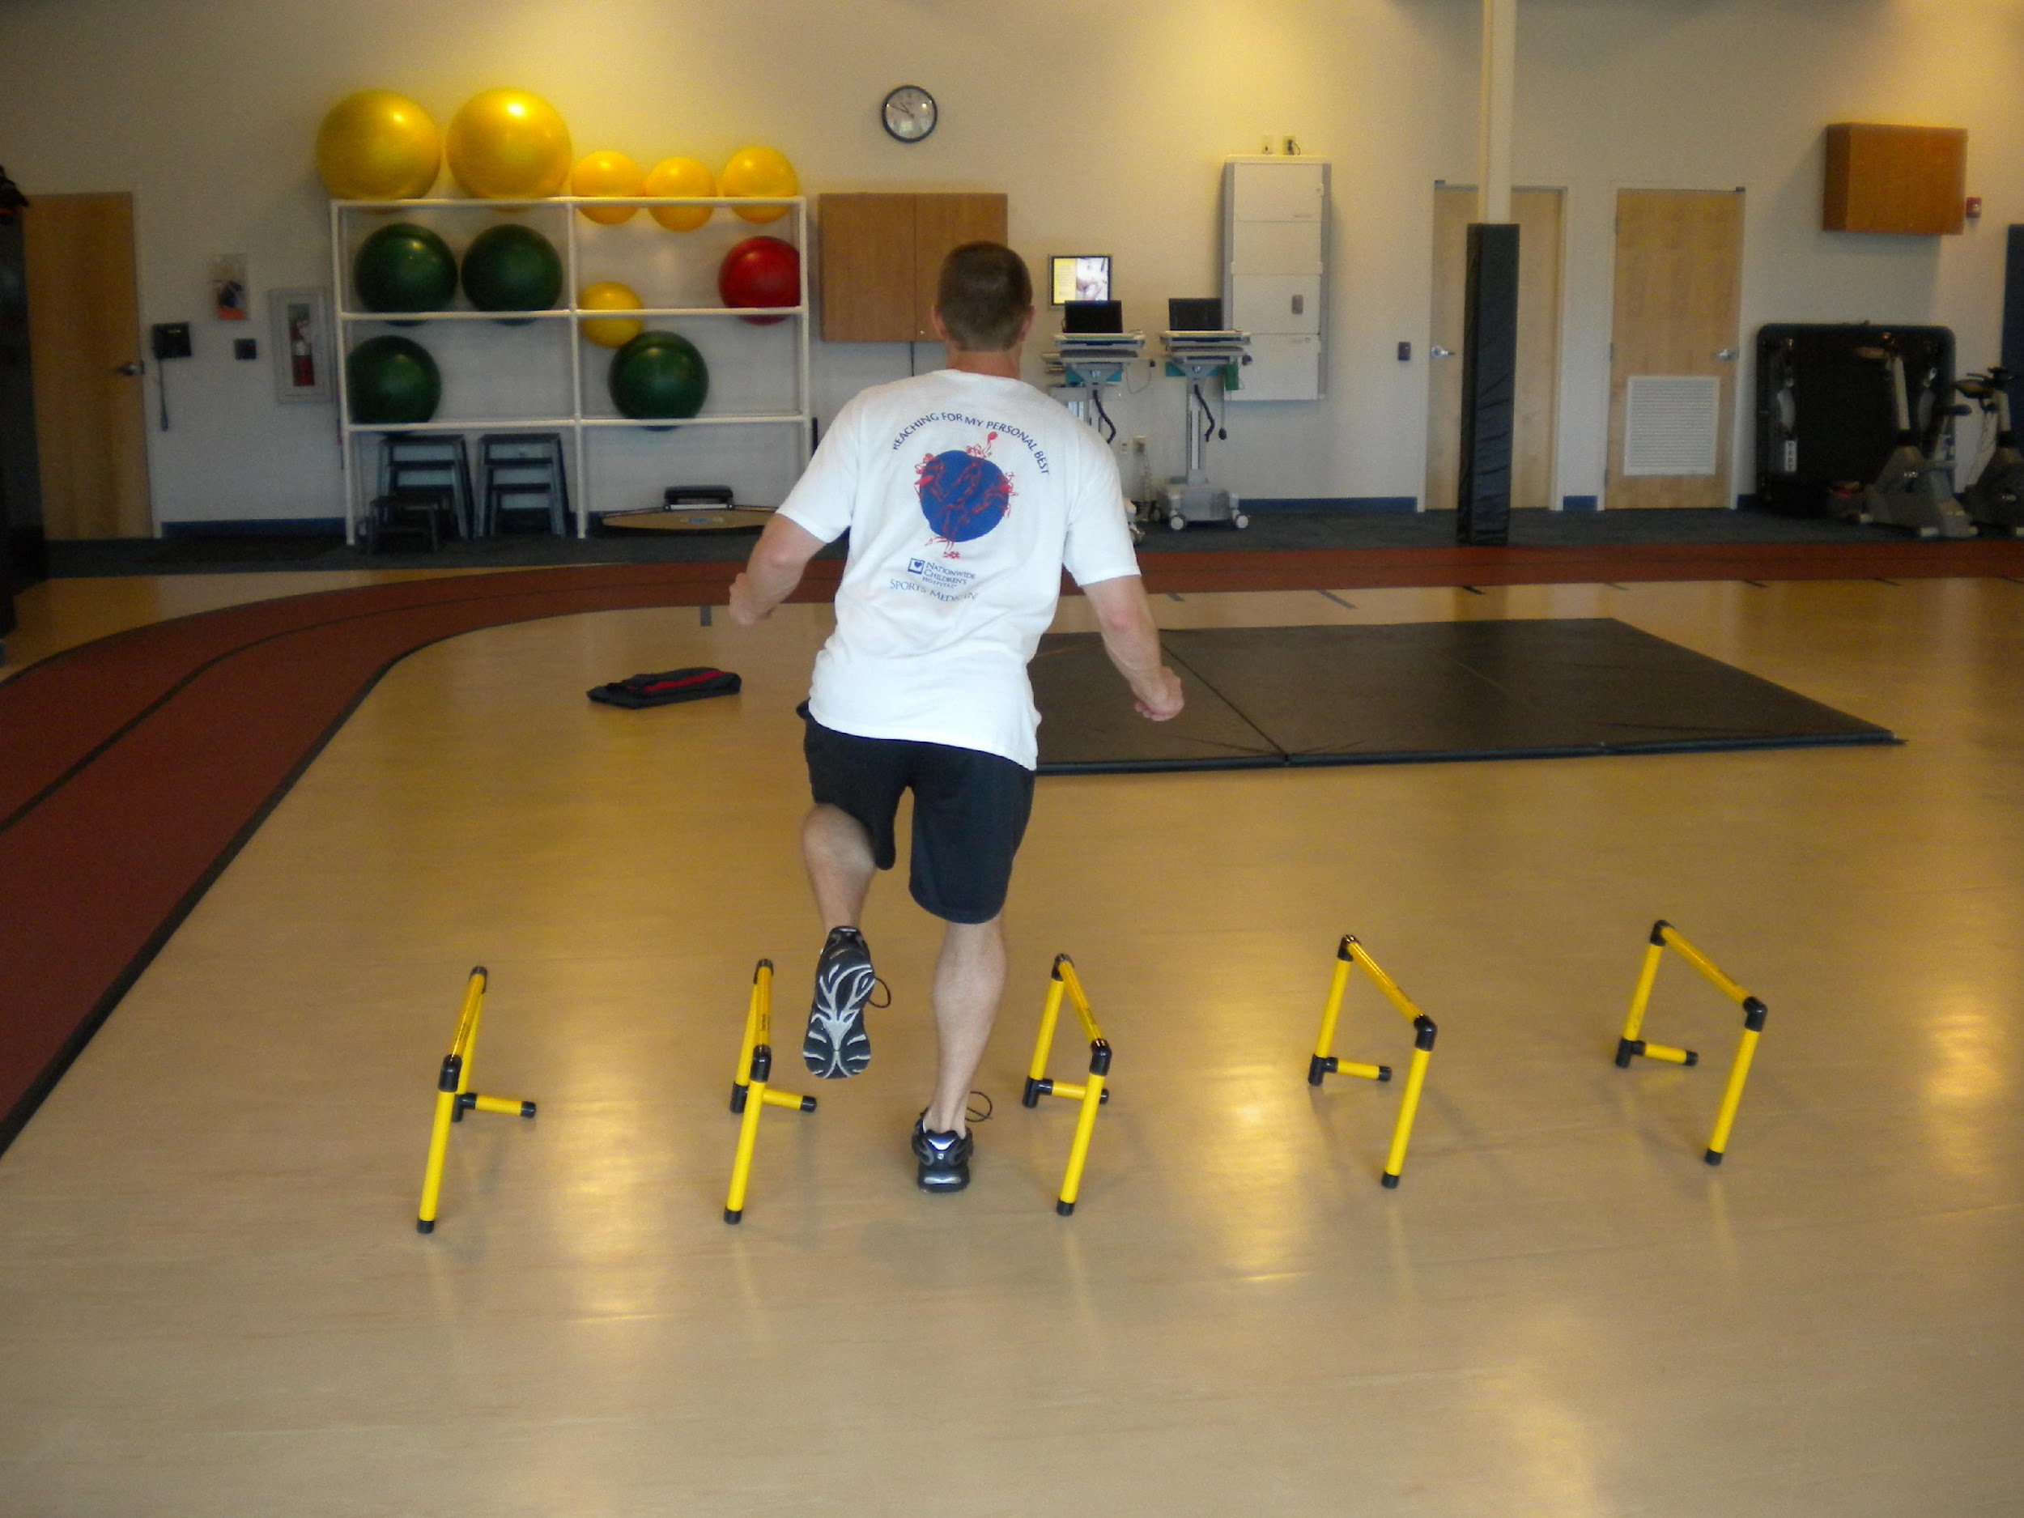
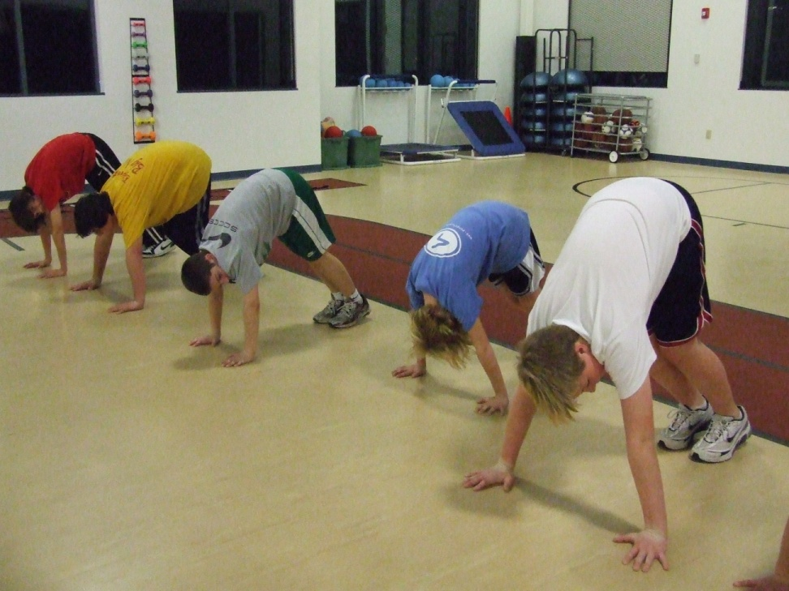
Hospital Setting
Nationwide Children’s Hospital
Physician Extender (ATTPS)
Sports Medicine Program Coordinator
Functional Rehabilitation
Doctors refer patients to AT’s that need a more aggressive type of therapy, sports specific, etc
Injury Prevention Programs
Youth sports
Health fairs

Slide 24
Hospital Setting
Children’s Hospital & Medical Center Omaha
Sports Medicine Program Coordinator
ATPPS
Built SMED clinical program
Built SMED outreach program
Expand our geographical footprint
Marketing opportunities
Sports organizations
YMCA’s
Build Youth Sports Safety resources

Slide 25
Choosing a PROFESSION Not just a job
What does this mean ?????
How old are you when you graduate?
How old when you retire?
Create the type of environment you want to spend ___ years working in !!!
“If you love your job, you’ll never work a day in your life!”

Slide 26
Get Involved
Network
Get plugged in
Explore other components of the profession available to you ….
Adds to your resume – makes you more marketable – raises the bar !!!

Slide 27
Look for ways to improve
Volunteer for local events
Columbus Marathon etc …
International events
US Olympic Committee
Available once you have some experience
Great to be part of something exciting

Slide 28
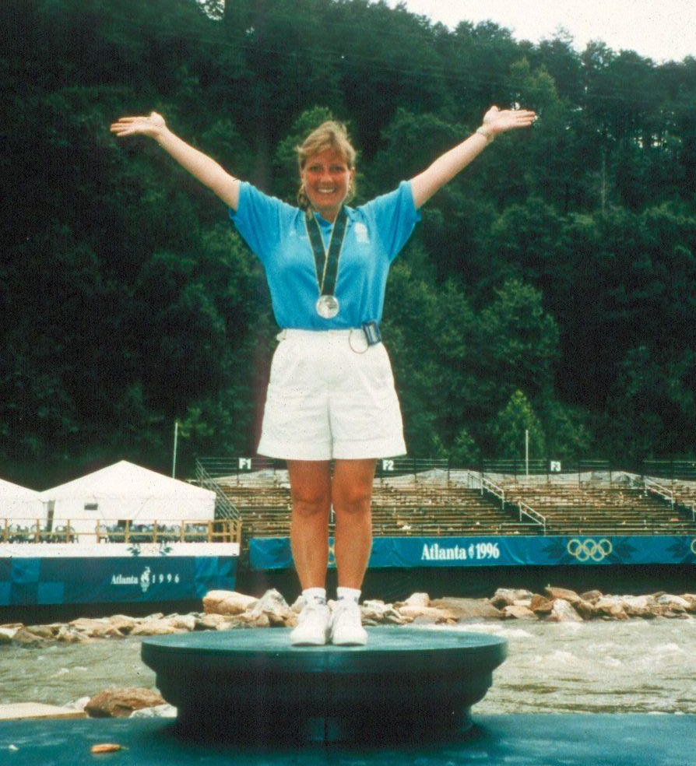
Whatever you choose – give it your all !!!

Slide 29
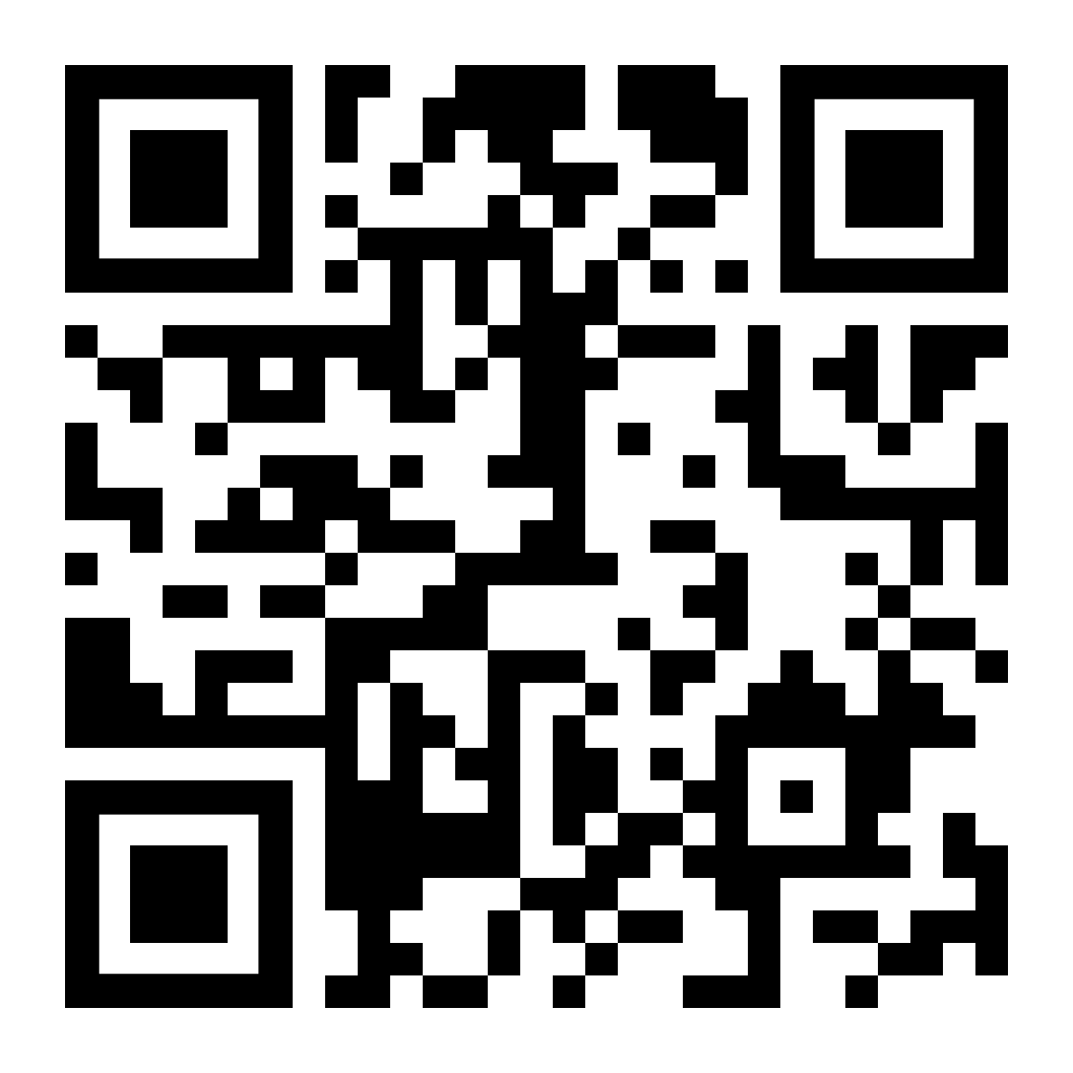
Please fill out the provided paper version of the breakout session evaluation, or scan the QR code to the right to access the virtual version.

